Slide 1
Aim:- Estimation of weight on body measurements

Slide 2
Materials:- 1. Animal for weighing. 2. Weighing machine or platform scale. 3. Measuring tape. 4. Measuring rod.

Slide 3
Procedure.
A] Direct method.
Animal is weighed directly on weighing machines or platform scales.
B] Alternate method / indirect method.
In this method, weight of an animal is indirectly calculated from body measurements
C] Schaeffer’s formula:- It is widely accepted for estimating body weight of an adult
cattle.

Slide 4
The formulae used in indirect method for estimating body weight are as below.
Length × Girth 2
Live body weight (in pounds) =
300
Were,
Length = Distance between point of shoulder to pin bone in inches.
Girth = Entire circumference of the body behind the point of elbowing inches

Slide 5
Agarwals Formula:- It is modified Schaeffer’s formula for Indian cattle.
Length × Girth
Live body weight =
( in pounds) Y
Where.
Y = 9 if the girth is less than 1.62 meters.
Y = 8.5 if the girth is less than 1.62-2.0 meters.
Y = 8.0 if the girth is less than 2.0 meters.

Slide 6
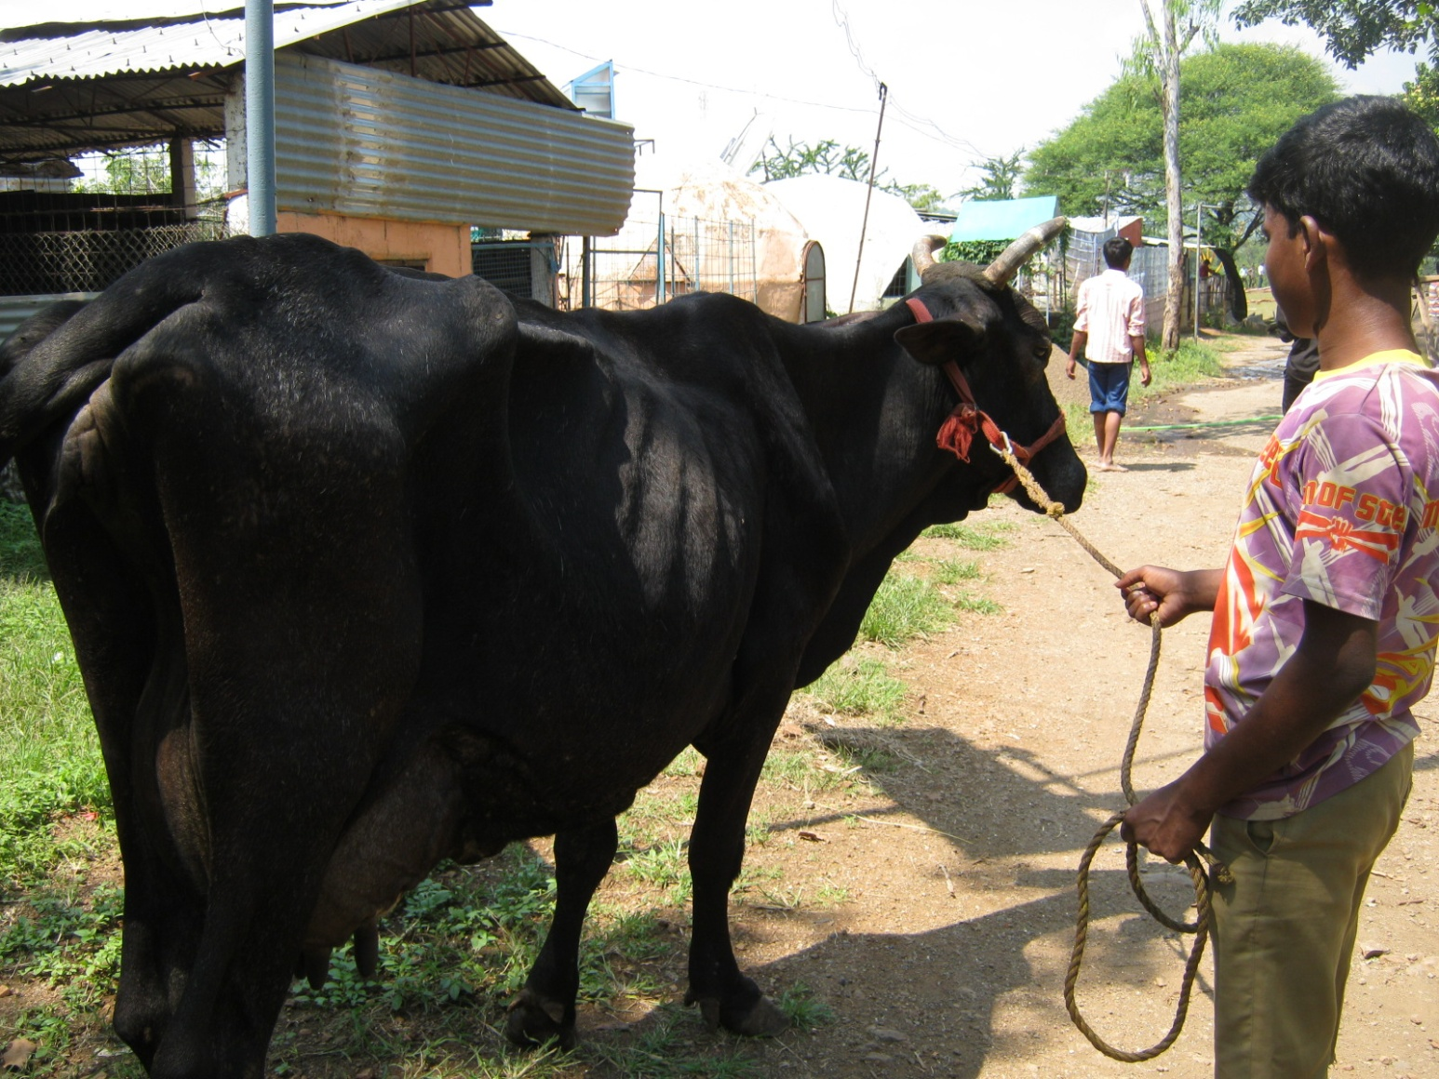

Slide 7
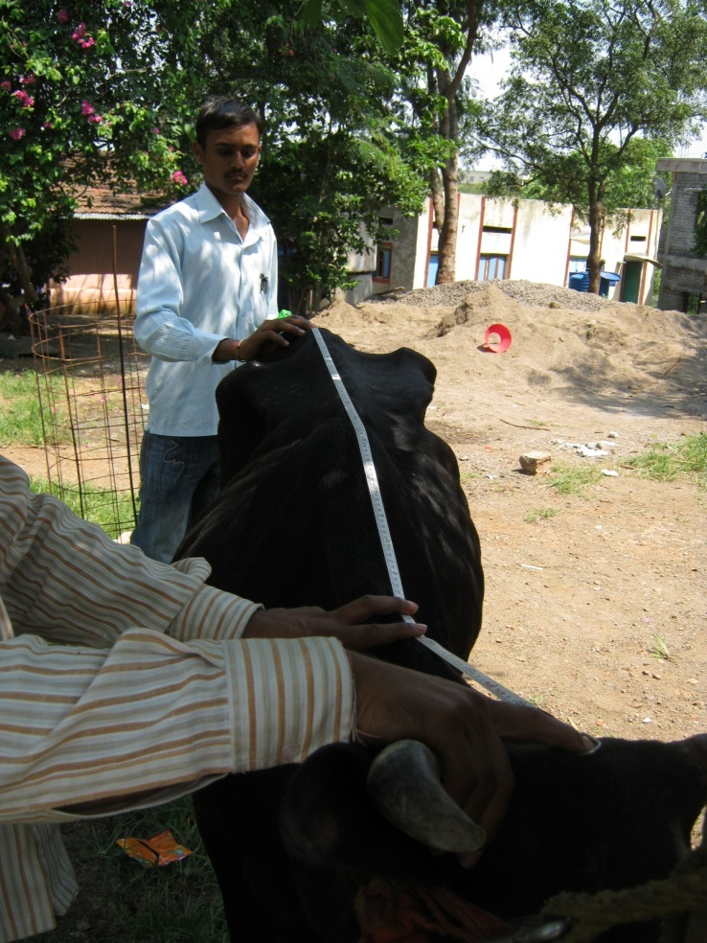
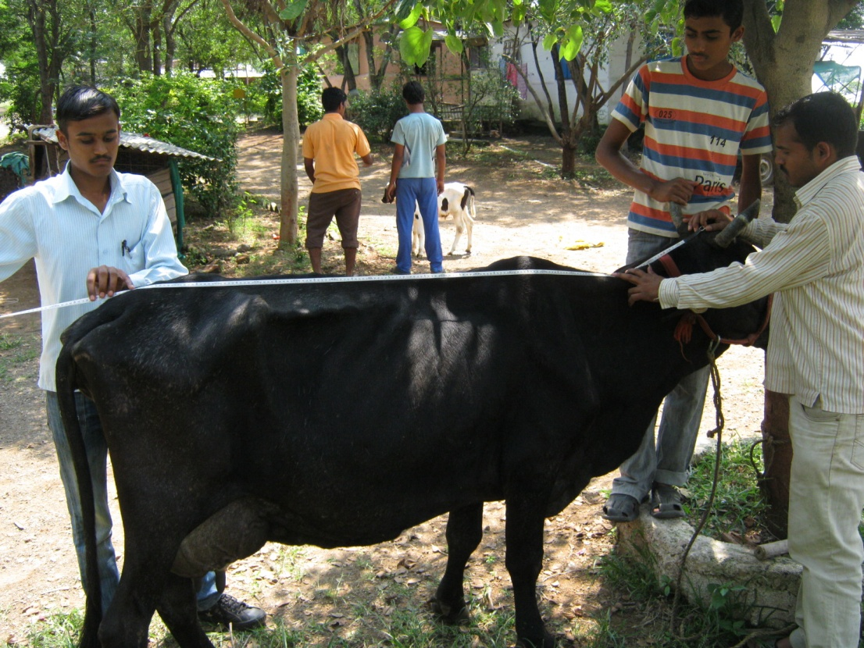

Slide 8
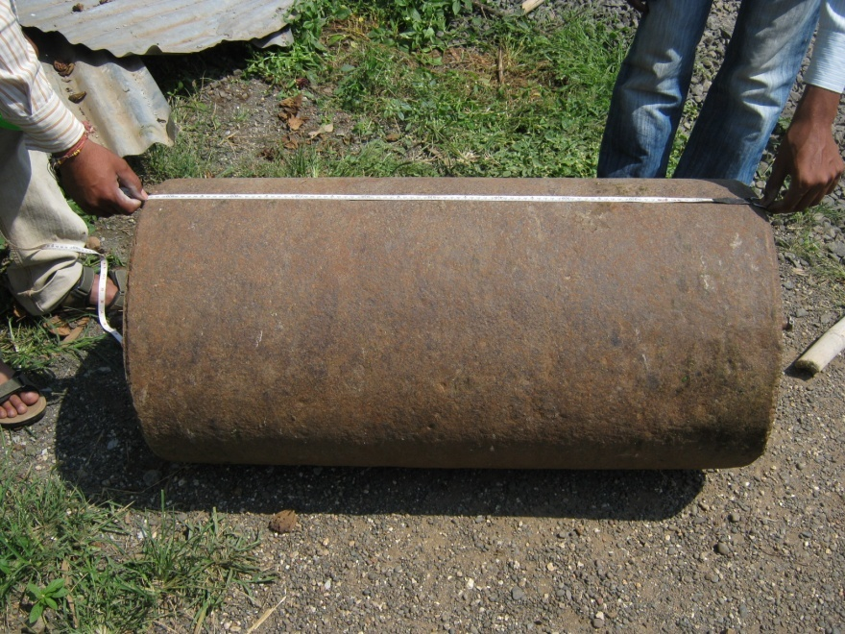
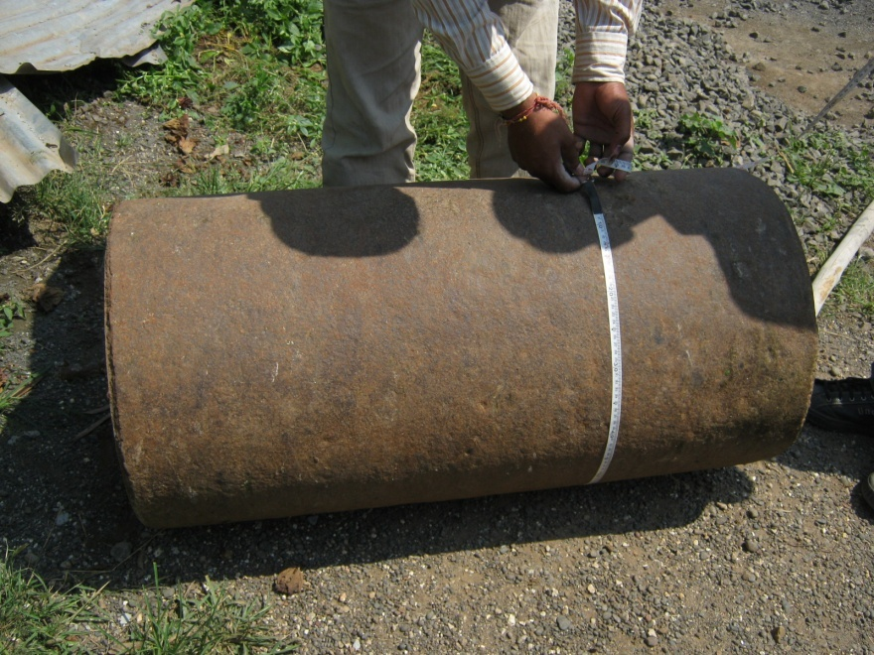
It is same as like we measure area of cylinder

