Slide 1
Soil Preparation

Slide 2
Soil Preparation
Soil preparation is one of the most important steps to have a successful cultivation.
The best garden soil is fertile, well drained yet retains moisture, and gets enough air circulation which is needed for healthy roots.

Slide 3
Process of Soil Preparation
Three important steps for soil preparation
Ploughing
2. Leveling
3. Manuring

Slide 4
Ploughing
Ploughing : The process of loosening and upturning the soil using plough is called Ploughing.
How ploughing helps?
- This process helps to break the soil lumps into small particles
- It uproot or pull-ups the unwanted plants growing in the field
- It helps uniform mixing of fertilizers with soil
-Increases the air among the soil particles . There are air molecules present in the soil particles. The size of soil particles affects the air-holding capacity of the soil This air present among the soil particles are essential for respiration of roots of plants and soil organisms.
4

Slide 5
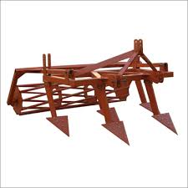
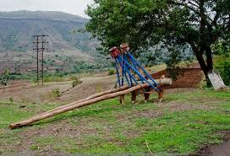
Ploughing
Tools used to plough :
Iron plough
Wooden plough

Slide 6
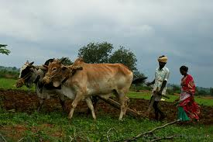
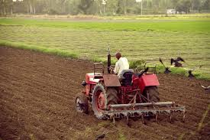
Ploughing
Examples :

Slide 7
Leveling
2. Leveling : A process for ensuring that the depths and discharge variations over the field are relatively uniform.
How leveling helps?
- It provides a slope which fits a water supply.
- Soil is naturally removed by the action of water or wind. It is known as soil erosion. Leveling helps to prevent that.
7

Slide 8
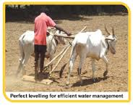
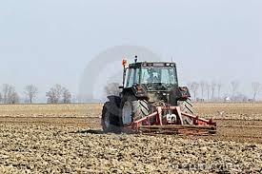
Leveling
Tools used for leveling
Animal-driven
Tractor driven leveler

Slide 9
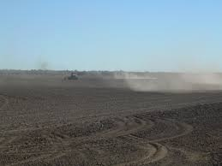
Levelling
levelling is done !!!

Slide 10
Manuring
3. Manuring:
This is the final process in the soil preparation, it helps to supply all the nutrients to the plants required for their growth. Manures are plant and animal wastes that are used as sources of plant nutrients. They release nutrients after their decomposition.
Naturally occurring or synthetic chemicals containing plant nutrients are called fertilizers.

Slide 11
Manuring
Manures with low nutrient, content per unit quantity have longer residual effect besides improving soil physical properties compared to fertilizer with high nutrient content.
Note : To determine which fertilizer or manure to be added in the soil it is important to know which nutrient soil, is lacking.
Tools used for manuring :
Manuring by drill or manually

Slide 12
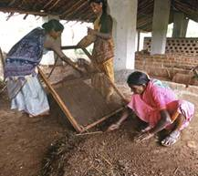
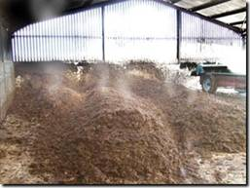
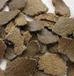
Manuring
Cotton seed oil cake

Slide 13
Quiz Time !!!
Q1. Ploughing is done for… (Select multiple )
To ease water irrigation
To help soil erosion
-To break the soil lumps into small particles
To uproot or pull-ups the unwanted plants growing in the field
It helps uniform mixing of fertilizers with soil
Q2. Levelling is done for… (Select multiple )
To help soil erosion
To prevent soil erosion
It helps uniform mixing of fertilizers with soil
To ease water irrigation
Q3. Manuring helps to supply all the nutrients to the plants required for their growth.
True
False

Slide 14
Thank You

