Slide 1
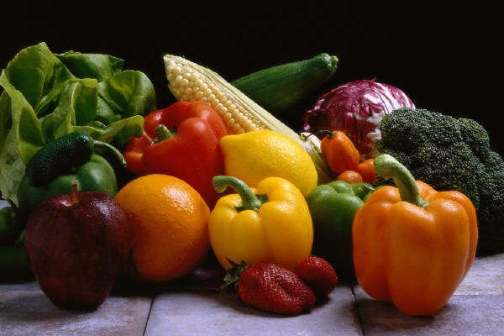
Introduction to important - Exotic Vegetables -

Slide 2
Demand-driven exotic vegetables production is suitable for the farmers as they have assured market through contract with consumers. Exotic vegetables market is growing at the rate of 15 to 20% per annum is increasing day by day since India is importing more than 85% exotic vegetables.
For more information visit - http://agricultureavenues.blogspot.in/2012/08/globalization-has-brought-many.html

Slide 3
Why Exotic Vegetables?
High Value .
High Nutrition .
Export Market .
Contract Farming .
Less Area required .
Change in lifestyle -Udupi (Traditional) restaurant to Mcdownals.
Growing Demand .

Slide 4
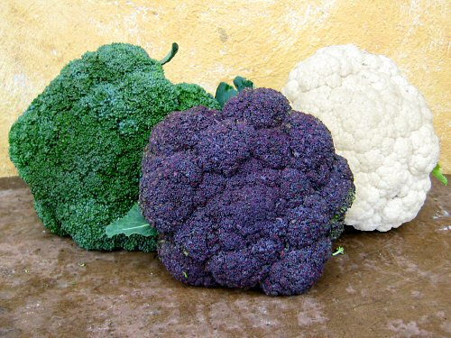
BROCCOLI
Soil And Climate -
Soil Well drain , Ph 5.5 to 6.5 ,
Winter season crop .
Spacing -- 45 to 55 Cm
Harvesting --- 10 weeks after sowing
Remark ---- Highly nutritious, contains almost all B complex vitamins and minerals.
Cauliflower family crop all other practices are same .
For more information - http://www.mnn.com/your-home/organic-farming-gardening/stories/how-to-grow-broccoli

Slide 5
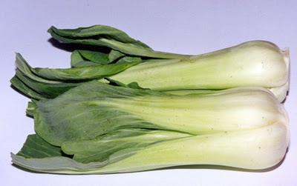
BOK CHOY
Also called as Chinese white Cabbage
Soil and Climate - Well drain soil , Ph – 5.5 to 7.0
Loose garden soil , high humus is good.
Cool season crop .
Spacing – As cabbage 45 *60 cm
Maturity - 45 to 50 days .
Remark -- Can be grown as indoor plants in pots .

Slide 6
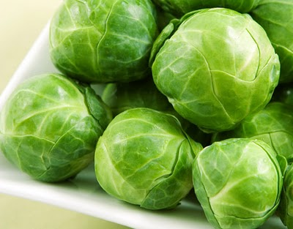
BRUSSEL SPROUT
Cabbage Family crop but very small head
Requires cool climate .
Soil - High organic matter , Fertile soil ,
Ph – 6.0 to 6.5
Planting spacing --- 24 inch * 30 inch .
Harvesting -- 90 to 120 days --- depend on climate .

Slide 7
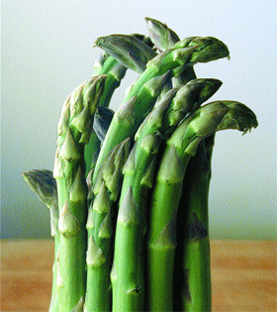
ASPARAGUS
A Lilly family crop , not much grown in India.
Most common in USA.
Perennial crop. Can yield up to 10 Years .
Mostly grown in back yard gardens .
Very good source of Vit B6 , Vit A , Vit C and Potassium , iron etc.
Soil - Sandy , well drain, high Organic matter .
Planting – By year old plant cutting .
Harvesting – After one year , cutting made 4 to 5 inches .

Slide 8
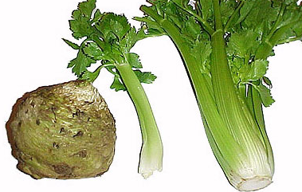
CELERY
Just like coriander, but not having any flavour ..
Mainly used as decorative vegetable in 5 star Hotels .
Originally from Europe .
Soil and climate - Prefers cool climate 20 to 26 degree.
Soil requires well drain , Ph 6.8 to 7.5 , rich soil give more sprouting .
Sowing and Harvesting –
Sowing done by seeds, Very tiny seed required proper sowing,
Soaking of seed gives better result.
2 to 3 year old seed are good .
Harvesting – 5 to 6 weeks , then after every 2 weeks for 5 to 6 tomes.
WE TRIED BUT FAILED ------ LETS SEE NEXT TIME

Slide 9
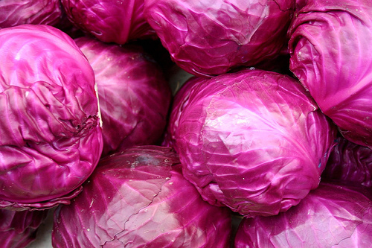
RED CABBAGE
Just like cabbage but red in colour .
Having demand in METRO.
All practices are same as cabbage .
Get 10 to 20 Rs / Kg more than regular cabbage .
Tunnel cropping yields more .

Slide 10
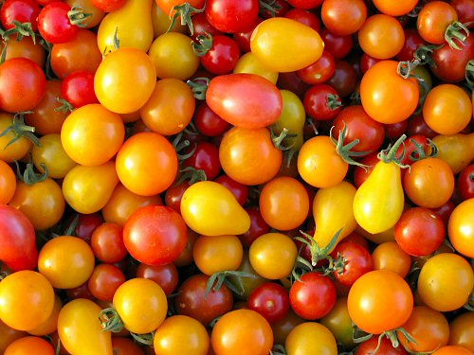
CHERRY TOMATO
It is just like our regular tomato but small in size.
Mostly confused with wild tomato variety .
But cherry tomatoes have less seed and not
bitter or sour in test .
Mostly used as decorative and vegetable purpose
Not suitable for Processing .
Generally grown in gardens in European countries .
In demand in 5 star hotel because of good flavour .

Slide 11
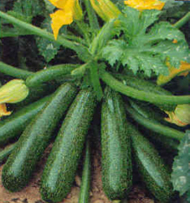
ZUCCHINI
Cucurbitaceous family crop .
Just like cucumber it grows
Requires cool climate and shed net
Other practices are same as cucumber .
.

Slide 12
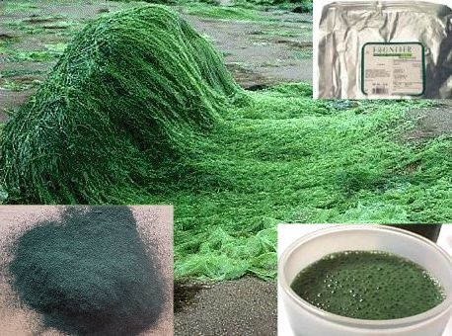
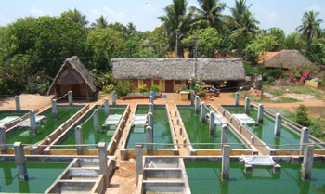
SPIRULLINA
Its Blue Green algae. Very high protein .
Used as direct food, cosmetic, medicines.
Can be grown in ponds (standing water)
Temp required – 25 to 35 degree.
Water Ph is very important .
( 7.0 to 8.0)
Grown on large scale in South India.
More information at KVK , Pravaranager .

Slide 13
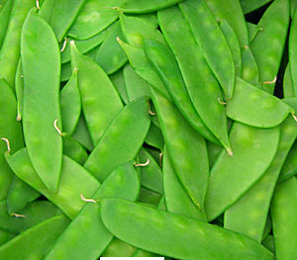
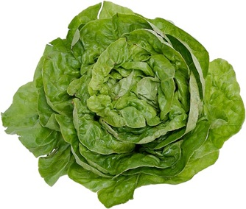
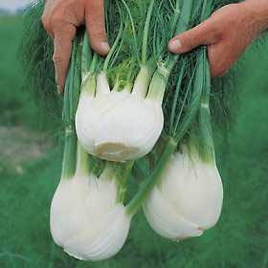
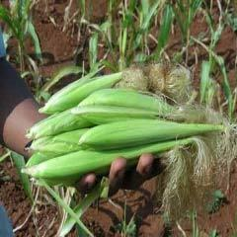
Chinese peas
Lettus
Baby corn
Fennel

Slide 14
Marketing of Exotic Vegetables -
Metro Mall
Fast food
Contract
Farming
MARKETING
Processing
Star hotel
City market
Medicinal compony
Export

Slide 15
Constraints / problems:
High input cost .
Required skilled labour.
Market fluctuation .
Technical know- how .
Less keeping quality .

Slide 16
Same Useful Links –
http://www.trikaya.net/
http://www.agricultureinformation.com/mag/2006/01/exotic-vegetables/
http://www.scribd.com/doc/6031001/Exotic-Vegetables
For any more information please contact :
Vigyan Ashram
(A center of Indian Institute Of Education)
At. Post Pabal Dist. Pune 412403
www.vigyanashram.com

