Slide 1
Plant Propagation
Vigyan Ashram Pabal

Slide 2
Plant Propagation
New plant life starts with
Simple seed
Cuttings and Grafting
Tissue culture

Slide 3
Seed
Seed is defined as a dormant plant which develops into a complete plant when subjected to environmental conditions
The environmental conditions are
Soil
Water
Moisture
Temperature

Slide 4
Cuttings and grafting
Cuttings
It refers to cut section of plant like stem or a branch and propagating it
Example Rose branch directly cultivated in soil
Grafting
It refers to combine tissues of plants similar or dissimilar
It requires a rootstock and a scion
For more details on grafting, please click the link here

Slide 5
Tissue Culture
It refers to
Collection of tissues or sterile condition organs of plants on an nutrient base
Example: Banana plant , Gerbera plant they are grown in a tissue culture laboratory on a glucose base
Tissue culture is also called as micro propagation

Slide 6
Germination
Germination is the process where embryonic plant is contained in the seed leads to emergence of new plant
The embryo formed is wrapped in a seed coat
When the seeds are not subjected to environment, they remain dormant
Factors affecting Germination
Water
Oxygen
Temperature and Light

Slide 7
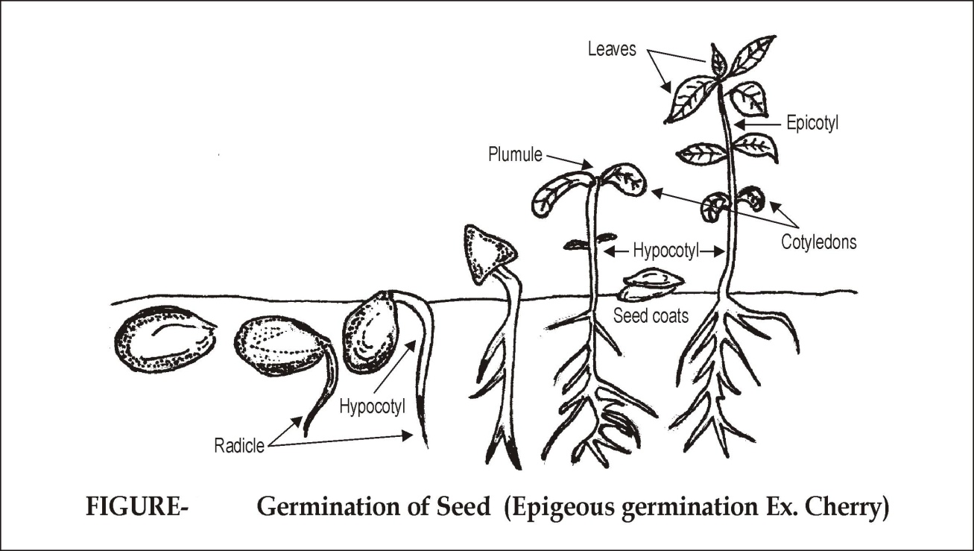
Diagram of seed Germination

Slide 8
Steps in seed germination
Step 1
Absorption of water
Step 2
Secretion of enzymes and hormones
Step 3
Step4
Hydrolysis of stored food into soluble form
Translocation of soluble foods and hormones to the growing points

Slide 9
Propagation
This refers to process of creating new plants from seeds, grafting, buddings,cuttings, tissue culture method
Types of Plant Propagation
Sexual Propagation
Asexual Propagation
Grafting
Tissue culture
Seed
Cuttings

Slide 10
Definition of plant propagation
Definition of plant propagation –
We will define propagation as production of new individuals from a selected plant having all the characters of the original one.

Slide 11
Sexual Propagation of plant
In this method, plant propagation is done through seeds. It is also known as seed propagation.
Seeds are produced as a result by sexual reproduction in fruits of the plants.
A plant grown from seed may have different characteristics than its parent tree
Some plants may not have seeds

Slide 12
Asexual Propagation in plants
These methods are horticultural done and not by plants
Examples: Cloning, Grafting, Tissue Culture, Propagation by vegetative plant parts like root, stem, leaf etc
Plants are derived from single parent thus there is no genetic change
Plant propagated through asexual propagation has same characters as the parent

Slide 13
Importance of Plant Propagation
Plant Propagation is important because
It multiplies the different species in large number.
It protects the plant species which are endangered?
It improves the characteristics and quality of the plants.
It produces quality and healthy plants on commercial base.

Slide 14
Propagation Media
- Propagation medium is a substance in which plant parts are placed for propagation.
- Propagation medium provides initial support and favorable conditions for Plant Propagation.
Examples of Propagation Media are
Soil
Sand
Leaf Mould
Vermiculite
Perlite.
Coco peat
Farm Yard Manure(FYM)
Saw dust

Slide 15
Advantages of Sexual Propagation
This is very simple and easy method of propagation.
Some species of trees, ornamental annuals and vegetables which cannot be propagated by asexual means should be propagated by this method. E.g. Papaya, Marigold, Tomato etc.
Hybrid seeds can be developed by this method.
New varieties of crops are developed only by sexual method of propagation.
Root stocks for budding and grafting can be raised by this method.
The plants propagated by this method are long lived and can resistance to water stress.
Transmission of viruses can be prevented by sexual method.
Seed can be transported and stored for longer time for propagation.

Slide 16
Disadvantages of sexual propagation
Characteristics of seedling propagated by this method are not genetically true to type to that of their mother plant.
Plants propagated by sexual method requires long period for fruiting.
Plants grow very high, so they are difficult for intercultural practices like spraying, harvesting etc.
The plants which have no seeds cannot be propagated by this method. E.g. Banana, fig, Jasmine, Rose etc.

