Slide 1
Physical Properties of Soil
Topic - Study of soil formation & physical properties of soil

Slide 2
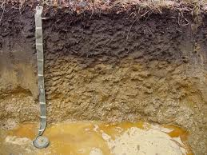
Soil Color
Color of soil is very useful tool for providing information about other soil properties as that of -
Organic matter content- If color of upper layer of soil is blackish , then normally these soils are contains more organic matter with good fertility.
Soil minerals – Lateritic soils are normally having rusty red color due to higher % of iron oxides.
Soils are classified as per their color my using color chart method commonly know as Munsell color chart.
For information on this please visit- http://en.wikipedia.org/wiki/Munsell_color_system
Black organic matter layer of soil profile
Image source -http://faculty.msmary.edu/envirothon/current/guide/soil_features_part_1.htm

Slide 3
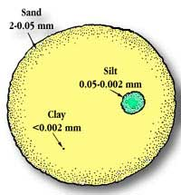
Soil Texture
The relative proportions of sand, silt, and clay particles in a mass of soil is referred as soil texture.
Clay – soils that are more than 60% clay
Silt – soils with high silt content
Sand – soils with highest content of sand
Loamy - Soils that don’t exhibit a dominant area in any of the three called loam
Soil can be classified in various types according to their texture with the help of following texture triangle -

Slide 4
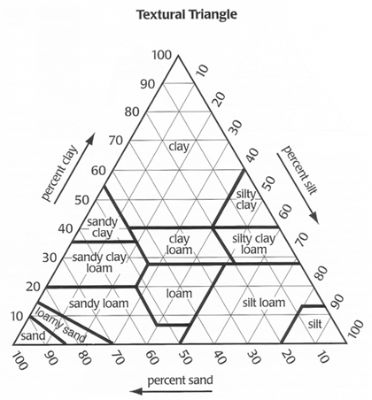
Soil texture triangle

Slide 5
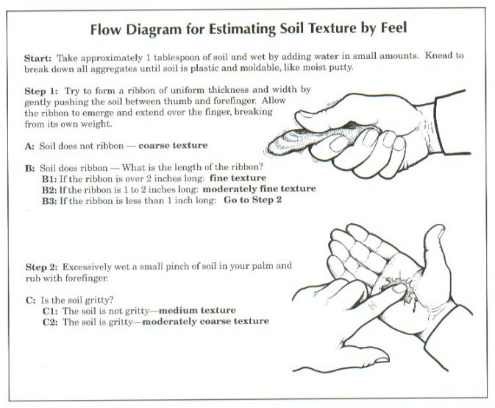
Soil texture test
Source : http://www.landjudging.com/stieglerbook.htm

Slide 6
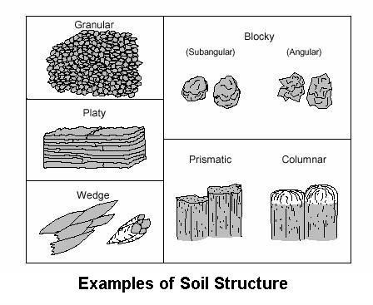
Soil structure
The arrangement of primary soil particles into compound particles or aggregates.
The type and grade of structure plays an important role in the movement of water within soils.
There are eight structural types commonly recognized in soil profiles: Granular, single grain, blocky, prismatic, columnar, platy, wedge, and massive.

Slide 7
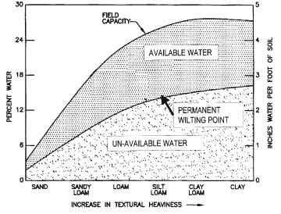
Soil Water Holding capacity
The capacity of soils to hold water available for use by most plants. It is commonly defined as the difference between the amount of soil water at field capacity and the amount at wilting point.
Field capacity is the amount of soil moisture or water content held in the soil after excess water has drained away.
Permanent wilting point (PWP) is the minimal point of soil moisture the plant requires not to wilt / die.
Simple method of measuring field capacity of soil - http://www.youtube.com/watch?v=Xfx3bhDd7YY

Slide 8
Soil Bulk Density
Bulk density is the mass of dry soil per unit volume, including the air space.
Bulk density has a major effect on the movement of air and water in soils.
Soils with high bulk densities are often compacted.(Soil compaction restricts rooting depth, which reduces the uptake of water and nutrients by plants. Similarly it also decreases infiltration, thereby increasing runoff and the hazard of water erosion)

Slide 9
Soil Bulk Density
Soils with a bulk density higher than 1.6 g/cm3 tend to restrict root growth.
Sandy soils are more prone to high bulk density.
Improving bulk density of soil- Tillage at the beginning of the growing season temporarily decreases bulk density and disturbs compacted soil layers, but subsequent trips across the field by farm equipment, rainfall events, animals, and other disturbance activities can re-compact soil.
Measuring soil bulk density - http://soilquality.org.au/factsheets/bulk-density-measurement

