Slide 1
Biogas
Energy & Environment
Notes:
Discussion on different types of renewable energy i.e. Non conventional sources of energy.

Slide 2
This is a PowerPoint that will teach you about energy and the need for biogas.

Slide 3
Energy can be dangerous..
Energy Can be useful as well !!
  In bombs, Chemical energy is transferred to light, heat and radioactive energy which can cause great harm and endanger many people’s lives.

Slide 4
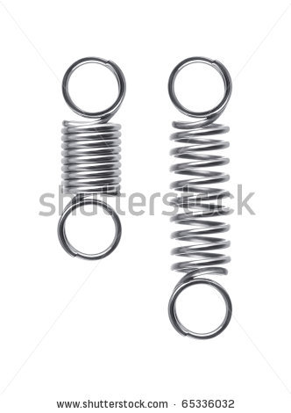

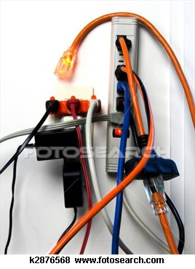
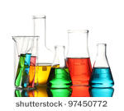

What is Energy?
What types are there?
Potential
Light & Heat
Kinetic & Electrical
Electrical
Sound
Chemical

Slide 5

Can you create energy?
  No, energy is conserved.
  Energy can be transformed but not created.
Do you know any poem about energy ?
Notes:
Song on energy
http://www.youtube.com/watch?v=o_5oYuDY2qM

Slide 6

Examples of Energy Transfer
1. Clap Your Hands
Think about the different types of energy, what energy are we using when we clap our hands together?
We know that energy cannot be destroyed and only transformed so what energy is this being transformed into?

Slide 7

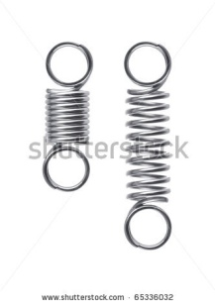

Which one of these do you think is the correct answer? Explain to a friend why you have chosen that answer.
A.
B.
C.
Kinetic
Potential
Chemical
Sound
Sound
Kinetic

Slide 8

The correct answer was C.
When we clap our hands we use kinetic energy and transfer it into sound energy.
:
Sound
Kinetic
What would happen if we clapped our hands together with more force?
What would happen if we waved our hands together but didn’t clap them?

Slide 9

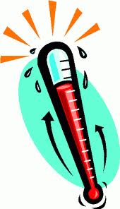
Examples of Energy Transfer
2. Rub Your Hands
The heat is caused by the kinetic energy transferred to overcome FRICTION
Kinetic
Heat
(AND SOMETIMES NOISE)

Slide 10
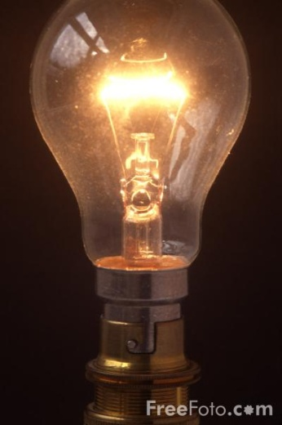
Examples of Energy Transfer
3. Switch on a light bulb
Electrical
Light
Heat

Slide 11
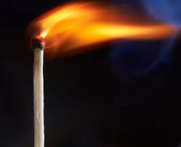

Examples of Energy Transfer
4. Light a match
A match is an example of using a fuel
Kinetic
Heat
Light
Chemical

Slide 12
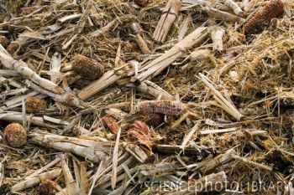
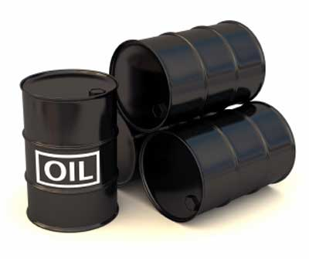
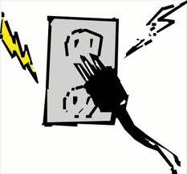

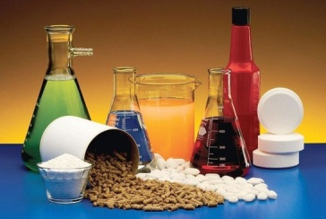

What is fuel?
Fuel is stored chemical energy. Can you tell me some examples of fuel?
Wood
Oil
Electrical
Light
Chemical
Kinetic
Heat

Slide 13
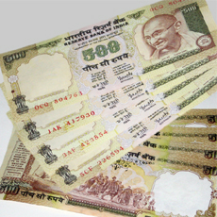
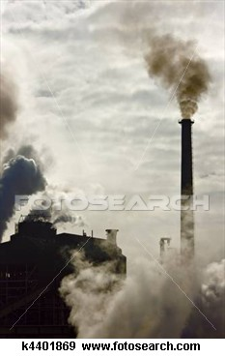
Disadvantages of Fuel
What if we had a fuel that was none of these?
Expensive
Polluting
Diminishing Resources
Time to gather
Biogas is an alternative energy, watch this video that explains how India is looking for alternative energy options.

Slide 14
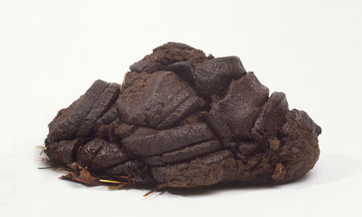
Biogas
Uses waste material to transfer chemical energy to other forms of useful energy!
Watch this video on U-tube that introduces biogas.
Electrical
Light
Kinetic
Heat
Chemical

Slide 15
Real Gobar Gas Plants
Vigyan Ashram
Watch video of the biogas plant being used at Vigyan Ashram.
Notes:
Video of Vigyan ashram

Slide 16
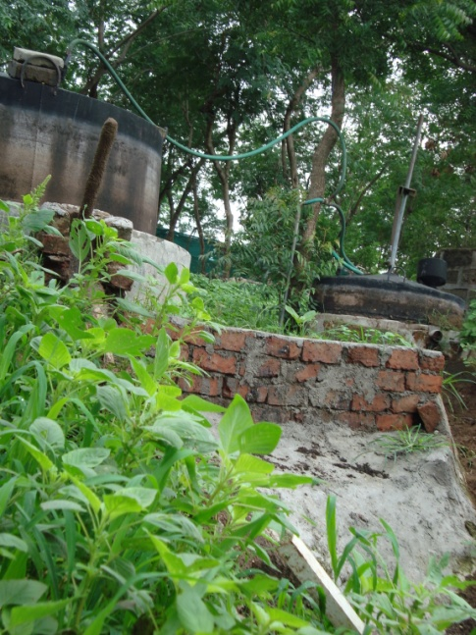
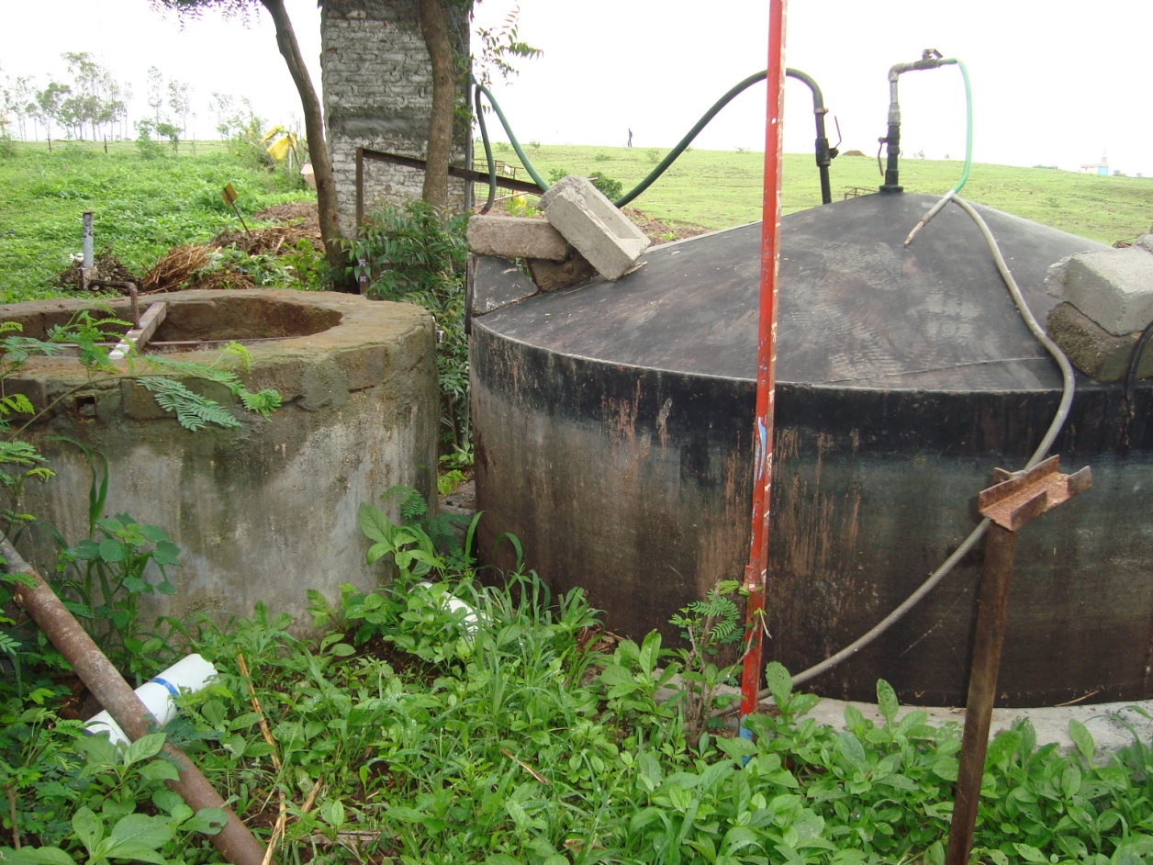
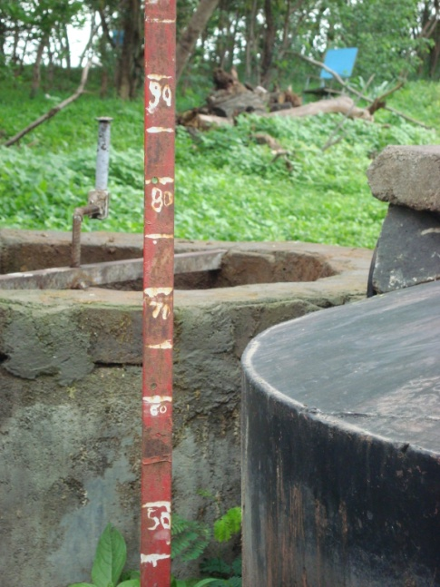
Real Gobar Gas Plants
Vigyan Ashram
Gas to kitchen
Sludge
Digester Tank
Mixer
Gas Holder
Notes:
Biogas practical explains how to use the measuring stick to calculate amount of gas produced.

Slide 17
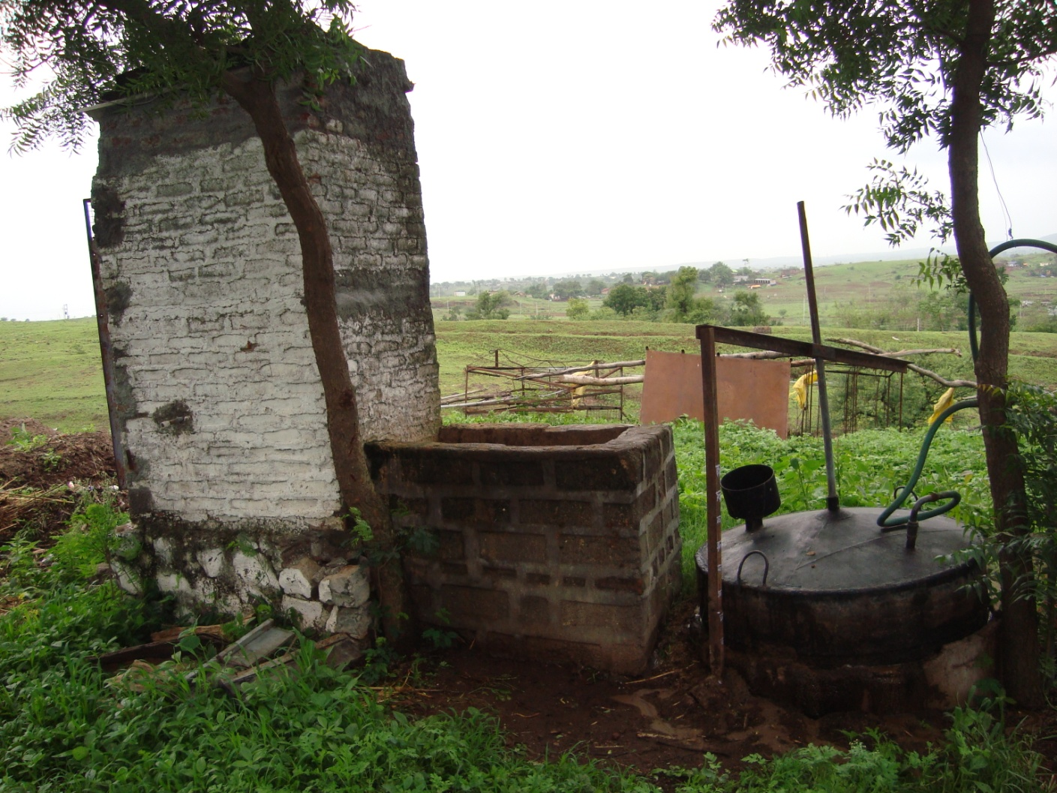
Real Gobar Gas Plants
Vigyan Ashram Plant 2
Gas to kitchen
Latrine
Gas collector
Digester
Mixer

Slide 18
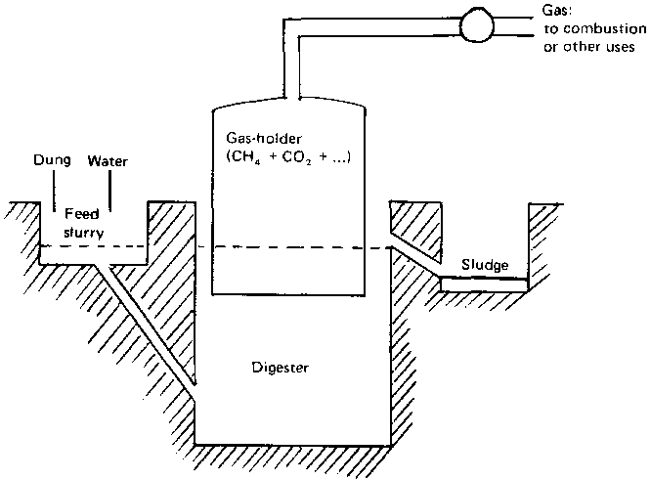
Different Types of Gas Plant
Gobar Gas Plant
Gas to kitchen
Sludge used as a fertiliser
Stops air getting to the digester- creates anaerobic condition
Notes:
The biogas plant is made from two parts
a Digester (or fermentation tank)
The digester is a cube-shaped or cylindrical waterproof container with an inlet into which the fermentable mixture is introduced in the form of a liquid slurry. The digester is provided with an overflow pipe to lead the sludge out into a drainage pit.
Gas holder.
The gas holder is normally an airproof steel container that, by floating like a ball on the fermentation mix, cuts off air to the digester (anaerobiosis) and collects the gas generated. The gas holder is equipped with a gas outlet. while the digester is provided with an overflow pipe to lead the sludge out into a drainage pit.
Digester reactors are constructed from brick, cement, concrete, and steel.

Slide 19
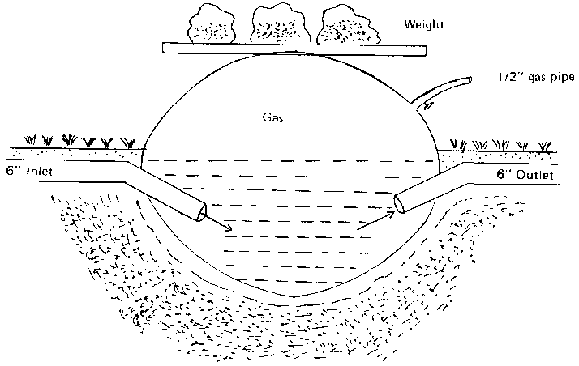
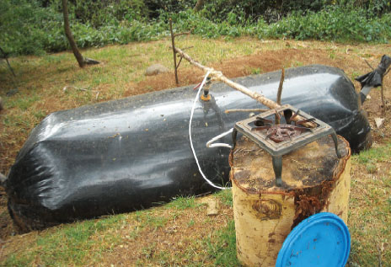
Different Types of Gas Plant
Sausage Bag Gas Plant
Material is polyethylene plastic
Gas to kitchen
Sludge used as a fertiliser
Quick to construct
May require importing
May require protection from sharp objects & vermin
Notes:
The digester is constructed of thick reinforced plastic.
The cost of this gas plant may be less of that of the Gobar and it is very quick to construct. Yet it may require importing. A fence may also be required around it to protect it from damage.
A hole in the ground accommodates the bag, which is filled two-thirds full with waste water. Gas production fully inflates the bag, which is weighted down and fitted with a compressor to increase gas pressure

Slide 20
How Does Biogas Work?
Anaerobic means that there is NO oxygen present!
Anaerobic Digestion in Digester

Slide 21
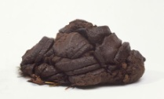
What to put in biogas plant?
Ratio of Nitrogen to Carbon
Solid waste has both Nitrogen and Carbon in it.
We can use cow manure but we can also put in other ingredients to mix with water e.g. food waste.
Nitrogen (N) is essential for anaerobic digestion.
Carbon (C) is an essential part of the gases released. Coming from carbohydrates e.g. green grass, corn stubble ( Low N quantity)
Ideally you want a material with low nitrogen and high carbon at a ratio of 1N:30C.
Notes:
Nitrogen and Carbon are the nutrients that need to be mixed with water to produce gas. These can come from cow manure or other ingredients. For example food waste has both Nitrogen and Carbon but different food have different levels of these ingredients. In practice, it is important to maintain, by weight, a C/N ratio close to 30:1 for achieving an optimum rate of digestion.

Slide 22
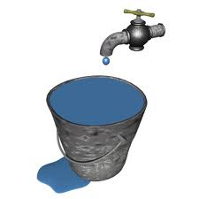
What is important
Ratio of water & Nutrients
Ratio
  1 water :1 solid waste
Nutrients
  carbon (C) and nitrogen (N)
    N= provide nutrients for the growth and multiplication of the anaerobic organisms
    Experiment with different types of solid waste!
Notes:
It is important to experiments with the waste ingredients inputted into the biogas plant in order to calculate the most effective ingredients in terms of gas produced. We need to add water to the solid waste in the mixer. Production of biogas is inefficient if fermentation materials are too dilute or too concentrated, resulting in, low biogas production and insufficient fermentation activity, respectively. Usually we put in the same volume of water as solid waste. However you can experiment with the amount of water added too. Experience has shown that the raw-material (domestic and poultry wastes and manure) ratio to water should be 1:1, i.e., 100 kg of excrete to 100 kg of water.
.

Slide 23
What is important
Stirring
  Prevents scum growth
Retention Time
  Effected by temperature, dilution, loading rate, etc.
  A normal period for the digestion of dung would be 2 to 4 weeks
  At high temperature bio-digestion occurs faster
    Between 20° and 30°

Slide 24
Biogas isn’t just for rural areas....
Watch video that shows a biogas plant developed by ARTI in Pune.
Notes:
Double click icon or refer to video in package called ARTI
Reference: Ashden Awards

Slide 25
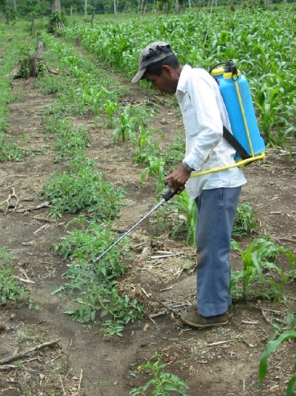
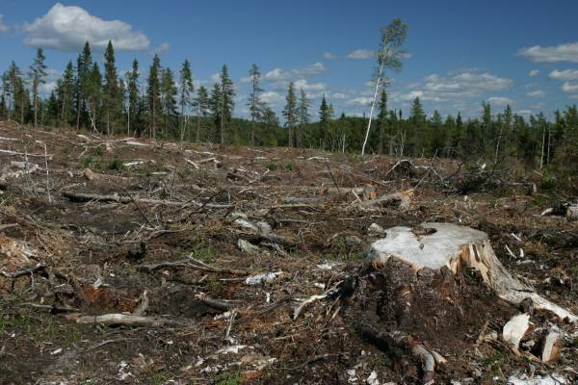
Advantages
1x =3kW hours of electricity
Save on fossil fuels
Save time collecting fuels
Improve hygienic conditions
Reduce pollution
Save Money
Protect Forests
Produce high quality fertiliser

Slide 26



Summary Questions
Why is energy transferred?
What happens in terms of energy when you hit your hand on a table?
Why is it important to use alternative energy?
Explain what two nutrients are important in a biomass plant and why?
Briefly explain what is happening in this picture.

Slide 27
We now know what energy is and why it is important to use alternative energy. We also know that biogas is an alternative energy, so lets look now at how we can construct a biogas plant to begin producing this important energy!

