Slide 1
Solar Cookers & Dryers:
Part 1
Energy & Environment

Slide 2
Lets get started by refreshing our knowledge on solar energy.

Slide 3
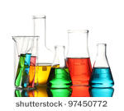

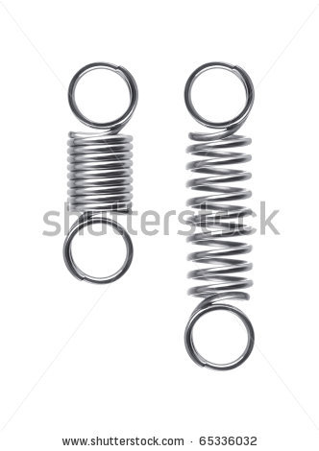
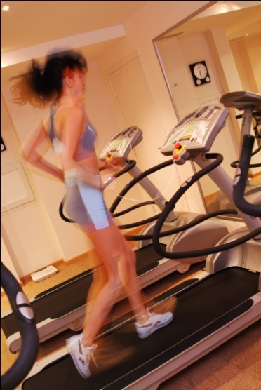
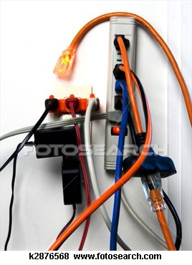
What are the different types of energy?
...................
Chemical
...................
Sound
...................
Potential
.................& ..............
Light
heat
...................
...................
Electrical
Kinetic

Slide 4
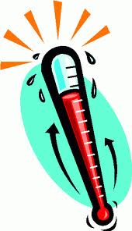

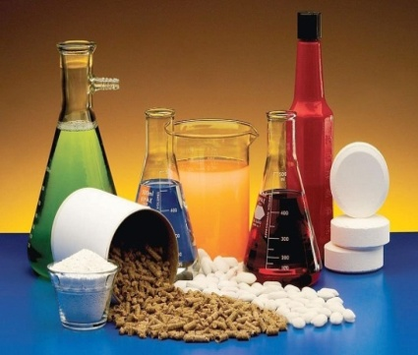
The sun is a source of chemical energy. What types of energy is this chemical energy transferred into? Think about the different senses you observe when the suns rays hit you.
?
?
Chemical
...................
...................
Light
Heat

Slide 5
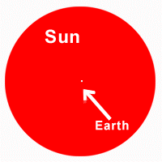
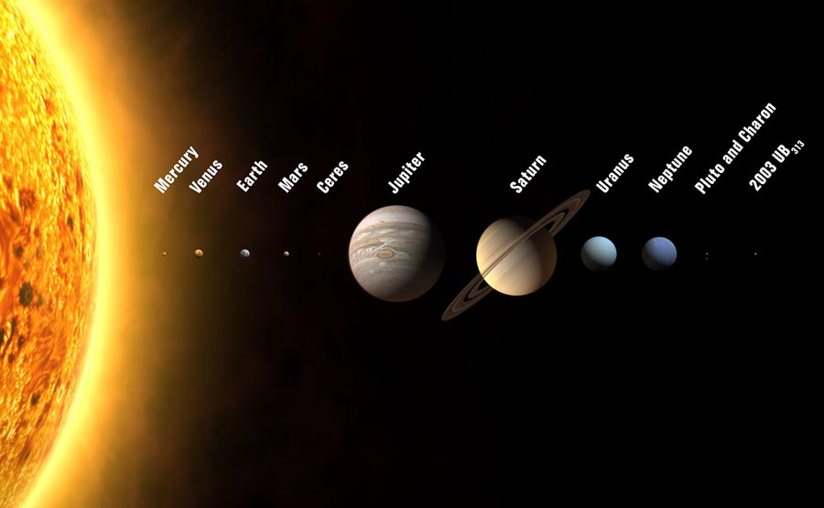

Interesting facts about the sun:
The sun’s diameter is 100x larger than the earth
145 million km
The Sun is nearly 93 million miles (approx 145 million km) from Earth
It takes 8 minutes 20 seconds for the light from the sun to reach the earth. This is called the speed of light.
  India has 250 sunny days a year

Slide 6
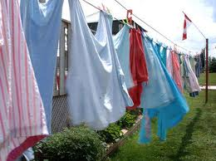
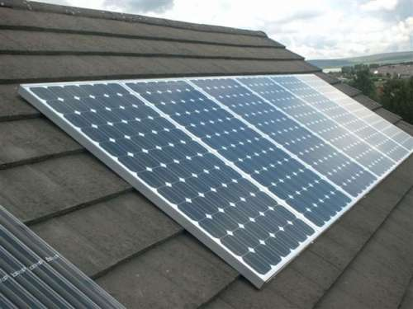
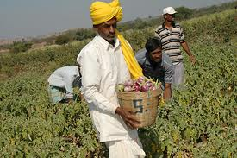
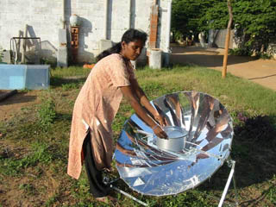
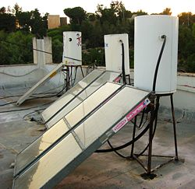
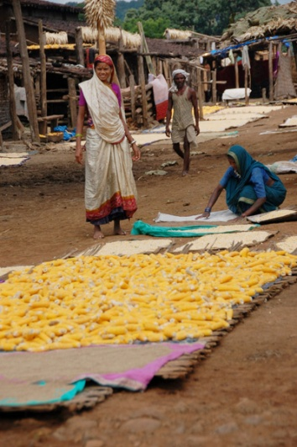
?
?
?
  Drying washing
  Solar Panels
  Growing crops
Can you think of some uses of solar energy?
?
?
?
Cooking
  Water heaters
  Drying food

Slide 7


We can use solar energy to cook our food. But why is it important to cook food? Is it just to make the food taste good?
It makes it safe to eat
It kills bacteria and prevents illness and disease

Slide 8
How can we use solar energy to cook our food?
Watch this video to find out:
Video of solar cookers in use
See video ‘solar bakery PRINCE India’

Slide 9
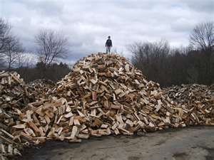
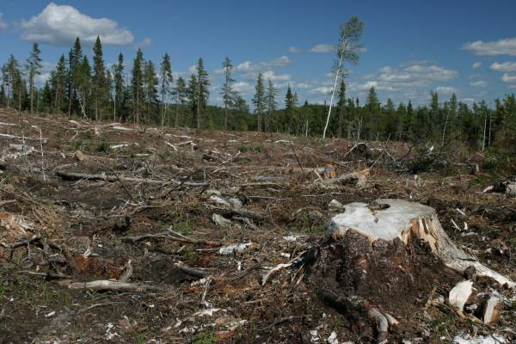
Why is it good to use the sun instead of other fuels for cooking?
Cooking uses a lot of fuel. In one month a typical rural Indian household uses:
400-600kg of firewood for cooking
Problems with collecting so much wood are:
Takes lots of time to gather
Leeds to Deforestation
Notes:
1 liter of Kerosene for lighting vs. 400-600kgs of firewood per
household per month for cooking.

Slide 10

The sun as a fuel
What is the boiling point of water?
...................
100°C
What temperature do we normally get from the sun?
...................
30-40°C
So how can we use this to cook if we cant even boil water with this temperature?
It’s now time for our first activity!
Notes:
How the sun heats up water?
Particles more energy??
Boiling point of water = 100 degrees
Only get 35-40 from the sun.
How can we use this to cook?
By making proper arrangements for to track sun & trap the heat we can cook very efficiently, saving huge amount of wood, kerosene and other possible fuels. Due to this reason , since a decade the use of solar cooker domestically increased its need

