Slide 1
Solar Cookers & Dryers
Part 2
Energy & Environment

Slide 2
When you annotated your drawing did you think about these ways of converting the 30-40°C heat into 100 °C heat:
Concentrating the sun rays
Converting the light energy into heat energy
Trapping heat
Using certain materials for their beneficial properties.
Using the greenhouse effect
?

Slide 3

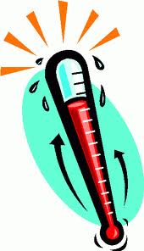
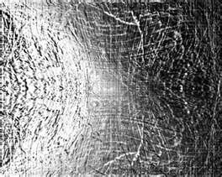
Lets look at how a solar cooker can concentrate the sun rays:
10%
10%
10%
10%
10%
10%
10%
10%
100%
10%
10%
10%
10%
10%
?
The suns rays are scattered from the source
What is hotter than one ray
Many rays! So we need to concentrate these rays to get more heat
But how can we concentrate the rays?
We can do this by reflecting the rays
Name a material that is good at reflecting:
________________
Mirrors (or any other reflective material)
Notes:
Concentrating sunlight: Sun’s rays are scattered from source, need to concentrate for higher temperature & heat. Mirrors or reflective metal is used to concentrate light and heat from the sun into a small cooking area.

Slide 4
Now let’s look at how a solar cooker can convert light energy into heat energy:
The light energy needs to be absorbed, it is then converted into heat energy.
What colour is good at absorbing energy?
__________
Black
Light colours reflect light
Dark colours absorb light, it is then converted into heat.
So rays are reflected
So no rays are reflected
Notes:
Converting light to heat: Sunlight heats the pan. A black pan will absorb almost all of the sun's light and turn it into heat. Solar cooker tried to absorb maximum heat from sunrays
Why? How does this work?
Complex: Due to the atoms that make up the colour. Atoms in the colour black take in energy and so heat up. This is called Light absorption??

Slide 5

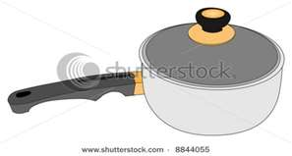
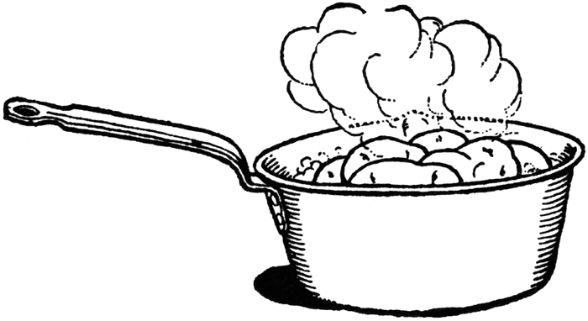
Let’s now look at how a solar cooker traps heat.
A solar cooker traps heat by preventing convection
Convection is when hot air particles travel to cool areas
Warm air
Hot air
Cold air

Slide 6
Finally lets now look at how a solar cooker can use the greenhouse effect to convert the 30-40°C heat into 100 °C heat.
The greenhouse effect is when light energy passes into a glass container and then is not able to leave. This trapped energy builds up and is converted into heat energy.
Glass allows visible light to pass through
Glass blocks thermal radiation from escaping.

Slide 7
Here is a summary of the ways a solar cooker can work:
Warm air
10%
10%
Hot air
10%
It’s now time for our second activity!
Cold air
Concentrate rays
Trap heat
Convert light energy to heat energy
Greenhouse Effect

