Slide 1
Solar Cookers & Dryers
Part 3
Energy & Environment

Slide 2
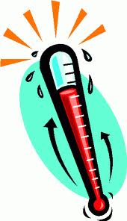
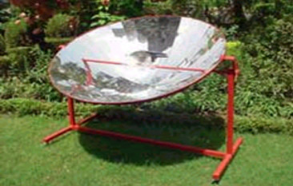
There are 2 different types of solar cooker the concentrator type and the box type.
Concentrator Type Cooker
This cooker can produce a temperature of over 200 °C
Parabolic Reflecting material is used to
Concentrate the Rays
This is the Focus point, where the rays are concentrated to.

Slide 3
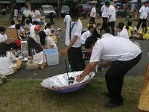
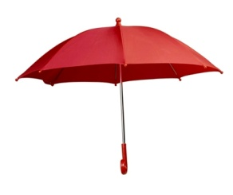
Here is a trial solar cooker made from an umbrella and tin foil!
Concentrator Type Cooker
The sun changes position throughout the day so this type of cooker needs to track the sunlight.
The user needs to be in the sun at all times
It is good for cooking lots of food at the same time, e.g. in a hostel

Slide 4

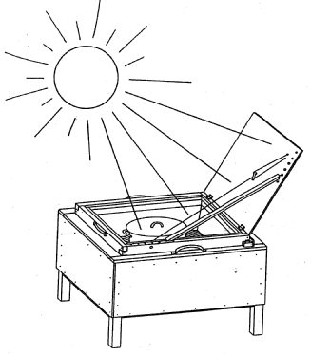
Box Type:
Its box shape is very good at
Trapping Heat
This cooker can produce a temperature of 150 °C
This is the outside reflecting lid. It
Concentrates the rays.
It can also cook food using boiling water at100 °C
This is a glass lid that
Traps the Heat
and
uses the greenhouse effect
It has a black bottom inside that
Converts light to heat energy
It also has reflective internal walls to
It has insulated sides and bottom to
Trap Heat
concentrate the rays

Slide 5
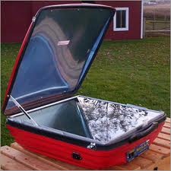
Box Type:
The user must stand in the sun to use it.
The cooker is small and portable so it is easy to move to face the sunlight.
This type of solar cooker is good for cooking food using boiling water.
Here is box type solar cooker in use. As you can see it is nice and compact.

Slide 6
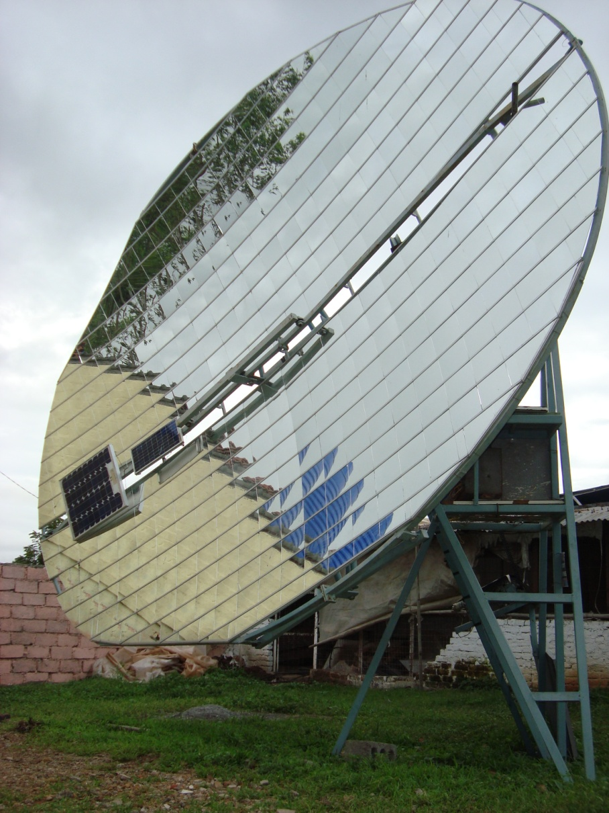
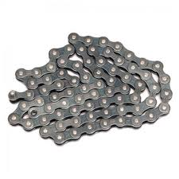
A Scheffler Solar Cooker is a type of concentrator type solar cooker.
It has large parabolic dishes for use in indoor community kitchens.
It tracks the sun’s movement using bike chains and a clock. It reflects the concentrated rays onto a fixed point.

Slide 7
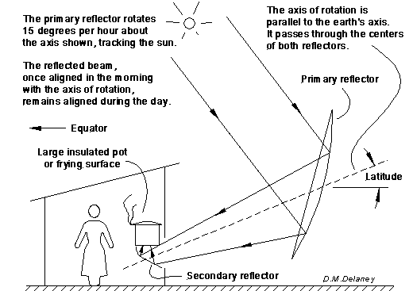
Here is a diagram that shows how a Scheffler cooker used for cooking keeps its focus on the cooking place as the sun moves
Sometimes the concentrated sunlight enters a nearby kitchen directly to strike a cooking pot or frying surface.
Or sometimes it’s used to create steam which is transported by pipes to a nearby kitchen
Notes:
Solar Bakery PRINCE India-- - YouTube.mp4
http://www.youtube.com/watch?v=KSqF84nOhqU

Slide 8
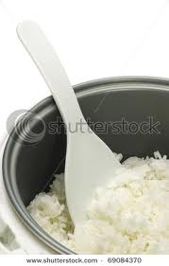
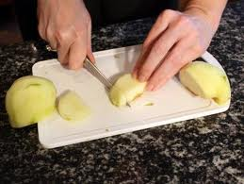
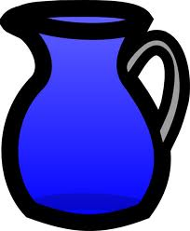
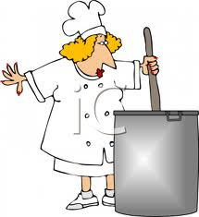
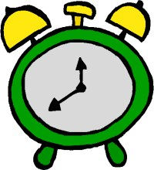
When we are using a solar cooker here are some things that we must take into consideration:
Cut food into smaller pieces
Use minimum amount of water e.g. in rice
  this will decrease the amount of time it takes to cook.
This increases the surface area of the food so that it will cook quicker.
Do not open the cooker for stirring as heat will escape
The time to cook may be longer than normal. Dependent on climate and sun.

Slide 9
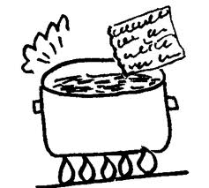
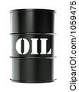
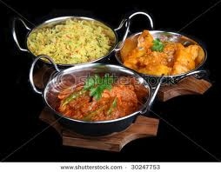


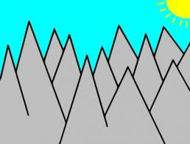

Advantages & Disadvantages of a solar cooker:
Advantages
Solar cookers do not require fuel
Solar cookers can be used to boil water that can then be used inside
Concentrator cookers are useful when there are lots of meals to be prepared at the same time
Disadvantages
Most do not work at night
Concentrator type cookers need to follow the sun
Some require constant attendance while cooking.
Most require level land
Most are too tall for women who like to cook sitting

Slide 10
We are now going to learn how to build our own solar cooker!

