Slide 1
Solar Cookers & Dryers
Part 4
Energy & Environment

Slide 2
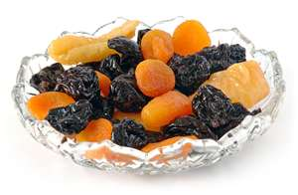
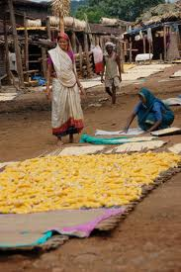
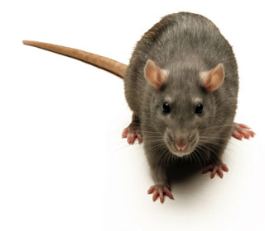
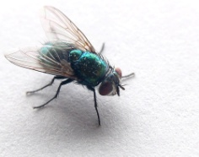
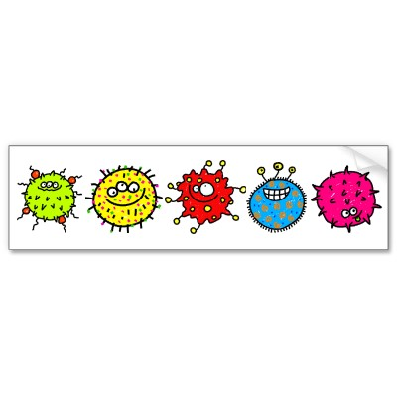
Drying food is very popular and we can use solar dryers to do this. But why do you think we need to dry food?
....................................................................................................
It prevents vegetables, fruits, coffee and other crops from decaying
Drying was one of the first methods of conserving food.
Traditional methods involved putting baskets on the floor or roof.
What are the problems associated with this method?
....................................................................................
The food is open to rodents, insects, dust, wind & rain.
This often leads to contamination of the food and the spread of germs
Notes:
·

Slide 3
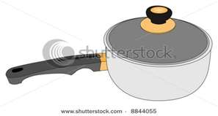
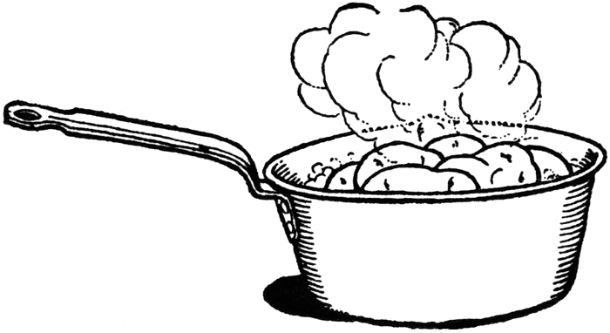
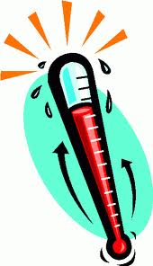
So a better method is to use a solar dryer. Solar dryers use the 4 same techniques as solar cookers. What are these 4 techniques?
?
?
Trap heat
Warm air
10%
10%
10%
Hot air
Cold air
Concentrate rays
?
?
Convert light energy to heat energy
Greenhouse Effect

Slide 4
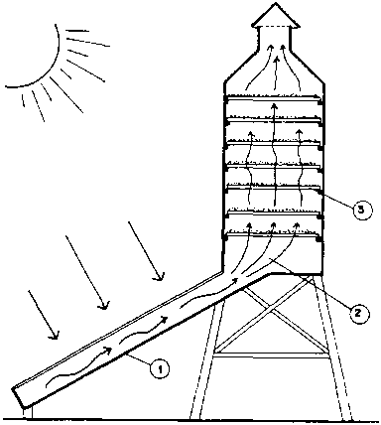
Here is how a solar dryer works. Fill in the gaps.
Warm humid air escapes through a vent at the top.
Glass container to .......................
and ...............................
trap heat
Food to be dried is placed on mesh shelves inside the dryer.
allow the greenhouse
effect to take place.
There are silver panels on the side of the glass container to
...........................
Hot dry air rises through the dryer.
concentrating rays.
convert light energy to heat energy.
Black Panel to ……………

Slide 5
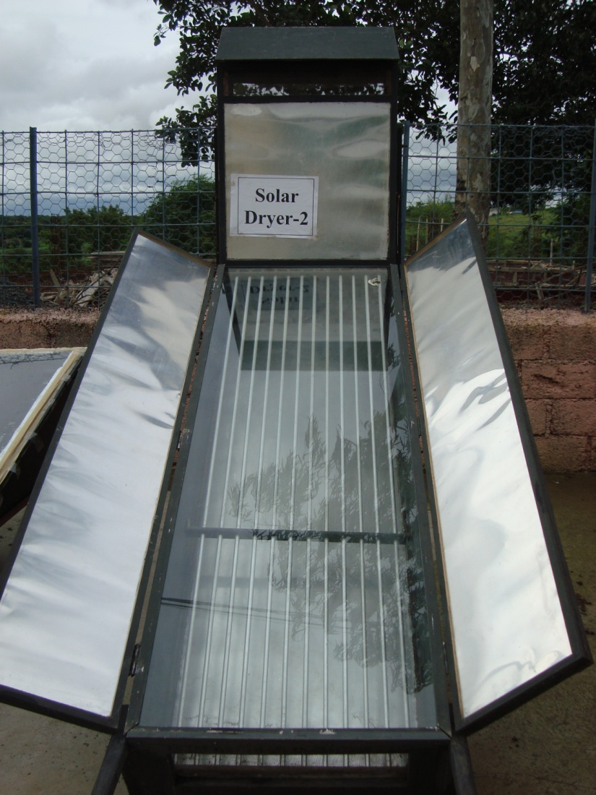
Here are 2 examples of solar dryers. Using the previous diagram you must label what each part does.
Warm humid air escapes through a vent at the top.
Food to be dried is placed on mesh shelves inside the dryer.
Food to be dried is placed on mesh shelves inside the dryer.
Glass container to trap heat and allow the greenhouse effect to take place.
There are silver panels on the side of the glass container to concentrate rays
Now let’s try the second one...
Black Panel to convert light energy to heat energy

Slide 6
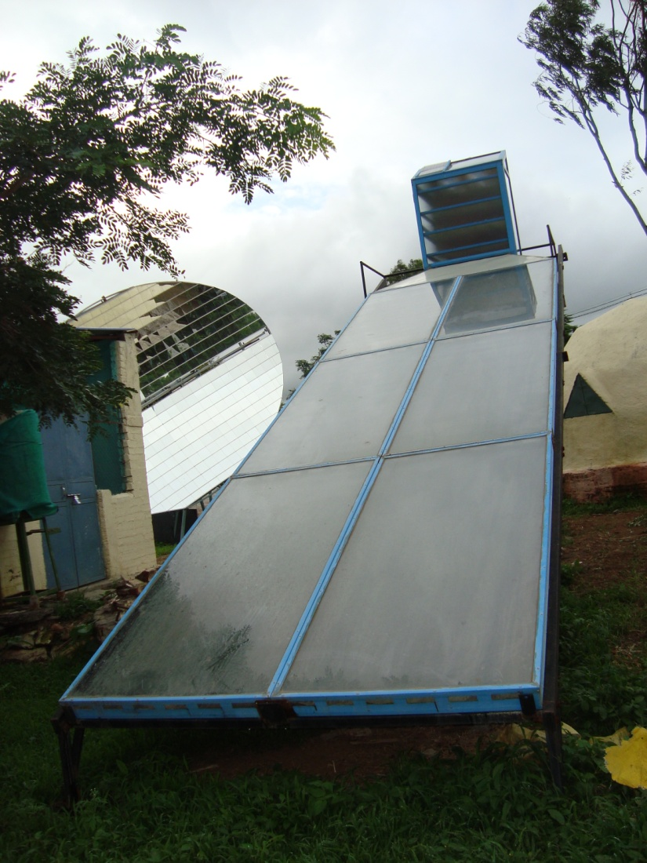
Label and explain this dryer also. Don’t forget to use these key terms:
Converting Light to heat
Trapping Heat
Greenhouse Effect
Concentrating Rays

Slide 7
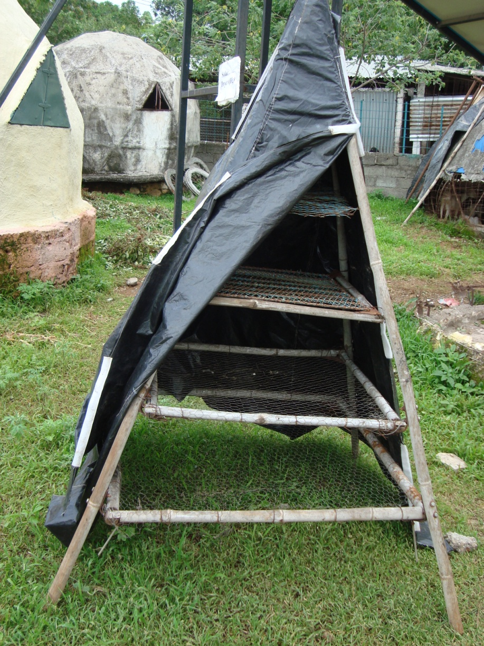
Solar dryers don’t need to use all 4 of the techniques to dry food. For instance this is a tent solar dryer. Can you guess which 2 drying techniques it uses?
.............................
and ...................................
Trapping Heat
Converting light energy
to heat energy
This dryer is cheap to produce as it is made from a plastic sheet, wire mesh and bamboo.
It is very easy to construct and is also simple to use and to maintain.

Slide 8
Its now time for our next activity!

