Slide 1
Electric AC Motor
Vigyan Ashram, Pabal

Slide 2
Objective
Objective of this presentation:
  Fundamentals of Motors
  Basics of AC motor
  How it works?
  Uses

Slide 3
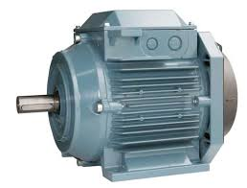
Electric Motor
Energy comes in many forms. Electric energy can be converted into useful work, or mechanical energy, by machines called electric motors.
Basically, motors take the electrical energy from an electricity source, such as an outlet or battery, and change that energy into something that spins, moves or does some sort of work
Electric motors work due to electromagnetic interactions: the interaction of current (the flow of electrons) and a magnetic field.
Electric Motor

Slide 4
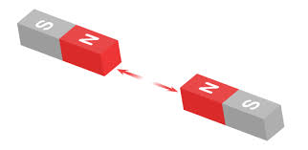
Magnetic Force
What happens when you put two magnets next to each other????
Sometimes they stick together quickly and sometimes they push each other away
The fundamental law of all magnets: – Opposite pole attract and Likes repel.
Inside an electric motor, these attracting and repelling forces create rotational motion

Slide 5
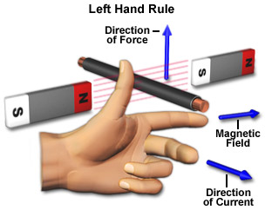
Fleming’s Left Hand Rule
Fleming’s left hand rule for motors
Don’t be confused with Fleming’s right hand rule for generator

Slide 6
Basic AC Motor Types
Electric Motors
Alternating Current (AC) Motors
Direct Current (DC) Motors
Synchronous
Induction
Motors are categorized in a number of types based on the input supply, construction and principle of operation

Slide 7
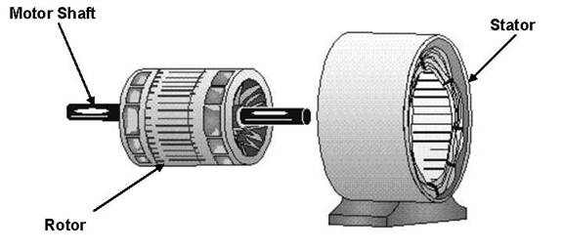
AC Motor
Alternating current (AC) motors use an electrical current, which reverses its direction at regular intervals
Two parts: stator and rotor
  Stator: stationary electrical component
  Rotor: rotates the motor shaft
Two types of AC motors :
  Synchronous motor
  Induction motor
The stator is in the stationary electrical component.
The rotor is the rotating electrical component, which in turn rotates the motor shaft.

Slide 8
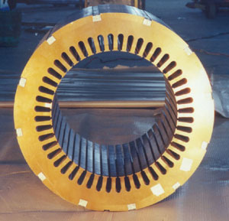
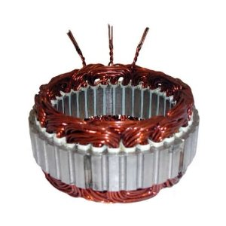
AC motor Parts
The stator is the stationary part of the motor’s electromagnetic circuit. The stator core is made up of many thin metal sheets, called laminations. Laminations are used to reduce energy loses that would result if a solid core were used
Stator Windings: Stator laminations are stacked together forming a hollow cylinder.
Coils of insulated wire are inserted into slots of the stator core.
Stator winding

Slide 9
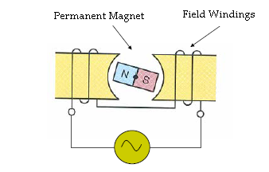
Working Principle
Elementary AC motor
Consider a rotor → formed by permanent magnet.
Consider a stator → formed by coil of conductor to create AC electromagnetic field

Slide 10
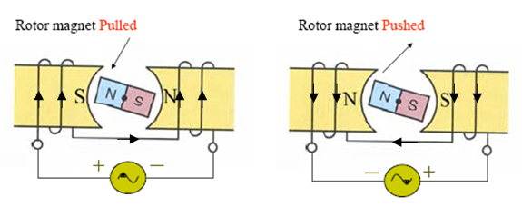
Working Principle
An AC Current flowing through conductors energize the magnets and develop N and S poles.
The strength of electromagnets depends on current.
First half cycle current flows in one direction.
Second half cycle it flows in opposite direction.

Slide 11

Working Principle
Consider the AC voltage at 0 degrees, then, no current will flow, and there is no magnetism.
Supplied voltage
Initial position of the rotor

Slide 12
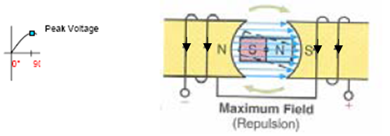
Working Principle
As voltage increases, current starts to flow and electromagnets gain strength and North and South poles appear.
The rotor magnet is pushed CW, and the rotor and motor starts to rotate.

Slide 13
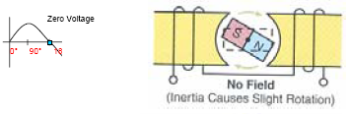
Working Principle
When voltage decreases, the current decreases also, the electromagnet loses the strength, and when V=0 there is no magnetism.

Slide 14
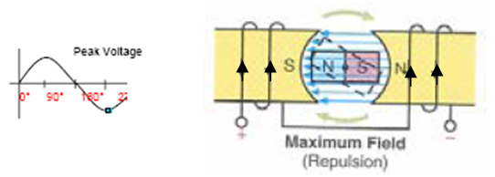
Working Principle
Now, AC voltage builds up as part of the negative cycle.
Then, current flows in opposite direction, and the magnets reverse polarity.
Therefore, the CW rotation continues.

Slide 15
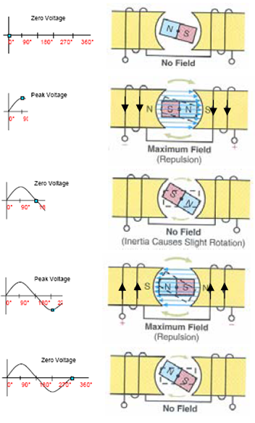
AC Motor Rotation

Slide 16
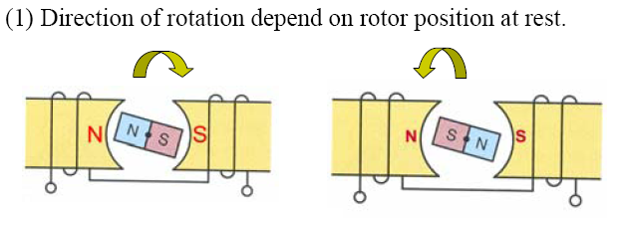
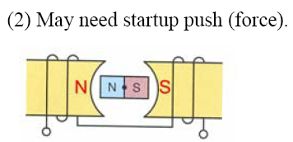
Limitation of the Elementary
Motor
The initial position of the rotor determines the direction of the motor rotation.

Slide 17
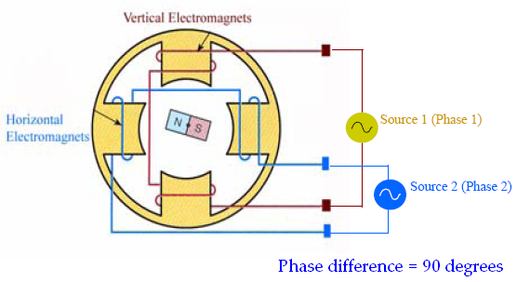
Practical AC Motor
By adding another pair of electromagnets the limitation mentioned before is removed.
Example: Two electromagnets = Vertical & Horizontal
Three phase system has three electromagnets

Slide 18
Induction Motor
Most AC motors are induction motors
Induction motors are favored due to their ruggedness (no brush), simplicity and cheap.
90% of industrial motors are induction motor.
Applications
  (1-phase): washing machines, refrigerators, blenders, juice mixers, stereo turntables, etc.
  (2-phase) induction motors are used primarily as servomotors in a control system.
  (3-phase): pumps, compressors, paper mills, textile mills, etc.

Slide 19
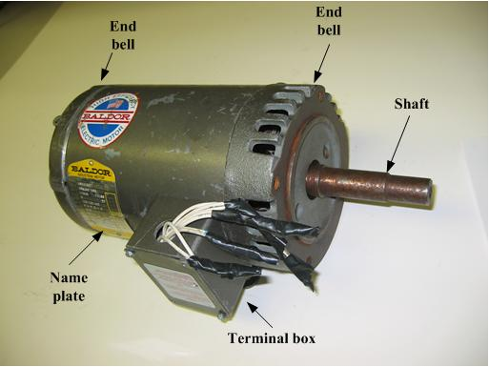
Induction Motor
The single-phase induction motor is the most frequently used motor in the world
Most appliances, such as washing machines and refrigerators, use a single-phase induction machine
Highly reliable and economical

