Slide 1
Electric DC Motor
Vigyan Ashram, Pabal

Slide 2
Objective
Objective of this presentation:
  Fundamentals of Motors
  Basics of electric DC motor
  How it works?
  Uses

Slide 3
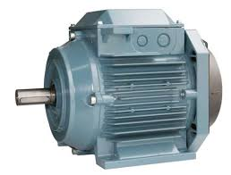
Electric Motor
Energy comes in many forms. Electric energy can be converted into useful work, or mechanical energy, by machines called electric motors.
Basically, motors take the electrical energy from an electricity source, such as an outlet or battery, and change that energy into something that spins, moves or does some sort of work
Electric motors work due to electromagnetic interactions: the interaction of current (the flow of electrons) and a magnetic field.
Electric Motor

Slide 4
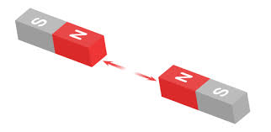
Magnetic Force
What happens when you put two magnets next to each other????
Sometimes they stick together quickly and sometimes they push each other away
The fundamental law of all magnets: – Opposite pole attract and Likes repel.
Inside an electric motor, these attracting and repelling forces create rotational motion

Slide 5
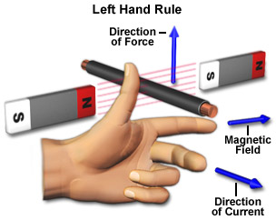
Fleming’s Left Hand Rule
Fleming’s left hand rule for motors
Don’t be confused with Fleming’s right hand rule for generator

Slide 6
Basic DC Motor Types
Electric Motors
Alternating Current (AC) Motors
Direct Current (DC) Motors
Shunt
Compound
Series
Motors are categorized in a number of types based on the input supply, construction and principle of operation

Slide 7
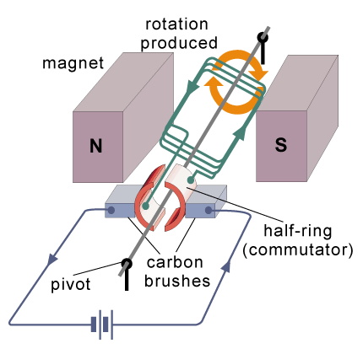
How DC Motor Works ?
When electric current passes through a coil in a magnetic field the magnetic force produces a torque which turns the DC motor
The commutator reverses the current each half revolution to keep the torque turning the coil in the same direction
I
Electric current is supplied through a commutator
I
Battery provides an electric current (I)

Slide 8
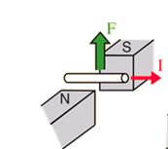
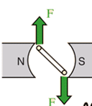
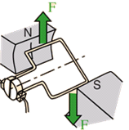


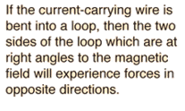
How DC Motor Works ?

Slide 9
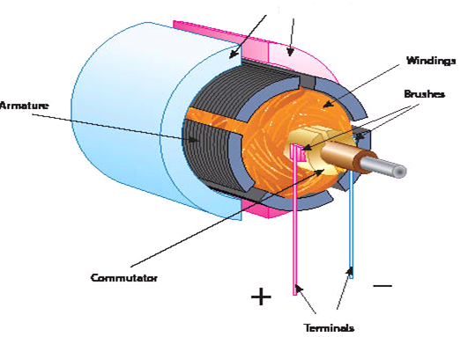
DC Motors Parts
Armature or rotor
Commutator
Brushes
Field magnet
DC power supply
Field Magnet

Slide 10
Armature
The armature is an electromagnet made by coiling thin wire around two or more poles of a metal core.
The armature has an axle, and the commutator is attached to the axle.
When you run electricity into this electromagnet, it creates a magnetic field in the armature that attracts and repels the magnets in the stator. So the armature spins through 180 degrees.
To keep it spinning, you have to change the poles of the electromagnet.

Slide 11
Commutator
Commutator is simply a pair of plates attached to the axle. These plates provide the two connections for the coil of the electromagnet.
Commutator and brushes work together to let current flow to the electromagnet, and also to flip the direction that the electrons are flowing at just the right moment
The contacts of the commutator are attached to the axle of the electromagnet, so they spin with the magnet. The brushes are just two pieces of springy metal or carbon that make contact with the contacts of the commutator.

Slide 12
Field Magnet
The armature is an electromagnet, while the field magnet is a permanent magnet (the field magnet could be an electromagnet as well, but in most small motors it isn't in order to save power).

Slide 13
Applications of DC Motors
1. D.C Shunt Motors:
It is a constant speed motor. Where the speed is required to remain almost constant from noload to full load.Where the load has to be driven at a number of speeds and any one of which is nearly constant.
Industrial use: Lathes, Drills, Boring mills, Shapers, Spinning and Weaving machines.

Slide 14
Applications of DC Motors
2. D.C Series Motors:
It is a variable speed motor. The speed is low at high torque. At light or no load ,the motor speed attains dangerously high speed. The motor has a high starting torque.(elevators, electric traction)
Industrial use: Electric traction, Cranes, Elevators,
Air compressor, Vacuum cleaner, Hair drier, Sewing machine

Slide 15
Applications of DC Motors
3. D.C Compound motor:
Differential compound motors are rarely used because of its poor torque characteristics.
Industrial uses:
PressesShears, Reciprocating machine.

