Slide 1
Electric Motor Starter
Vigyan Ashram, Pabal

Slide 2
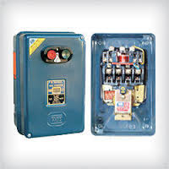
Starter
Starter is a device which connects with motor in series to decrease the current at starting time and increase current after starting the motor (in other words start or stop the motor) and provide overload protection.
DOL is a simple and ordinary starter suitable for squirrel cage induction motors having a capacity up to 5 hp : --
Inner View
Stop Button
Outer View
Start Button
Direct On Line Starter (D. O. L)

Slide 3
Need of a Motor Starter?
Starter is used to reduce the starting current of the motor.
and to safe guard the motor winding in the high starting
current. different type of starters are used to. i.e. 3
point starter ,4 point starter etc...
Very large motors it is generally desirable to take some measure to reduce the starting current otherwise damage may be done to the machinery driven by the motor & line disturbances may be created that affect the operation of other motors on the same line.

Slide 4
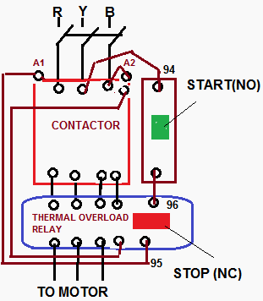
Direct On Line (DOL) starter
The simplest form of motor starter for the induction motor is the Direct On Line starter. The Direct On Line Motor Starter (DOL) consist a MCCB or Circuit Breaker, Contactor and an overload relay for protection. Electromagnetic contactor which can be opened by the thermal overload relay under fault conditions.
Typically, the contactor will be controlled by separate start and stop buttons, and an auxiliary contact on the contactor is used, across the start button, as a hold in contact. I.e. the contactor is electrically latched closed while the motor is operating.
Contactor
Overload Relay

