Slide 1
IC Engines And Its Operation
Vigyan Ashram, Pabal

Slide 2
Objective Of The Presentation
In this presentation you will learn :
What is IC engine?
How it works?
Where it is used?

Slide 3
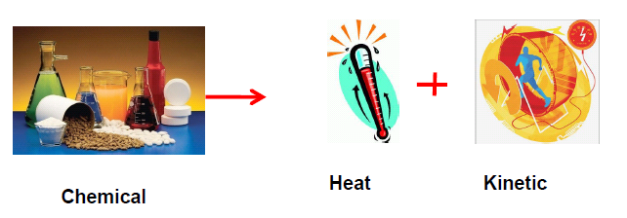
Engine
What is engine?
An engine is a machine designed to convert energy into useful mechanical motion.
Automotive engines change chemical energy of the fuel into heat energy and finally into mechanical energy.

Slide 4
Engine Types

Slide 5
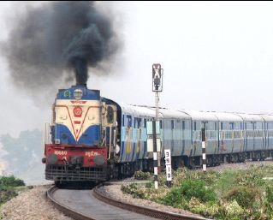
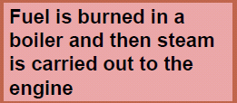
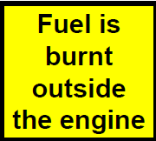
External Combustion Engines
Steam is used to obtain rotary motion of the shaft

Slide 6
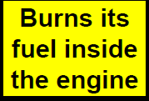
Internal Combustion (IC)
Engines
1. Chemical energy is released when the fuel-air mixture is ignited by the spark in the combustion chamber
2. The gas produced in this reaction rapidly expands forcing the piston down the cylinder on the power stroke
Chemical energy --burning → heat → Pressure → Speed

Slide 7
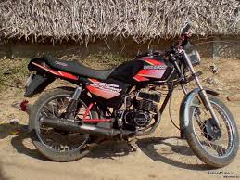
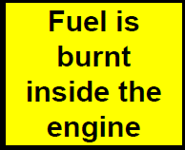
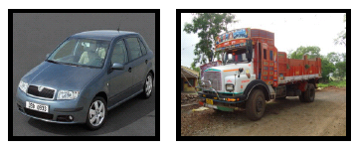
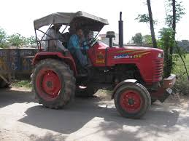
Two types of Internal Combustion Engines

Slide 8
Four Stroke Engine

Slide 9
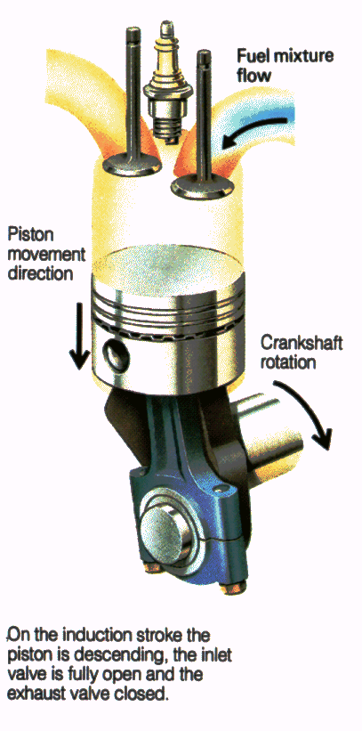
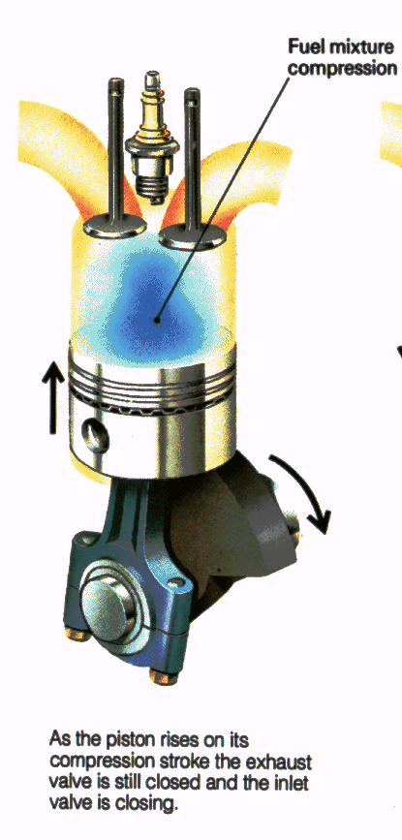
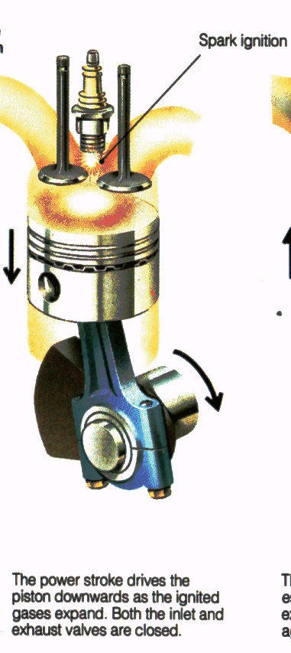
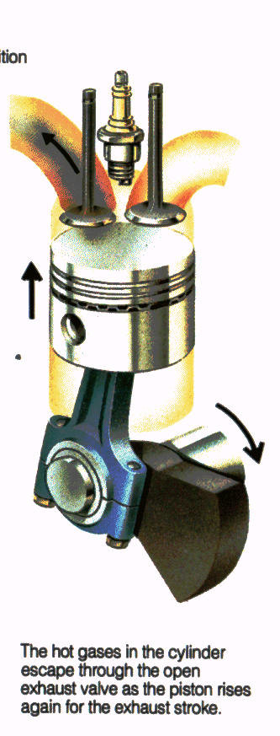
Four Stroke Engine (petrol)
In four stroke engine, fuel is burnt once in 2 revolutions.
1 2 3 4
1. Induction Stroke
2. Compression Stroke
3. Power Stroke
4. Exhaust Stroke

Slide 10
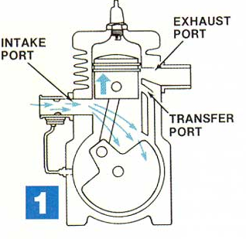
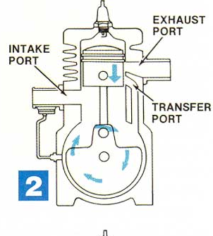
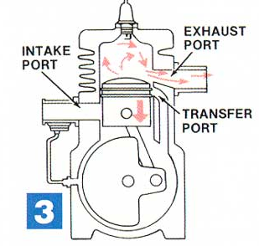
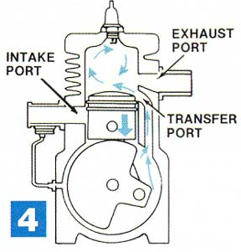
Two Stroke Engine (Petrol)
In the 2 stroke engine, sparks fires once every revolution. Piston going upward or downwards is called a stoke
Since there are 2 stroke in one revolution, the engine is called 2 – stroke engine.
Ignition and power stroke:
Exhaust stroke
Intake Stroke
Compression stroke

Slide 11
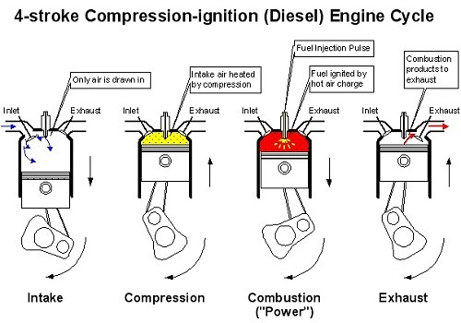
Four Stroke Engine (Diesel)

Slide 12
Differences Between Diesel And Petrol Engine
 | Petrol | Diesel
Explosion | Fuel is mixed with air, compressed by pistons and ignited by sparks from spark plugs | The air is compressed first, and then the fuel is injected. Because air heats up when it's compressed, the fuel ignites.
Ignite | petrol engine uses sparks to ignite its fuel/air mixture | diesel engine uses only air compression to ignite its fuel.
Power | Delivers much more power from a given size engine | Low on power compared to petrol engine
Fuel Efficiency | Low compared to diesel engine | Better than petrol engine
Uses | Because of good power it is also suitable for race cars such as Formula 1 | It is not suitable for racing cars

Slide 13
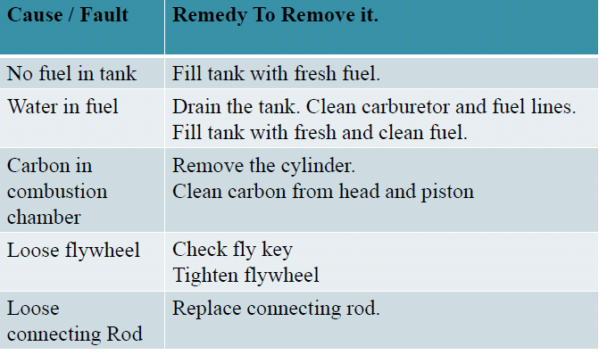
Engine Troubleshooting

Slide 14
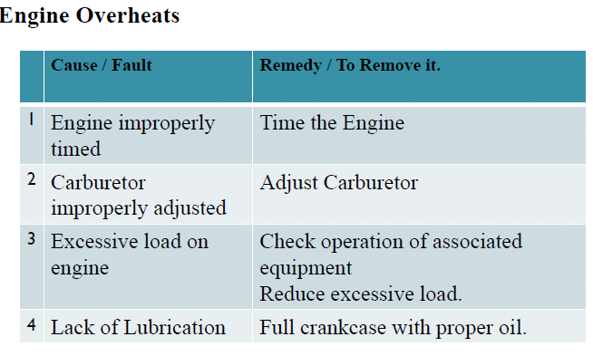
Engine Troubleshooting

Slide 15
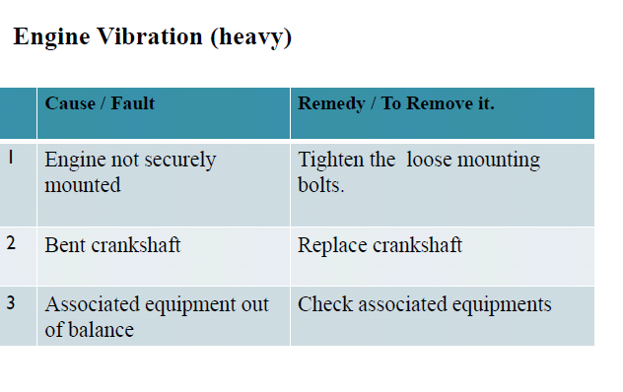
Engine Troubleshooting

