Slide 1
Pump Installation
Vigyan Ashram, Pabal

Slide 2
Pump Installation
Pump Installation considerations :
Foundation
Suction Piping
Discharge Piping

Slide 3
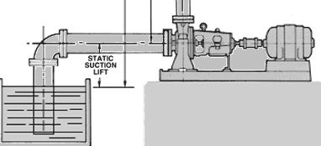
Foundation or Unit Location
The pump unit should be located as close to the water surface as possible to :
Allow for the use of a short, direct suction pipe
Minimize vertical suction lifts
With a minimum number of fittings. Suction lifts exceeding 15 ft should be avoided whenever possible.
Foundation

Slide 4
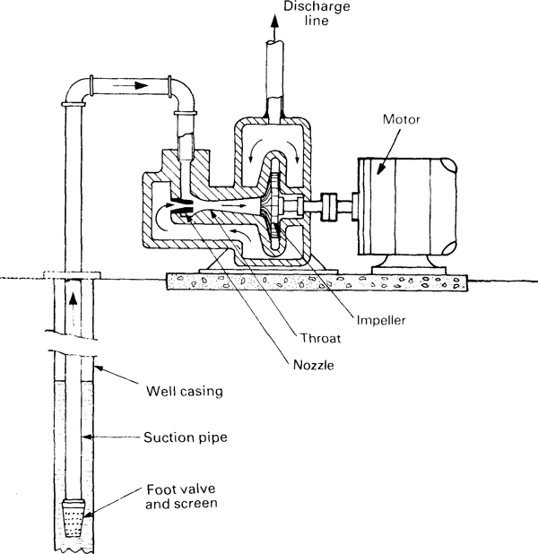
Suction Piping
Suction pipe is the pipe through which water is lifted to the pump level.
Thus the pipe has its lower end dipped in the water and the upper end is connected to the eye or the inlet of the pump.
At the lower end, a strainer and a foot-valve are also fitted.

Slide 5
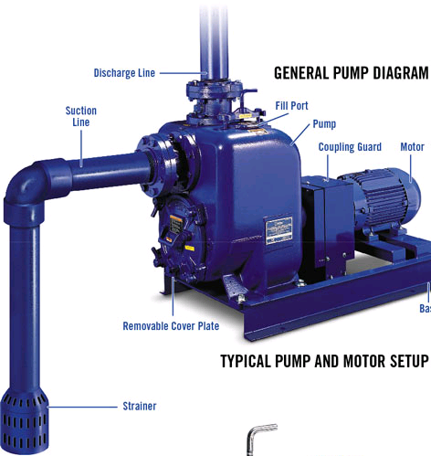
Suction Piping
i. Strainer : It is a screen provided at the foot of the suction pipe, it would not allow entrance of the solid matters into the suction pipe which otherwise may damage the pump.

Slide 6
Suction Piping
ii. Foot valve
- It is a one direction valve provided at the foot of the suction pipe.
It permits flow only in one direction i.e. towards the pump.
Foot valve facilitates to hold the primed water in the suction pipe and casing before starting the pump.

Slide 7
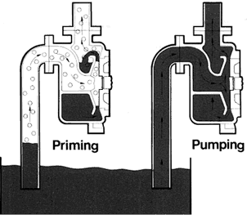
Priming
Priming is the process in which the impeller of a centrifugal pump will get fully sub merged in liquid without any air trap inside.
- This is especially required when there is a first start-up. But it is advisable to start the pump only after primping.
Priming of a pump is very essential step in start up of a centrifugal pump. Fact is that centrifugal pump are not capable of pumping air or vapours

Slide 8
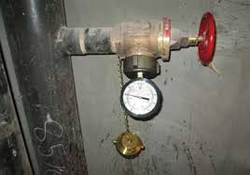
Discharge Piping
Discharge piping
Discharge pipe is used for delivery of liquid. One end connected to the outlet of the pump while the other delivers the water at the required height to the delivery tank. It consists of following components:
i. Delivery gauge
This gauge connected on the delivery side of the pump to measure the pressure on the delivery side.
ii. Delivery Valve
It is a gate valve on the delivery side of the pump to control the discharge
Delivery valve
Delivery gauge
Discharge or delivery pipe

Slide 9
Precautions
Centrifugal Pump Starting and Stopping :
During pump start-up, check the lubrication of the motor bearings and prime the pump.
After priming, the pump must be started with the discharge valve fully closed.
The discharge valve must then be opened slowly to allow any air in the system to escape. The
Pump discharge valve must be opened and closed slowly to prevent water hammer in the system.

Slide 10
Precautions
Centrifugal Pump Starting and Stopping :
During power failure (when the motor stops running), the discharge valve can remain open. This might be a problem because the water can actually flow backward.
On large pumps, emergency power operated valves are provided to prevent the impellers from running in reverse. On smaller pumps, check valves are provided.
If the pump will be shut down for longer periods, additional steps should be taken. In cold weather, for example, all water must be drained out from the pump to prevent freezing.
The pump packing or seal must be removed if the pump is to be stored idle for longer periods.

Slide 11
Centrifugal Pump Maintenance
Centrifugal pumps require regular inspection and maintenance.
Bearings on the motor may become worn and must be checked and kept well lubricated.
The packing or seal can wear out due to friction resulting in leakage from the pump. These should be checked regularly.
Bearing and motor temperatures must be monitored. If a surface is substantially hotter than normal, the unit should be shut down and the cause of excessive heat investigated.
In case of any unusual noises or vibrations from the pump, it must be stopped and the cause investigated.

