Slide 1
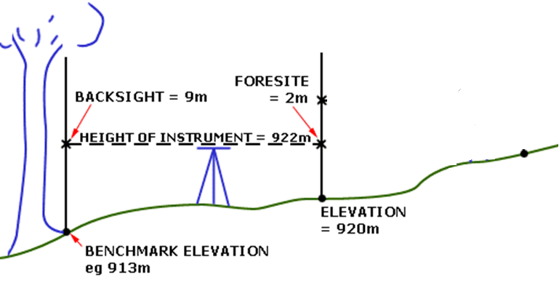
How to use a Dumpy Level
Example 1
Find the difference in height between the benchmark and the top of the slope
?
Top of Slope
Divide hill into 3 spots to make easier
Otherwise too far to see or leveling staff not long enough

Slide 2

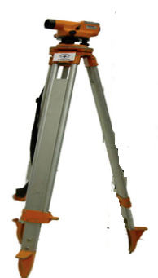
How to use a Dumpy Level
Example 1
9mAOD
Back sight

Slide 3

How to use a Dumpy Level
Example 1
Rotate Dumpy round
9mAOD
2mAOD
2m
Foresight
Back sight
Foresight
Move Level to new position

Slide 4
How to use a Dumpy Level
Example 1
Move Dumpy to new position
6mAOD
9mAOD
2mAOD
Back sight
Back sight
Foresight

Slide 5
How to use a Dumpy Level
Example 1
Rotate Dumpy round
to new position
6mAOD
9mAOD
2mAOD
Back sight
Back sight
Foresight
Move Level to new position

Slide 6
How to use a Dumpy Level
Example 1
1mAOD
6mAOD
9mAOD
2mAOD
Back sight
Foresight
Back sight
Foresight

Slide 7
How to use a Dumpy Level
Example 1
1mAOD
Level of dumpy = 922m
6mAOD
Level of dumpy = 926m
9mAOD
2mAOD
Back sight
1m
Foresight
Foresight
Back sight
6m
6m + 920m
2m
9m
913m + 9m
 | Ground Level | Backsight (from Dumpy Level) | Height of instrument (Ground Level + Backsight from Dumpy Level) | Foresight (from Dumpy Level) | Height of new point (Height of instrument-foresight)
Bench mark | 913 | 9 | 922 | 2 | 920
 | 920 | 6 | 926 | 1 | 925

Slide 8
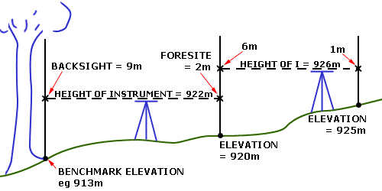
How to use a Dumpy Level
Example 1
?
 | Ground Level | Backsight (from Dumpy Level) | Height of instrument (Ground Level + Backsight from Dumpy Level) | Foresight (from Dumpy Level) | Height of new point (Height of instrument-foresight)
Bench mark | 913 | 9 | 922 | 2 | 920
 | 920 | 6 | 926 | 1 | 925
So the difference in height is
925m-913m=12m

Slide 9
Example 2
I want to construct a water pipe on the hill by Vigyan Ashram
To find the pressure that will result from the pipe
I need to know the height difference between point A and point D
A= 875mAOD
B
C
D

Slide 10
Example 2
 | Ground Level | Backsight (from Dumpy Level) | Height of instrument (Ground Level + Backsight from Dumpy Level) | Foresight (from Dumpy Level) | Height of new point (Height of instrument-foresight)
Benchmark | A=875 |  |  |  | B=
 | B= |  |  |  | C=
 | C= |  |  |  | D=
A= 875mAOD
B
C
D

Slide 11
Example 2
Level of dumpy=879mAOD
4m
A= 875mAOD
9m
Level of dumpy=871mAOD
1m
B
11m
B= 870mAOD
Level of dumpy=862mAOD
2m
C
12m
C= 860mAOD
D
D= 850mAOD

Slide 12
Example 2
 | Ground Level | Backsight (from Dumpy Level) | Height of instrument (Ground Level + Backsight from Dumpy Level) | Foresight (from Dumpy Level) | Height of new point (Height of instrument-foresight)
Benchmark | A=875 | 4 | 879 | 9 | B= 879-9=870
 | B= 870 | 1 | 871 | 11 | C= 871-11=860
 | C= 860 | 2 | 862 | 12 | D= 862-12= 850

Slide 13
Example 2
 | Ground Level | Backsight (from Dumpy Level) | Height of instrument (Ground Level + Backsight from Dumpy Level) | Foresight (from Dumpy Level) | Height of new point (Height of instrument-foresight)
Benchmark | A=875 | 4 | 879 | 9 | B= 879-9=870
 | B= 870 | 1 | 871 | 11 | C= 871-11=860
 | C= 860 | 2 | 862 | 12 | D= 862-12= 850
Once you have gone down the hill,
check you answer by coming back up the hill
 | Ground Level | Backsight (from Dumpy Level) | Height of instrument (Ground Level + Backsight from Dumpy Level) | Foresight (from Dumpy Level) | Height of new point (Height of instrument-foresight)
 | D=850 |  |  |  | C=
 | C= |  |  |  | B=
 | B= |  |  |  | A=

Slide 14
Example 2
Level of dumpy=879mAOD
4m
9m
Level of dumpy=871mAOD
A= 875mAOD
1m
B
11m
B= 870mAOD
Level of dumpy=862mAOD
2m
C
12m
C= 860mAOD
D
D= 850mAOD

Slide 15
Example 2
 | Ground Level | Backsight (from Dumpy Level) | Height of instrument (Ground Level + Backsight from Dumpy Level) | Foresight (from Dumpy Level) | Height of new point (Height of instrument-foresight)
Benchmark | A=875 | 4 | 879 | 9 | B= 879-9=870
 | B= 870 | 1 | 871 | 11 | C= 871-11=860
 | C= 860 | 2 | 862 | 12 | D= 862-12= 850
Once you have gone down the hill,
check you answer by coming back up the hill
 | Ground Level | Backsight (from Dumpy Level) | Height of instrument (Ground Level + Backsight from Dumpy Level) | Foresight (from Dumpy Level) | Height of new point (Height of instrument-foresight)
 | D=850 | 12 | 862 | 2 | C=862-2=860
 | C=860 | 11 | 871 | 1 | B=871-1=870
 | B=870 | 9 | 879 | 4 | A=879-4=875

Slide 16
Example 2
So what was the change in height?
Change in height= 25m
A= 875mAOD
B
C
D
A= 850mAOD

Slide 17
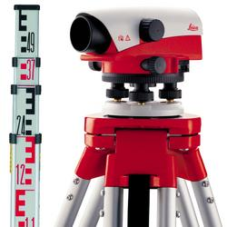
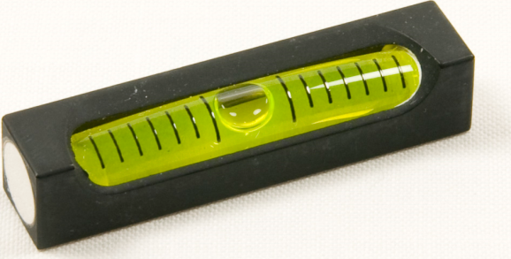

Summary Questions
What is a Dumpy Level Used for?
What 2 things can you use to check if things are level?
How does a spirit level work?
One you have done a backsight reading what would you do next with a dumpy level?

