Slide 1
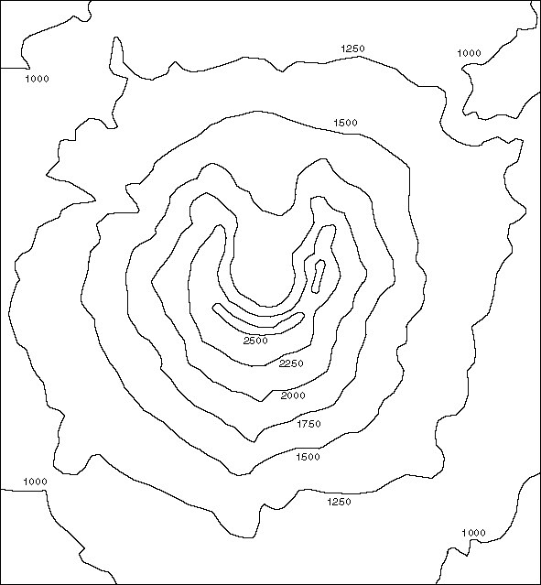
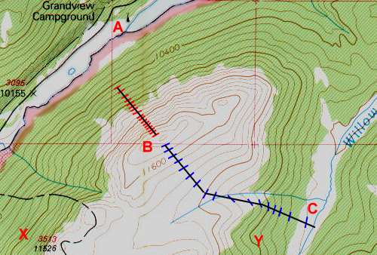
Contours
Contours show points of the same height. These points are joined up usually in 5m or 10m intervals.
  This line is made up from joining up all the points of the same height
Notes:
.

Slide 2

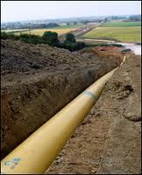
Why do you think it is important to have contours on a map? Make a list with a friend of your answers.
.....................................
....................................................
..................................................................
...........................................................................
.....................................................................................
Here are a couple of examples:
  To find level land for construction
  or agriculture.
  To design a pipeline

Slide 3
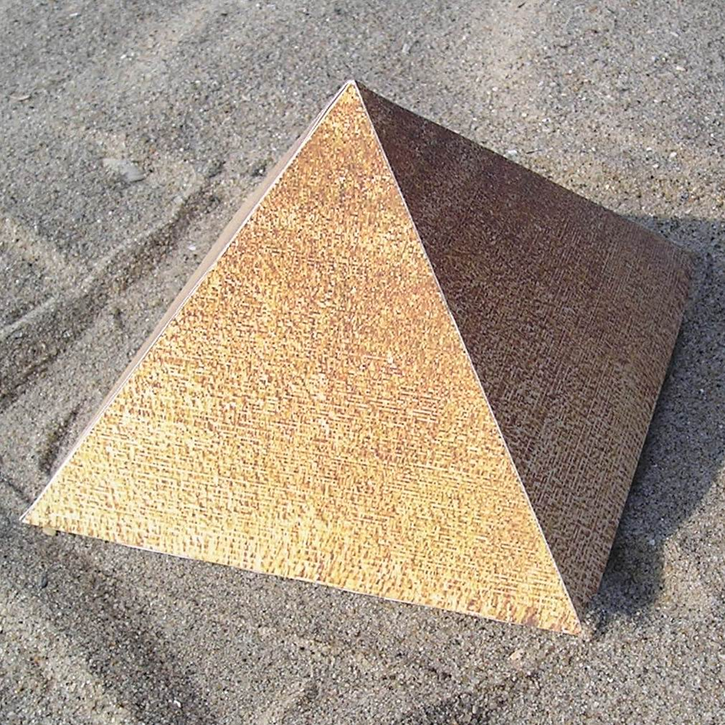
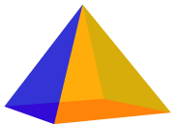
Activity 2: Contour Exercise
Plot this pyramid using contours
Chose a suitable scale
Level at top=60mAOD
Remember that a pyramid
has 4x sides and this has a
square base
Level at base=10mAOD
50m
50m
Notes:
A 3D model would help students here

Slide 4
Contour Exercise
Is this what yours looked like?
What is your scale?
1cm to 10m
1:100?
10m
20m
30m
50m
40m
60m
60m
50m
50m

Slide 5
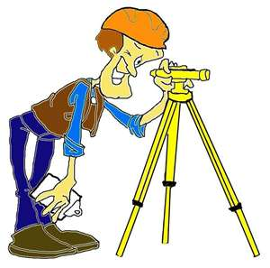
Drawing Maps
We were able to plot the pyramid as we had the dimensions
Level at top=60m
As we only wanted to plot the pyramid we did not need to know where it was relative to other areas
Level at base=10m
50m
50m
But how do we plot a map if we do not have the co-ordinates or dimensions?
We need to carry out surveying

Slide 6
Surveying
Surveying is the art and science of measuring and mapping land
The main job of the surveyor is measuring, mapping, and observing

Slide 7
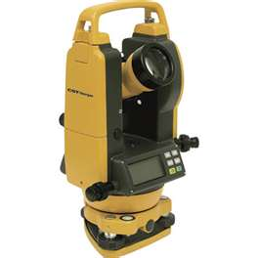
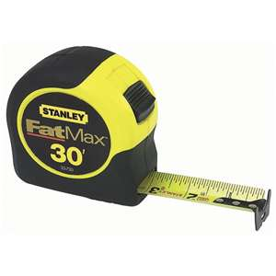
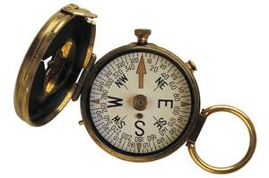
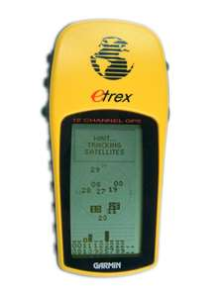
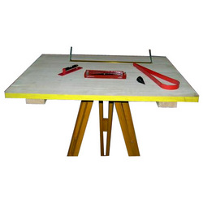
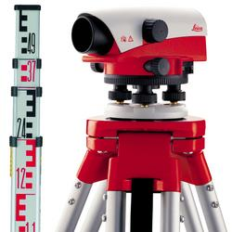
Here are some surveying tools:
Theodelite
Compass
Measuring Tape
GPS
alidade
Dumpy Level
Plane Table
Leveling Staff
Tripod
Tripod

Slide 8
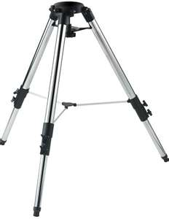

Plane Table Survey
A Plane Table provides a solid and flat surface
to make field drawings, charts and maps
A tripod is needed so that an even surface can be achieved on uneven ground
Spirit/bubble levels are used to get horizontal surface level.

Slide 9
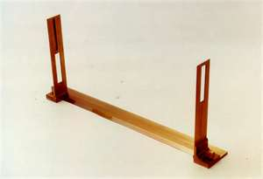
Plane Table Survey
This is an Alidade which is used to sight objects of interest:
Perpendicular straight edge ruler
Eye piece
Thread to bisect/spilt in half the point of interest
Notes:
A typical surveyor's instrument reticle has two pairs of stadia marks. One pair are on the horizontal centreline and the other on the vertical. Each functions in the same manner and are placed for measuring on either axis.
The stadia marks are set a specific distance apart. The distance is chosen so that there is a fixed, integer ratio between the distance observed between the marks and the distance from the telescope to the measuring device observed. This is known as the stadia constant or stadia interval factor. For example, a typical stadia mark pair are set so that the ratio is 100. If one observes a stadia rod, rule or levelling rod with the telescope and sees that the rod spans 0.5m between the marks (the stadia interval), then the distance from the instrument to the rod is:
0.5m x 100 = 50 m. In the image to the right, the upper stadia mark is at 1.5 m and the lower at 1.345 m. The difference is 0.155 m. Thus the distance from the instrument to the levelling rod is:
0.155 x 100 = 15.5 m

Slide 10
Plane Table Survey
Youtube video
http://www.youtube.com/watch?v=UMdPgp5oMRw

