Slide 1
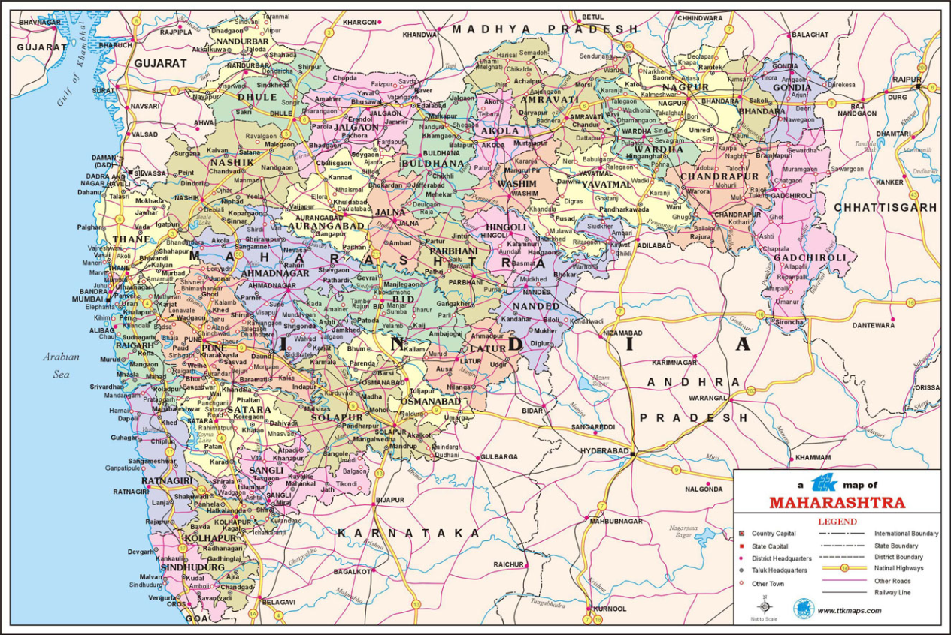
Maps & Plane Table Surveying
Energy & Environment
1. Introduction to Maps

Slide 2



Maps
A map is a visual representation of an area
They can be used by everyone. People who are illiterate or who different languages can use them.
The Survey of India is India’s central engineering agency who are
in charge of mapping and surveying
What are maps used for? Discuss with a friend and think of 4 uses of a map:
?
?
Finding your location
Measuring distance between locations
?
?
Get information of the land of an area
Find the height difference of the land

Slide 3
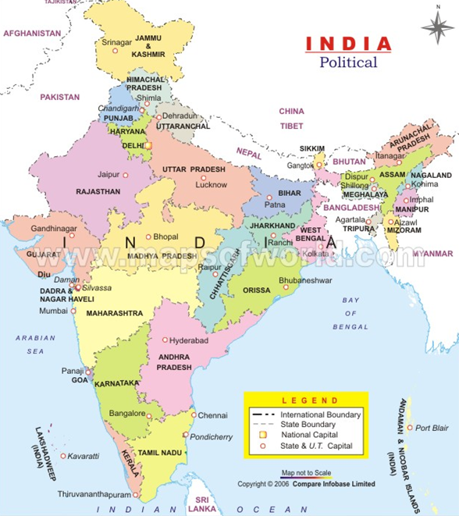
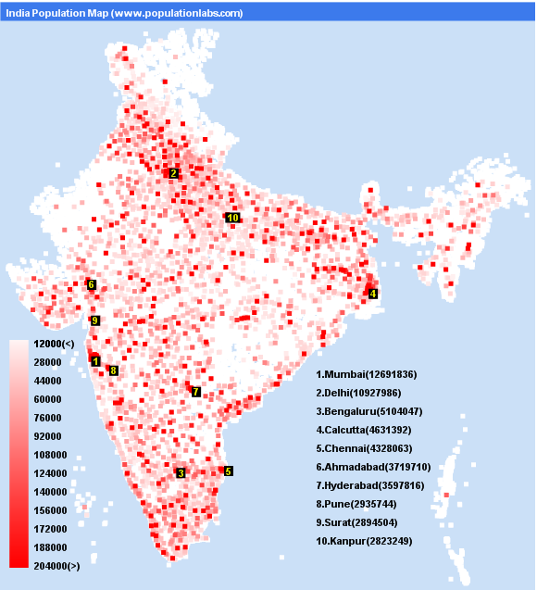
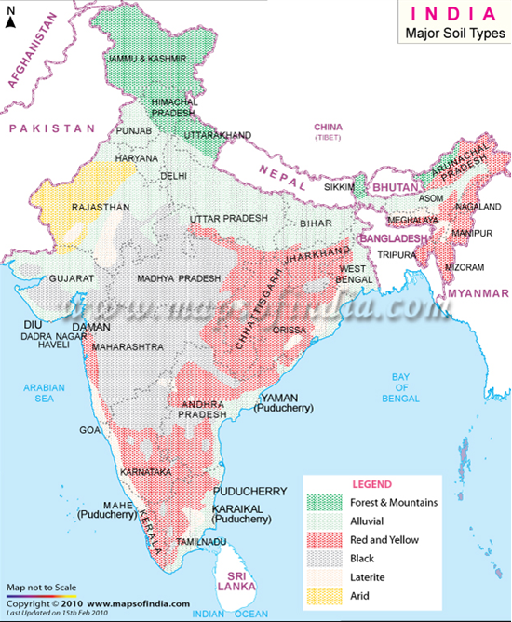
Here are some other uses of maps:
Political Information
Show population
Show ground/soil information

Slide 4
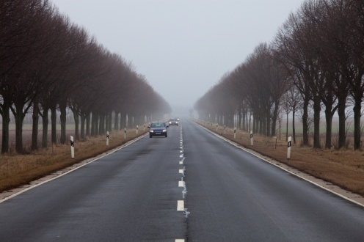


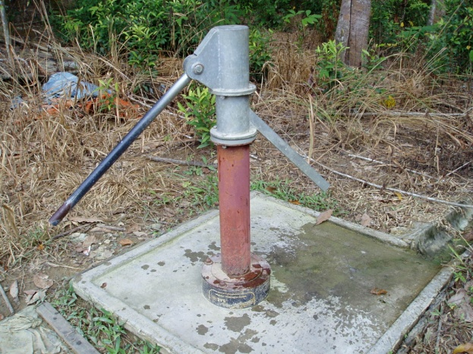
Maps
Who uses them?
Road Users
Farmers
Water suppliers
Everyone

Slide 5

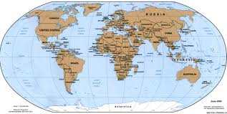
Scale
Maps are scaled down so that they fit on the available paper or screen. When scaling down a map, every part of the map is scaled by the same amount.
There is a fixed relationship or Scale between an actual distance and that shown on a map
There are 2 methods to calculate this scale:

Slide 6
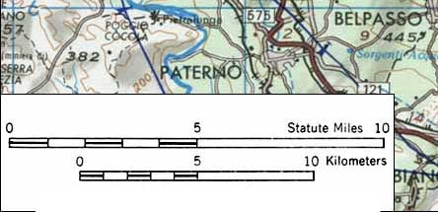
The Graphical Method:
This is easy to use and still counts if the map is enlarged or reduced. There is a measurement drawn at the bottom of the map which represents a certain distance, all other distances can be worked out using this.
The Fractional method
This is when the real distance is reduced to a smaller one using a fixed calculation:
1:25,000 = 1cm to 25,000cm or 1cm to 250m
1,10,000=1cm to 10,000cm or 1cm to 100m

Slide 7
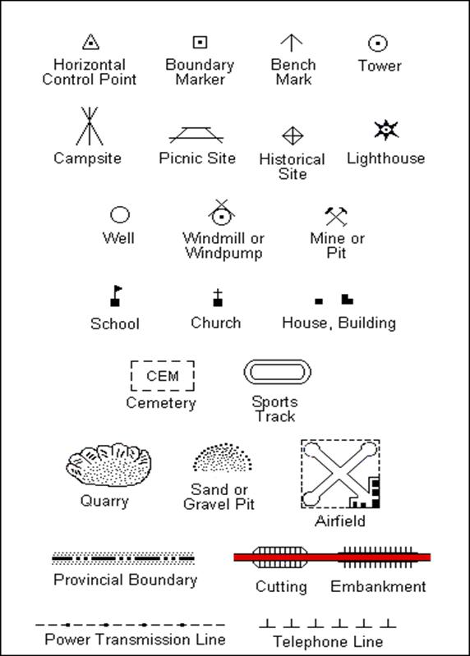
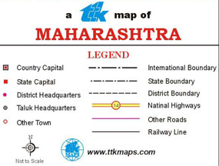
Legend/Key
Direction
N
All maps need a Key to explain what all the symbols used mean

Slide 8
Now it is time for Activity 1!

