Slide 1
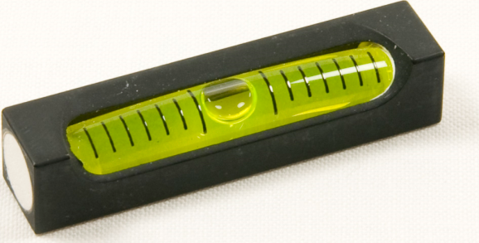

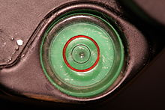
Ways of ensuring something is level
Leveling Tube
Spirit Level
A transparent tube that is filled with water. The water at the two ends will always be level.
Tube incompletely filled with a liquid-normally an alcohol as it has more favorable properties. When it is level the bubble will appear in the center.

Slide 2
Leveling Tube
Atmospheric Pressure
Leveling Tube
Atmospheric Pressure
If a tube is open to air at both sides, the water in the tube will flow until it is has a constant pressure throughout
Pressure due to water = density x gravity x change in height
So water will flow from the high end to the lower end until it is at equal levels thus have a constant pressure throughout

Slide 3
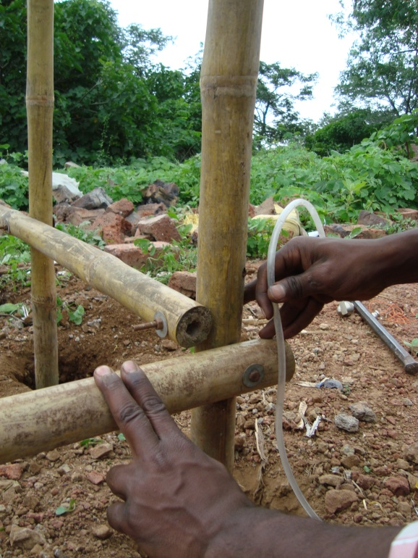
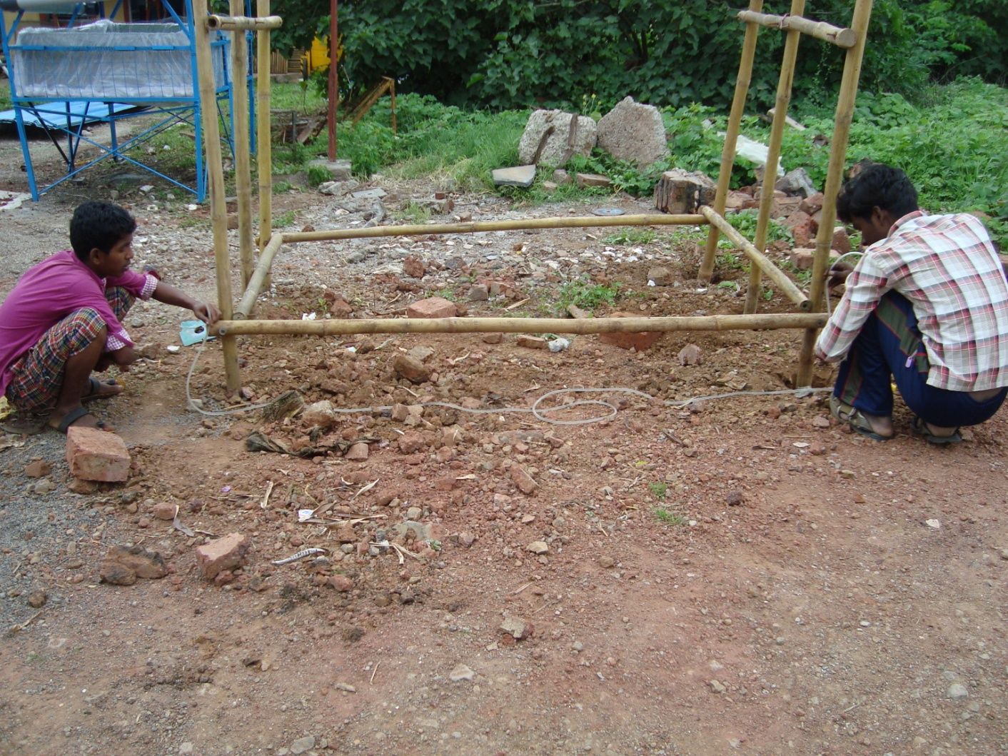
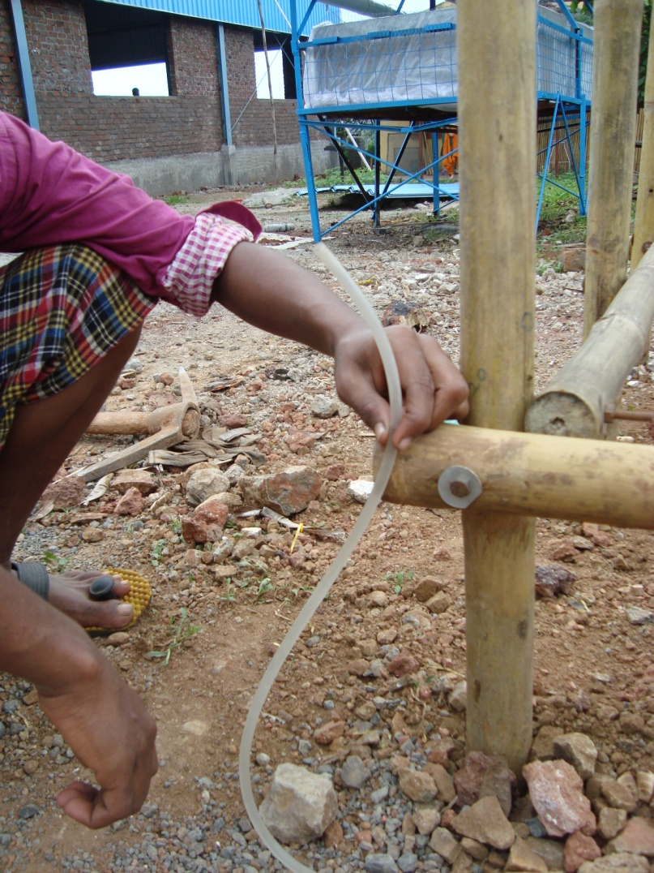
Leveling Tube
Level of water
Level of water
Is this bamboo post level?
The students are using a leveling tube to find out
No, they are not level

Slide 4
Leveling Tube
Level of water
Level of water
What will they need to do to make it level
No, they are not level

Slide 5

Leveling Tube
The owner of this house wants to build a fence around his house
As he lives on a slope he is unsure how he will make it level
He is by himself so he cannot use the leveling tube the way the students just had

Slide 6
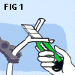
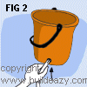
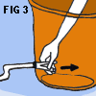
Leveling Tube
How can he use a leveling tube by himself?
He needs the leveling tube and a bucket
Drill a hole in a bucket, smaller than that of the pipe
Spilt the leveling tube, this will allow the tube to fit in the hole
Put the pipe into the bucket
Pull until tight

Slide 7
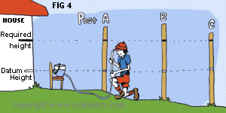
Leveling Tube
This man wants to cut the fence posts to the ‘required height’
But they are not on level ground-how will he know where to cut them?
Now you can measure this difference on these posts
Now you can measure the difference between the datum height and required height
Put bucket of water on chair
Put hose on ground so all air escapes
Mark on the post where the water level reaches
Mark on the other posts where the water level reaches

Slide 8
Spirit Level
Spirit Level
Air is less dense than liquid
Due to the density of the liquid and air
Density= mass =
volume
Kg
m³
Density of air < Density of liquid so the air bubble floats

Slide 9


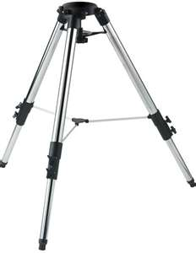
Activity:
Spirit Level/Leveling Tube Practical
Fill the tube with water, ensure that no air gets trapped.
Check if the windows of the Classroom are level with the leveling tube
Use the spirit level to make a level surface on the tripod

Slide 10
Let us return to the lesson plan

