Slide 1
These are the steps you must follow in order to carry out an accurate plane table survey:
Chose a location where you can see all other points of interest
Pace out the area so that you get a feel for what kind of scale you may use.
Set up tripod over this location and get as level as possible
Put on drawing board and ensure level
Secure drawing sheet to the drawing board
Pivot drawing board so that the top of the sheet is aligned with and north and mark on
Mark central point of drawing sheet and apply the plumb line.
Place the alidade on the drawing board with the end with the narrow slit towards your eye and align it so that the rule touches the central point.
Draw a line along the rule in the direction of this point.
Measure the distance from the plumb line to the point of interest. Use a suitable scale to mark on this distance on your drawing sheet.

Slide 2
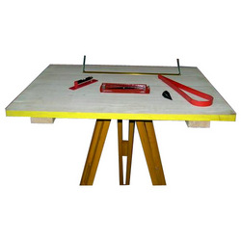
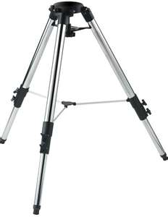

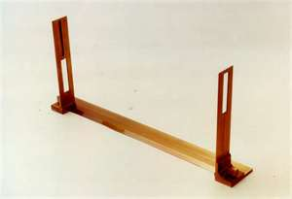
Methods of Plotting
Radiation
B
C
P
Chose a point that you can
see all required positions
A
Notes:
Radiation:
Select appoint p so that all point to be located are visible from it.
Set up the table at p and leveled.
Marked the direction of magnetic meridian with through compass in top corner of sheet.
Select the point p on the sheet so that it is exactly over station p on the ground.
Centering the Alidades on p, sight the various points A, B, C etc. and draw the rays along edge of Alidades.
Measure the distance PA, PB, PC etc. from p to various point with chain or tape and plot them to scale along the co responding rays. Join the points a, b, c, etc. to give outline of survey.

Slide 3
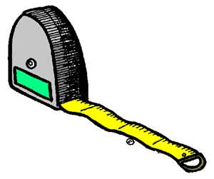
Methods of Plotting
N
Radiation
7cm
B
A
A
Measure with a tape
C
P
70m
Chose a point that you can
see all required positions
A

Slide 4
Methods of Plotting
N
Radiation
7cm
B
A
A
Measure with a tape
C
70m
A

Slide 5
Methods of Plotting
N
5cm
B
Radiation
7cm
B
A
50m
A
Measure with a tape
C
70m
A
Notes:
Radiation:
Select appoint p so that all point to be located are visible from it.
Set up the table at p and leveled.
Marked the direction of magnetic meridian with through compass in top corner of sheet.
Select the point p on the sheet so that it is exactly over station p on the ground.
Centering the Alidades on p, sight the various points A, B, C etc. and draw the rays along edge of Alidades.
Measure the distance PA, PB, PC etc. from p to various point with chain or tape and plot them to scale along the co responding rays. Join the points a, b, c, etc. to give outline of survey.

Slide 6
Methods of Plotting
N
5cm
B
4cm
Radiation
C
7cm
B
A
50m
A
40m
Measure with a tape
C
70m
A

Slide 7
Methods of Plotting
N
B
5cm
Radiation
C
4cm
P
7cm
A
1:1000
A

Slide 8
Methods of Plotting
N
B
Radiation
C
P
A
1:1000
A

Slide 9
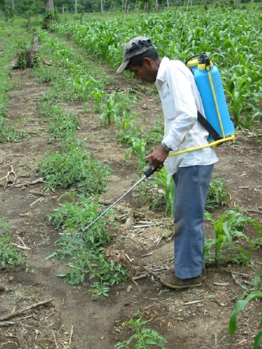

What could we use this map for?
A farmer wants to know how big his field is so he knows how much seed to buy.
1 bag of seed will cover 0.5m²
How will he work out how many bags of seed he will need?
You must find the area of the field from the scale drawing
Convert it using the scale into the real life area
Divide this area by the area 1 bag of seed will cover

Slide 10
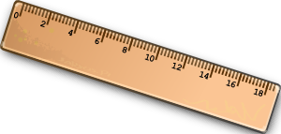
What could we use this map for?
The area of a square is hxb
N
The area of a triangle can be found by 0.5xhxb
B
Radiation
h=9cm
C
P
9x8 = 72 =36 cm²
2 2
b=8cm
A
1:1000
A

Slide 11
What could we use this map for?
As the scale is 1:1000
36 cm² on the map=36cm² x 1000 in real life
So in real life the area is 36000cm²
Or 3.6m²
N
B
Radiation
So as 1 bag of seed will cover 0.5m²
C
P
We will need
3.6m² = 7.2 bags of seed
0.5m²
So the farmer will need to buy 8 bags of seed to cover his field.
A
1:1000

Slide 12
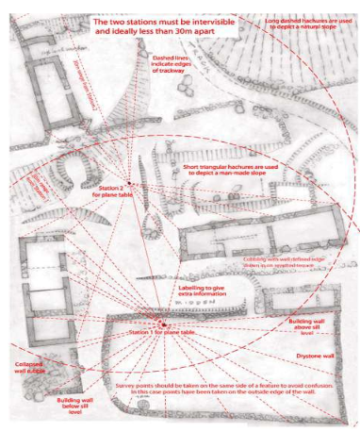
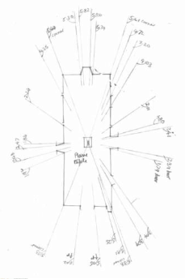
Other examples of Radial Plotting
Notes:
http://www.slideshare.net/Azil14/plane-table-in-surveying

