Slide 1
Smokeless Chulha Part- I
Vigyan Ashram
(A center of Indian Institute Of Education)
At. Post Pabal Dist. Pune 412403
www.vigyanashram.com
www.techshala.com
www.renindia.in

Slide 2
Objective
Upon completion of this presentation you will be able to explain how Integral Fuel Container stove types works .

Slide 3
Stove Basics
Cooking stoves powered by liquid petroleum fuels like kerosene usually require a mechanism that vaporizes the fuel and mixes it with oxygen for the fuel to burn efficiently.
Once the fuel is vaporized, it is directed toward a dispersion plate or burner where it is ignited and forms a flame suitable for cooking.
Stoves of this type require priming and preheating before they are ready to use.

Slide 4
Stove types
Basic stove types (smokeless chulha) :
Integral Fuel Container
Kerosene wick stove
Pressure stove
External Fuel Container
LPG stove
Biogas Stove

Slide 5
Stove Types
Integral Fuel Container - This type of stove has the fuel container connected directly to the stove.
Examples: Kerosene wick stove and Pressure stove
External Fuel Container - The fuel container is separate from this type of stove and connected by a fuel line.
Examples : LPG stove and Biogas Stove

Slide 6
Stove fuel types
Liquid
Refined kerosene and alcohol
Gas
Biogas, LPG (Liquefied petroleum gas is a different chemical compound to natural gas even though they are both hydrocarbons. LPG consists of propane and/or butane )
6

Slide 7
Kerosene wick stove

Slide 8
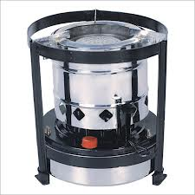
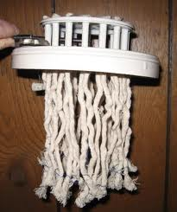
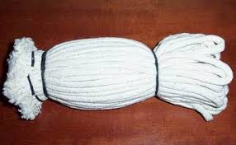
Kerosene wick stove
A kerosene wick stove works much like a candle.
Multi-wick stoves can use thick cotton mop strands as wicks
Kerosene wick stove
Wicks

Slide 9
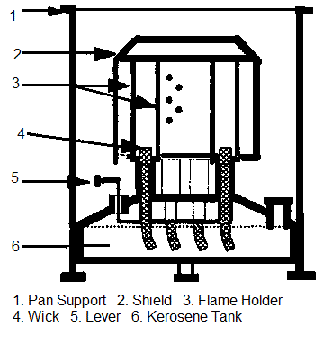
How it works?
One end of a wick rests in a kerosene tank and fuel is drawn up through the wick by capillary action.
A flame is applied to the other end of the saturated wick, igniting the fuel and drawing more fuel into the wick, thus maintaining the flame.
Many kerosene cooking stoves have multiple wicks to provide a broader, hotter and more consistently heated cooking area.
Kerosene Wick Stove internals :

Slide 10
Kerosene Pressure stove

Slide 11
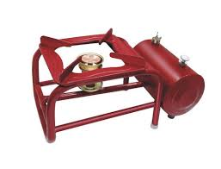
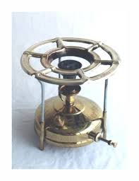
Kerosene Pressure stove
This type of stove uses pressure and heat to vaporize the kerosene before ignition.
Main advantage of the pressure stove over wick stove is it is more efficient and does not produce dirt. Because it does not use wick.
Kerosene Pressure stove

Slide 12
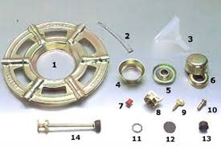
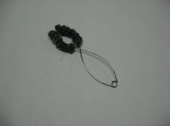
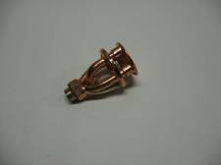
Pressure stove parts
Top plate Cleaning needle Fuel funnel Flame ring Spirit cup Flame ring for the silent burner Leg shoe Tank lid Air key Pump valve Burner washer Tank lid washer Pump washer Pump rod complete Pre-heating wick Burner
15
16

Slide 13
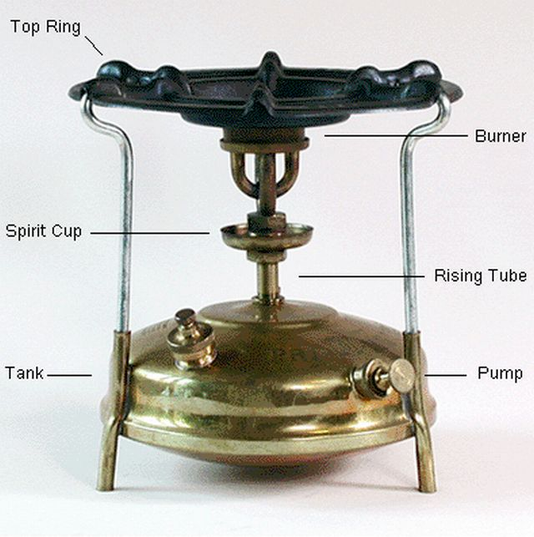
How it works?
1. A typical kerosene pressure stove is fed fuel from a tank under pressure; fuel pressure is created by gravity, a hand pump
2. Burner assembly is pre-heated in a circular "spirit cup" just below the burner.
3. Fuel for heating is either introduced from the tank's fuel line or poured directly by the user

Slide 14
How it works ?
4. As the initial flame burns, it heats the fuel in the fuel line to its boiling point, and the fuel begins to vaporize
5. When a valve on the fuel line is opened, the vaporized fuel is forced through a jet toward the dispersion plate, mixed with oxygen drawn in through vent tubes and ignited by the initial flame to create the cooking flame

Slide 15
Thanks

