Slide 1
Smokeless Chulha Part - II
Vigyan Ashram
(A center of Indian Institute Of Education)
At. Post Pabal Dist. Pune 412403
www.vigyanashram.com
www.techshala.com
www.renindia.in

Slide 2
Objective
Upon completion of this presentation you will be able to explain how “External Fuel Container”
stove type works .

Slide 3
Stove Basics
Cooking stoves powered by liquid petroleum fuels like kerosene usually require a mechanism that vaporizes the fuel and mixes it with oxygen for the fuel to burn efficiently.
Once the fuel is vaporized, it is directed toward a dispersion plate or burner where it is ignited and forms a flame suitable for cooking.
Stoves of this type require priming and preheating before they are ready to use.

Slide 4
Stove Types
Integral Fuel Container - This type of stove has the fuel container connected directly to the stove.
Examples: Kerosene wick stove and Pressure stove
External Fuel Container - The fuel container is separate from this type of stove and connected by a fuel line.
Examples : LPG stove and Biogas Stove

Slide 5
LPG STOVE

Slide 6
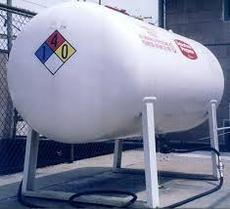
LPG
What is LPG (Liquefied Petroleum Gas ) ?
A clean-burning fossil fuel, Liquefied Petroleum Gas (LPG) is naturally derived from crude oil and natural gas.
Marketed as Propane and Butane, or a combination of the two, LPG is used worldwide in a number of different applications like cooking equipments, fuel for vehicles ...etc.
Origins Of LPG :
LPG results from processing natural gas and refining crude oil.
About 60% of the world’s LPG is obtained from natural gas, and the remaining 40% is achieved from refining crude oil

Slide 7
LPG for cooking
LPG is used for cooking in many countries for economic reasons, for convenience or because it is the preferred fuel source.
Approximately 30% Indian households use LPG which is supplied to their homes either in pressurised cylinders or through pipes

Slide 8
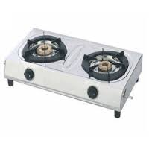
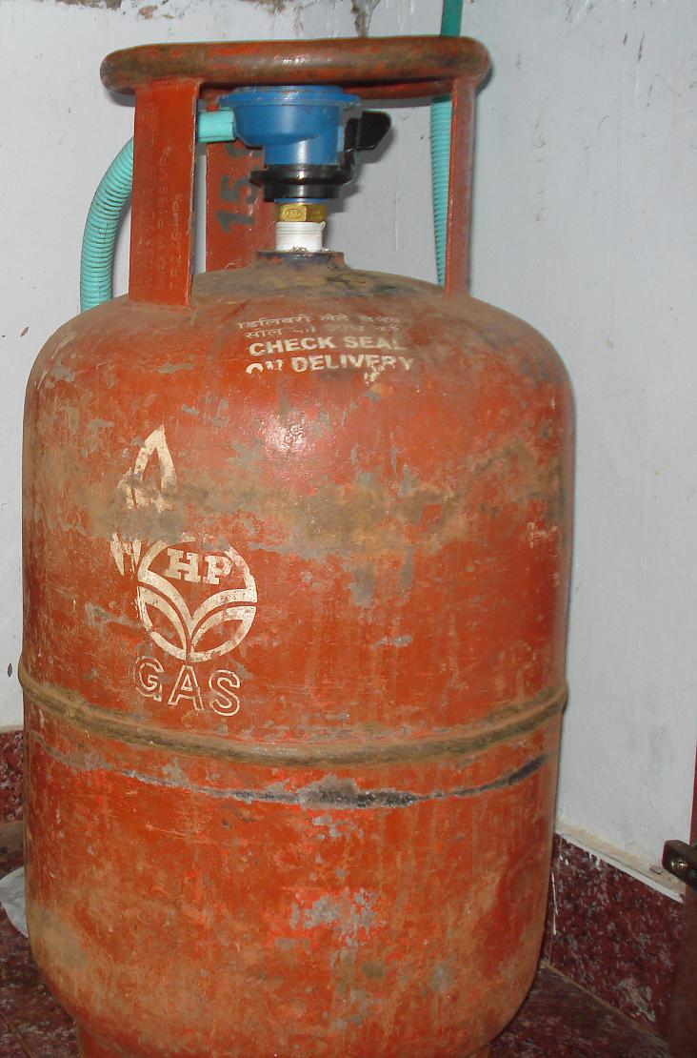
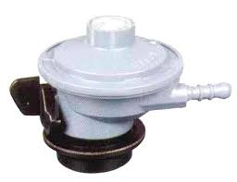
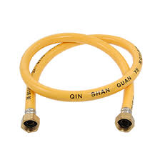
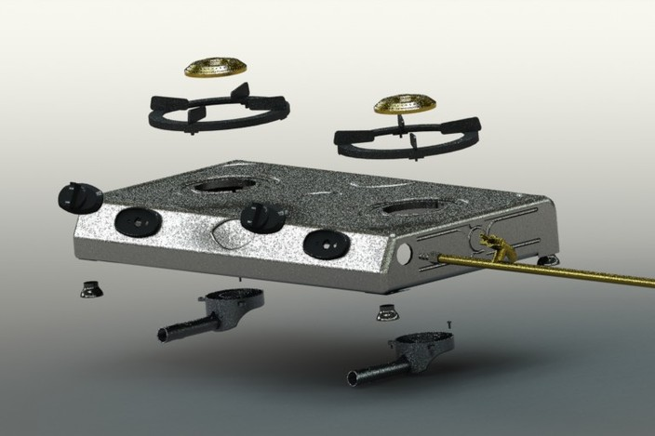
LPG Stove Accessories
LPG Stove
Regulator
Rubber tube
LPG Cylinder with regulator and rubber tube

Slide 9
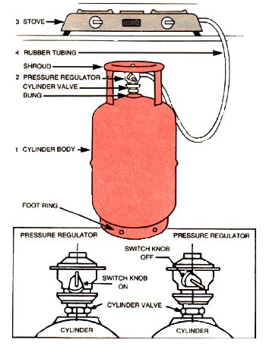
LPG Stove Connection

Slide 10
How regulator works ?
Regulators have a diaphragm, which is a flexible rubber disc that responds to pressure changes and functions to regulate the flow of gas to the proper pressure.
The diaphragm works in combination with springs and other parts within the regulator.
It also works in conjunction with the regulator vent which allows the diaphragm to move freely.
If the vent is obstructed, the diaphragm will not operate properly. The vent should remain free of dirt and debris to ensure the regulator operates correctly.

Slide 11
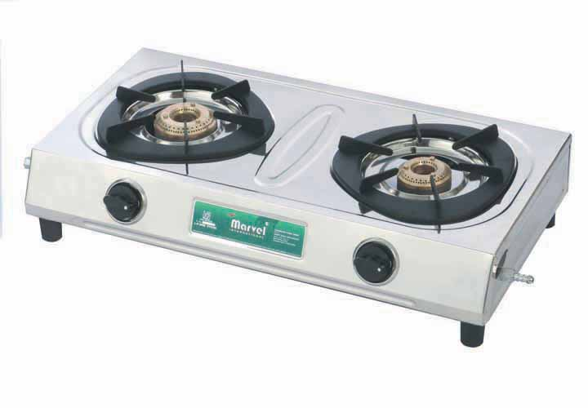
LPG Cooking Stove
From a health and environmental view this is the best option for cooking
LPG is subsidized by the government of India
A family of 4 cooking uses about 50% less fuel when using gas rather than wood
Many people prefer the taste of food cooked on a wood stove

Slide 12
BIOGAS STOVE

Slide 13
Biogas Stove
A biogas stove uses methane gas for cooking.
Biogas is a natural, clean, burning fuel created from decomposing manure.
It doesn’t produce any smoke unlike charcoal or wood. Therefore, your cooking area will remain clean and you will remain in better health.
Required temperature for bio-gas production is between 32 and 37 degrees Celsius. If the temperature is less than 15 degrees Celsius, no gas will be produced

Slide 14
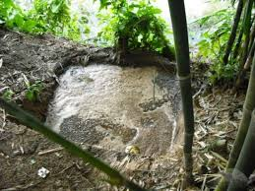
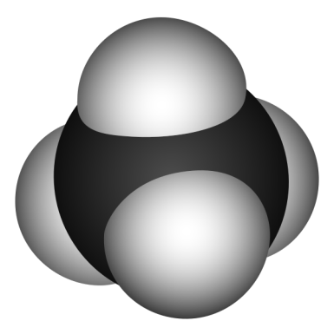
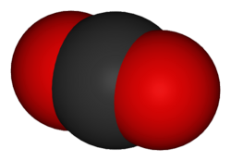
What is biogas?
Biogas is nothing but gas that is made up of methane (CH4) and carbon dioxide (CO2).
A mixture of methane and carbon dioxide
CH₄
CO₂
Methane or ‘swamp gas’, produced naturally in muddy ponds
What is this?

Slide 15
How to produce?
It is created as a by product when organic material decomposes in anaerobic(absence of oxygen) conditions
When the decomposition process occurs in an enclosed environment it can be captured and used as a natural fuel source.
Biogas production for any scale requires a digester and a gas storage tank

Slide 16
How to produce?
Leftover food from houses, shops, restaurants and factories
What types of organic waste could be turned in biogas?
Leftover straw and crops from farming
Cow, sheep and chicken manure
Sewage
Leftover meat and blood from abattoirs

Slide 17
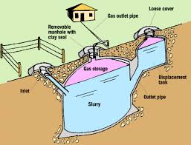
How to produce?
The digester holds the organic waste and water mixture, called slurry, that slowly decomposes to form biogas.
Notes:
Diagram: Practical Action Technical Sheet on Biogas

Slide 18
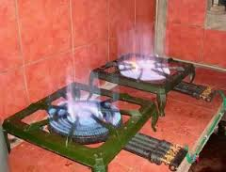
Biogas Stove
Biogas gets generated at atmospheric pressure hence normal LPG gas stove will not work directly on biogas.
You need to remove the pressure reducing pin from the LPG stove to operate the stove on biogas. The efficiency will often not be as good as with a genuine biogas stove

Slide 19
BIOGAS PLANT
Biogas Stove

Slide 20
LPG and Biogas Stove Differences
Compared to LPG, biogas needs less air per cubic metre for combustion (firing). This means, with the same amount of air more gas is required. Therefore, gas jets are larger in diameter when using biogas.
The flame speed is lower with biogas than with LPG. Therefore, speed of gas at the burner heads must be reduced. This can be achieved by conical shaped small holes, but normally, the bottom of the cooking pot functions as a speed breaker for the flame.

Slide 21
Additional information
http://collections.infocollections.org/ukedu/ru/d/Jg33ime/14.html#Jg33ime.14
http://togo.peacecorps.gov/publications/BioGasManual(en).pdf

Slide 22
Thanks

