Slide 1
Stove Maintenance and precations
Vigyan Ashram
(A center of Indian Institute Of Education)
At. Post Pabal Dist. Pune 412403
www.vigyanashram.com
www.techshala.com
www.renindia.in

Slide 2
Objective
Upon completion of this presentation you will be able to explain how to maintain and safely use stoves

Slide 3
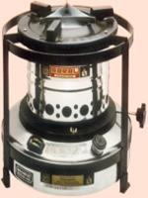
Wick Stove Maintenance
Sufficient air is needed to burn kerosene completely.
Yellow flame indicates that there is an insufficient air
Yellow flame makes utensil black.
Blue flame indicates that kerosene is getting burned completely. Blue flame carries more heat than yellow flame.
Always keep all the wicks at same level. Cut burnt wicks periodically & uniformly.
In wick stove , kerosene gets raised through capillary action.

Slide 4
Safety- Wick Stove
After use of the stove, lower the wick using knob and then cover the wick. DO NOT blow the air through mouth to extinguish the fire.

Slide 5
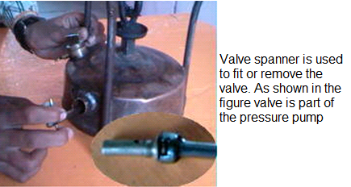
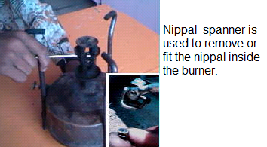
Pressure Stove Maintenance
Use proper tools to open burner and valves

Slide 6
Pressure Stove Maintenance
Few common problems :
Problem 1 : Tank is not holding the pressure. :
Check if the tank has any air leakage.
To check for a leakage empty the tank and apply liquid soap (soap+water) on the outer side of the tank and check for bubbles
Problem 2: After releasing the key, air gets released. This shows pressure is there but kerosene is not going into burner. Might be burner is blocked.
Problem 3: Pressure pump is not developing enough pressure. If pump is moving very easily, then check washer and valves. You may need to replace them.
Problem 4: Gas flame is disturbed or not constant – Clean the nipples.

Slide 7
Safety Measures :
Ensure that water does not enter in the stove tank while cleaning.
Excessive pumping can cause explosion.
Clean the nipple with the pin before use.
Stove tank must be filled with the help of funnel to avoid spills. It should never be filled while the stove is burning.

Slide 8
Safety -LPG Stove

Slide 9
LPG Safety
Liquefied Petroleum Gas (LPG), stored as a liquid under pressure in cylinders, is widely used in homes as cooking gas.
The main hazards associated with LPG are fire or explosion in case of even minor leakage.
LPG being colourless and odourless, a distinctive foul odour is added to enable easy detection of a leak.
As LPG vapour is heavier than air, these vapour accumulate at lower levels and a fire or explosion may result.

Slide 10
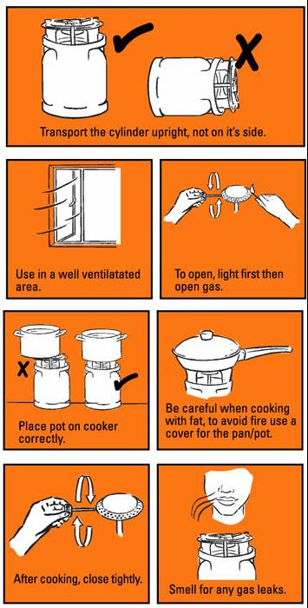
LPG Safety

Slide 11
LPG Safety

Slide 12
Maintenance
Problem : When you suspect there is a gas leakage ? - Some times leaks do not produce gas in a large enough volume to be detected by smell. So use bubble test by applying mixture of soap on all the burner pipes and the rubber tube connected to LPG cylinder.
-Check the fuel supply system. Always inspect the gas line and connections

Slide 13
Maintenance
Problem : Flame is not constant
- Check if the burner holes are blocked. You can use pin to clean the burner

Slide 14
Thanks

