Slide 1
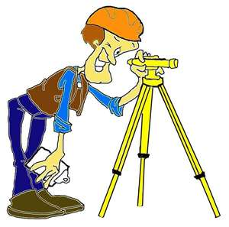
Dumpy Level Surveying
Energy & Environment

Slide 2
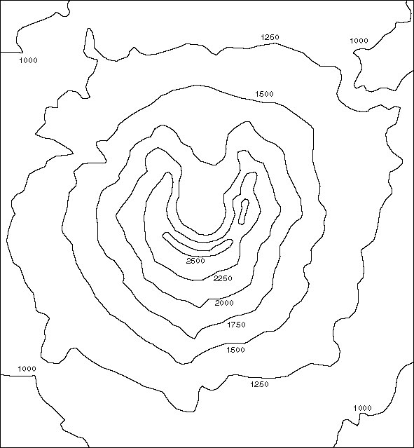
Revision from Previous Lesson
What are these lines called and what are they used for?
They are called contours. They join up similar spot heights
If this map has a scale of 1:25,000 what does this mean?
For every 1cm on the map, it represents 25,000cm in real life or 250m

Slide 3
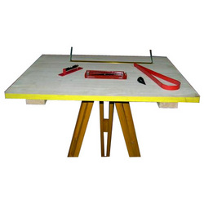
Revision from Previous Lesson
What is this called and what is it used for?
What is this called and what is it used for?
An Alidade. It is used for looking through and drawing a line parallel to your line of sight
A Plane table. It is used for drawing on.
What is this called and what is it used for?
A Tripod. It is used for getting a level surface on rough ground

Slide 4
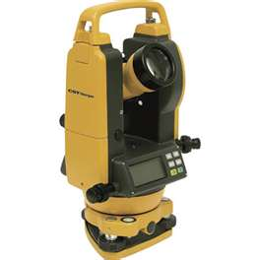
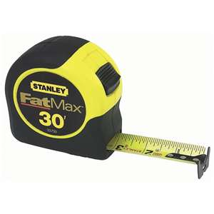
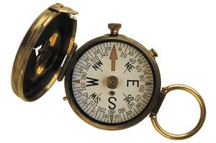
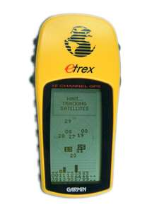
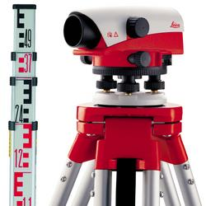
Surveying Tools
Theodelite
Compass
Measuring Tape
GPS
alidade
Plane Table
Dumpy Level
Leveling Staff
Tripod
Tripod

Slide 5

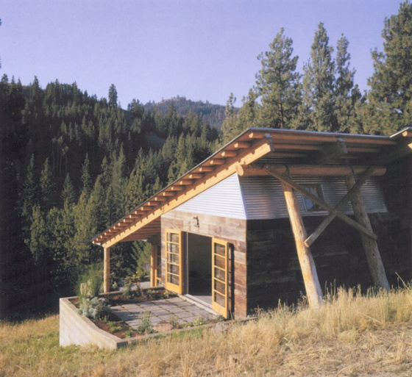
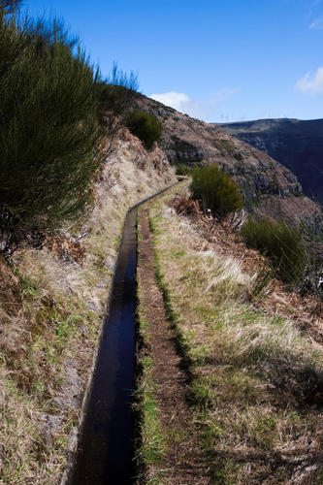
Dumpy Level
What do we use it for?
To find the elevation of a point with respect to a known level.
Why might we want this information?
Water Transportation
Building on a slope
How could we mark this information on a map?
Contours

