Slide 1
Low Cost Housing Ventilation 1

Slide 2
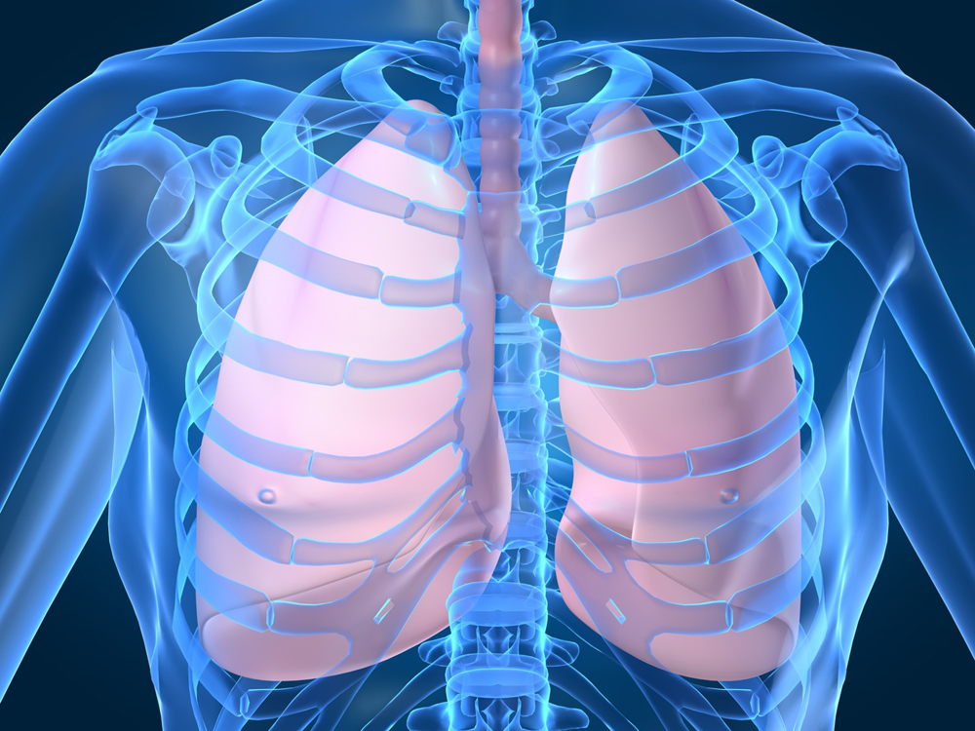
This is the Human ventilation system:
Did you know that all living things have a ventilation system?
Can you guess where it is?
Air in
Air out

Slide 3
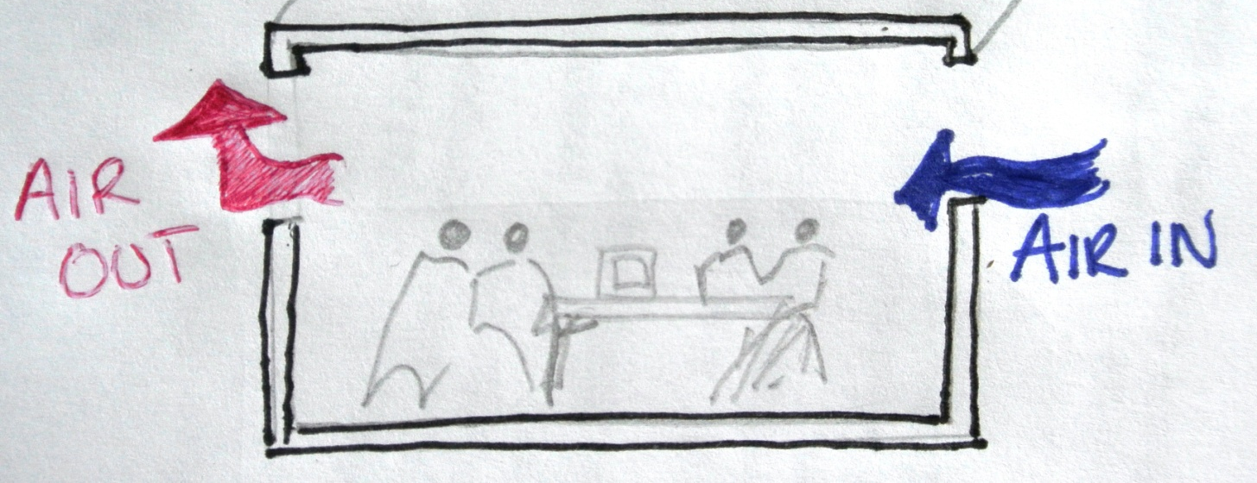
Building Ventilation
As you can see cool air enters and warm air leaves

Slide 4

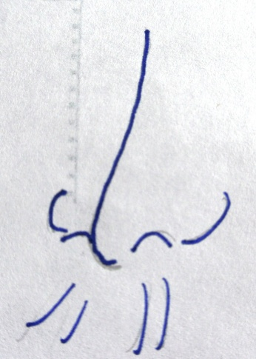
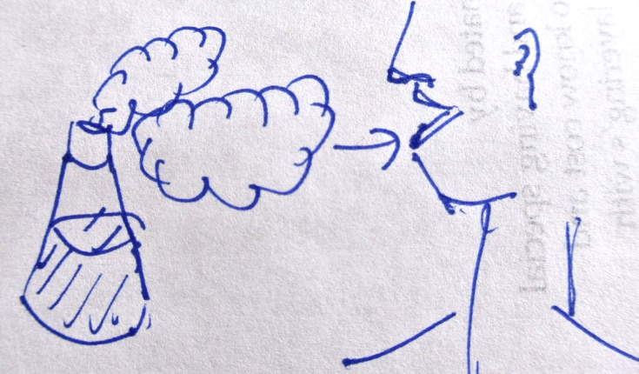


But why do we need ventilation?
When it is too hot we need ventilation to stay cool.
We also need clean air for our health, and to minimise:
Bad smells
Moisture and mould
Intake of air borne chemicals

Slide 5
Ventilation also affects a buildings ecology.
Moisture and mould are examples of factors that affect a building’s ecology . A building changes over time in order to adjust to it’s environment.
Cleaning, sanitizing and maintaining surfaces will also improve the building’s ecology. Maintenance will improve the building’s appearance and allow it to last longer.

Slide 6
Ventilation relies on convection currents.
But what are convection currents?

Slide 7
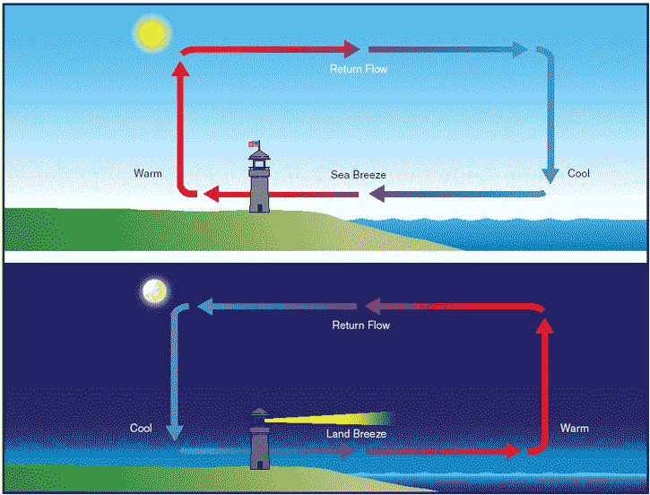
Convection Currents are circular motions of particles that occur when there is difference in air pressure.
This difference in air pressure is caused by hot air particles becoming less dense and therefore rising and cold air particles becoming more dense and falling.
Hot air rises
Cold air falls

Slide 8

Here is an example of ventilation:
Wimbledon Tennis Centre Court, UK
Uses Natural Ventilation and air conditioning
Needed to keep tennis players cool when roof is on
Remember:
Cold air falls
Notes:
At the Wimbledon Tennis tournament held every summer in the UK, the most important games are played on Centre court. In recent years a roof has been constructed on Centre court. In order to keep the tennis players and spectators cool and comfortable a ventilation system was needed.

Slide 9
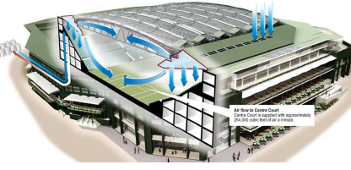
Wimbledon Ventilation System
There are 9 underground water coolers
Cold air enters through vents in the roof

Slide 10
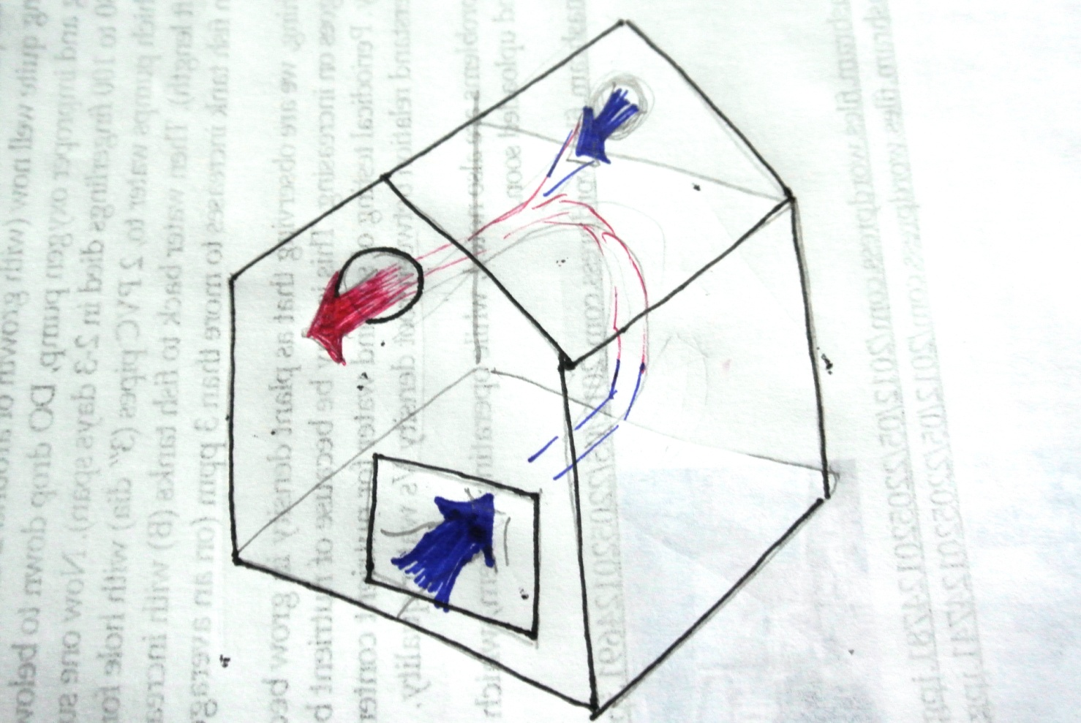
This picture shows a ventilation system in a house. Can you explain this diagram;
what is happening and why?

Slide 11
Thanks

