Slide 1
Low Cost Housing Ventilation 2

Slide 2
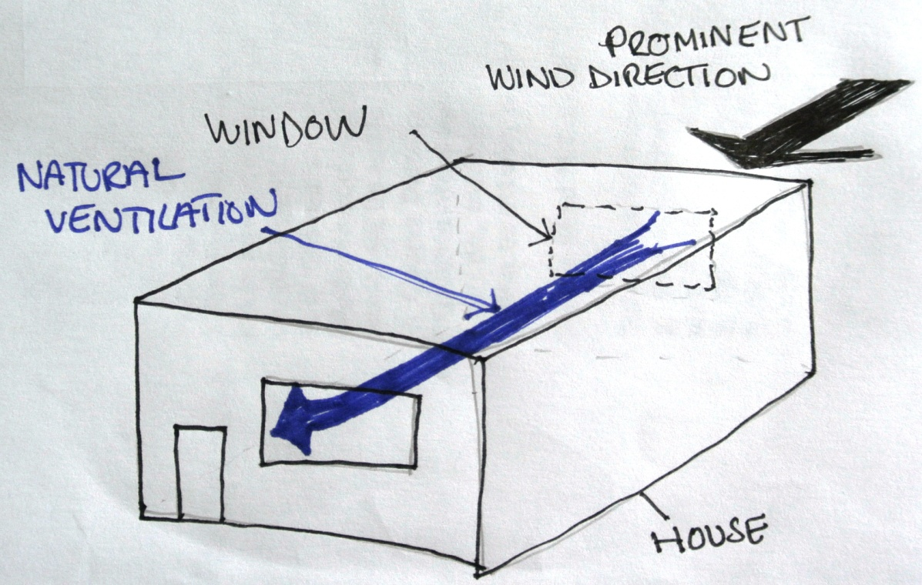
So how will we cool our house?
It is important to consider wind direction.
In India the prominent wind direction is from the North East or the East.
Therefore our house should face that direction

Slide 3
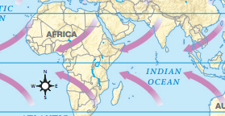
Prominent wind directions
However these change seasonally . It’s best to ask or research wind direction in your area.

Slide 4
It’s now time for an activity!
4
Prevailing Wind Direction
1
3
2
If this was a plan of your house, which windows 1,2,3 or 4 would you open to get the best ventilation? (Hint: You can open more than one.)

Slide 5

If all windows are closed:
4
Prevailing Wind Direction
1
3
2
No breeze (ventilation)

Slide 6
If one window is open:
4
Prevailing Wind Direction
1
3
2
Very little air movement in house

Slide 7
If Windows 2 & 4 are opened:
4
Prevailing Wind Direction
1
3
2
Very little air movement as two open windows are around the same air pressure

Slide 8
If windows 1 & 3 are opened
4
Prevailing Wind Direction
1
3
2
✓
Good breeze (ventilation) through house

Slide 9
If windows 1,2,3 & 4 are opened
4
Prevailing Wind Direction
1
3
2
✓
Good breeze (ventilation) through house

Slide 10
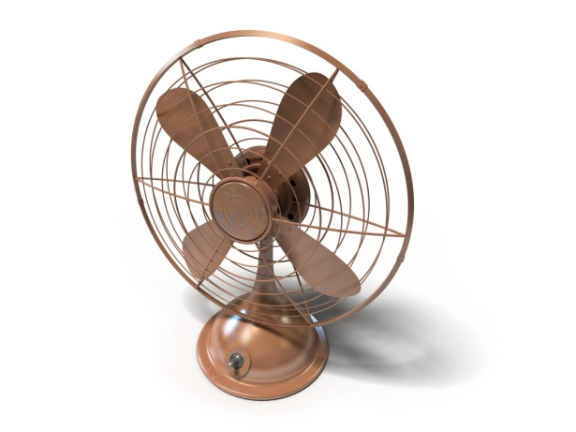
Which direction would you place fan to assist with ventilation?
4
Prevailing Wind Direction
1
3
2
?

Slide 11

Which direction would you place fan to assist with ventilation?
4
Prevailing Wind Direction
1
3
2
Destroys natural ventilation. Aim fan in direction of air flow.

Slide 12
Which direction would you place fan to assist with ventilation?
4
Prevailing Wind Direction
1
3
2
✓
Enhances natural ventilation

Slide 13
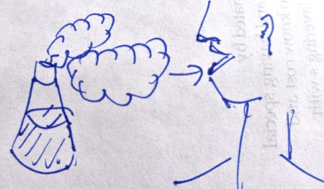
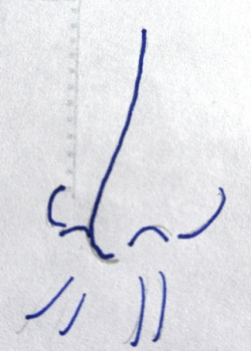


Here is a summary of what we have learnt so far:
Ventilation is important to reduce...
Cleaning, sanitizing and maintaining surfaces will also improve the building’s ecology
It is important to consider:
  The prominent wind direction.
  Positions of windows and whether
they are open or closed
✓

Slide 14
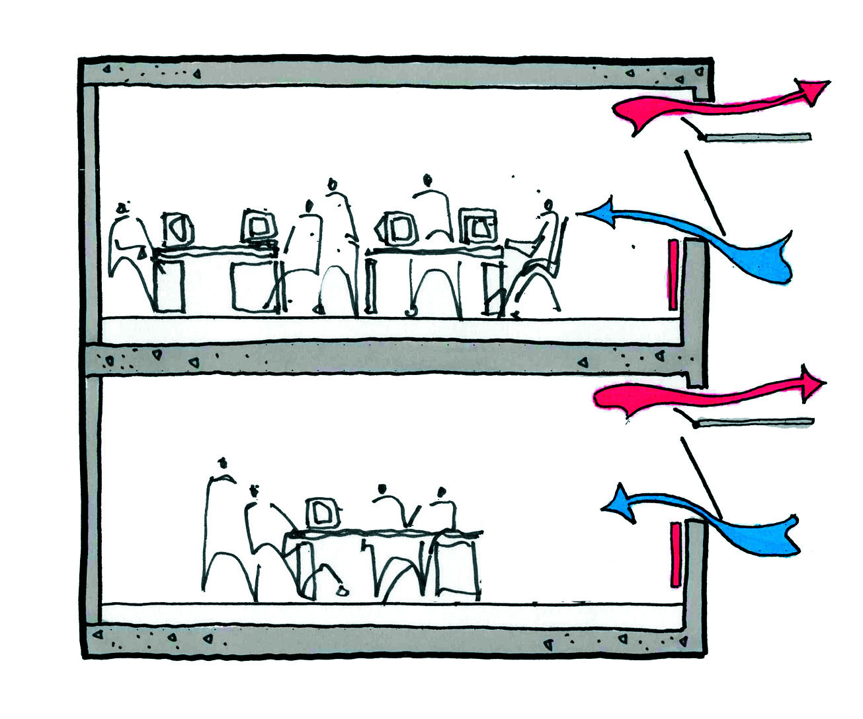
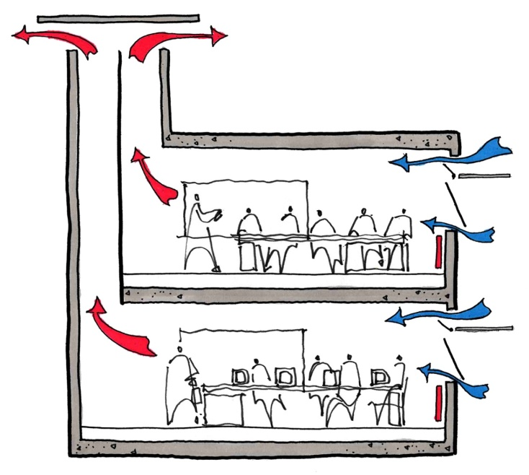
Now lets use what we have learnt so far to answer this question:
Which design do you think is better and why?

Slide 15
Thanks

