Slide 1
Low Cost Housing Ventilation 3

Slide 2
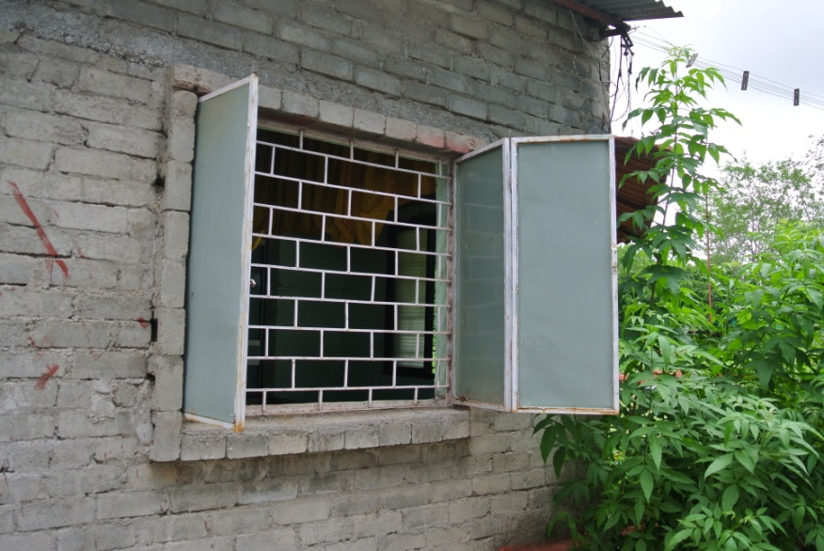
Windows
Do not open or close all windows and doors at the same time.
Optimise the ventilation by experimenting with opening different windows instead.
Experiment and see
what works best in the
morning and evening.

Slide 3
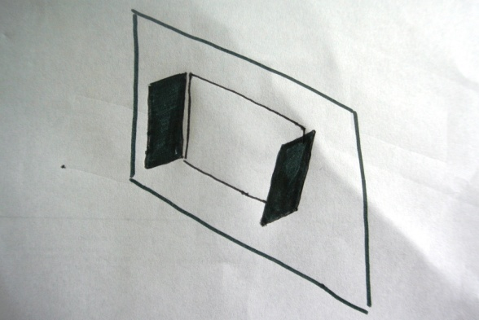
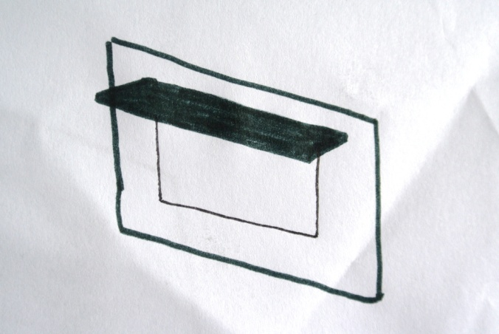
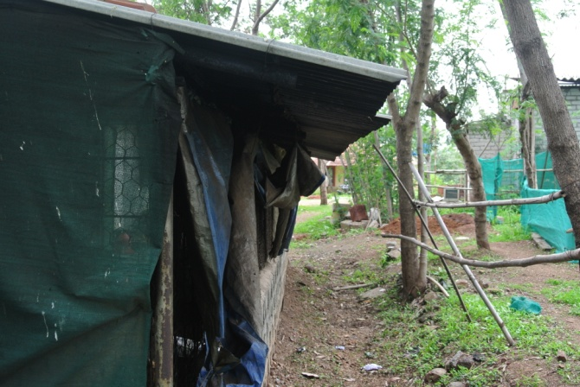
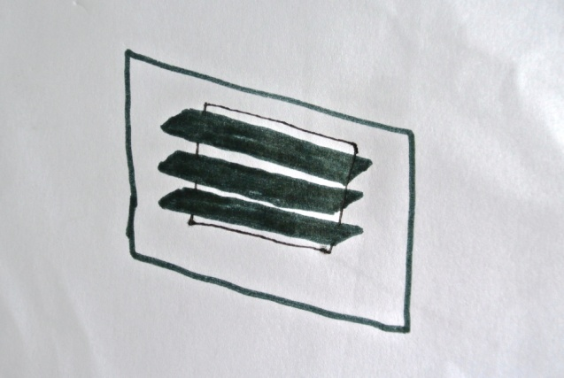
Lighting
To provide shading from sunlight, through windows, you can use:
Side Flaps:
Overhang/ awning:
Louvres:

Slide 4
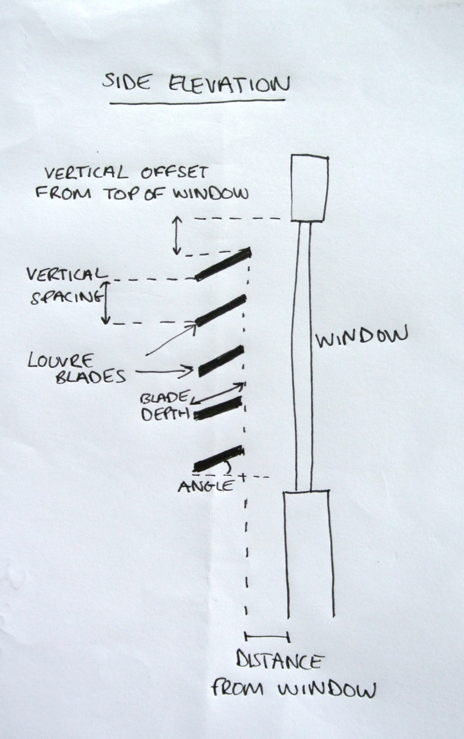
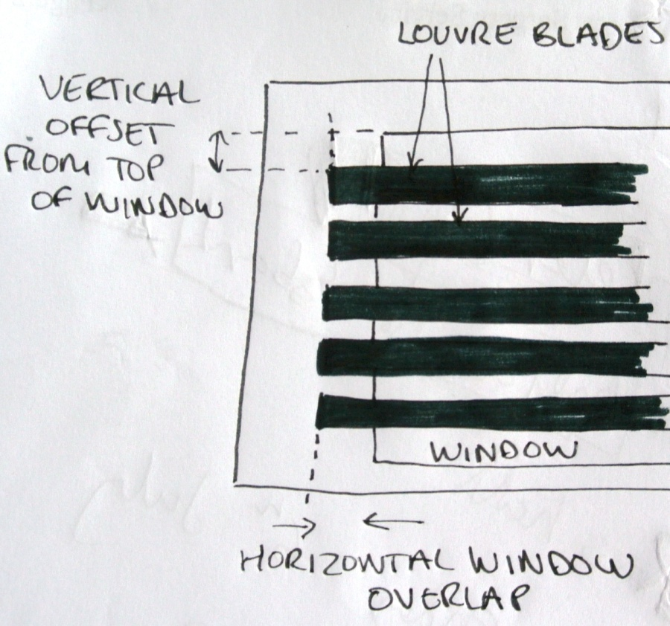
Louvres

Slide 5
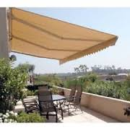
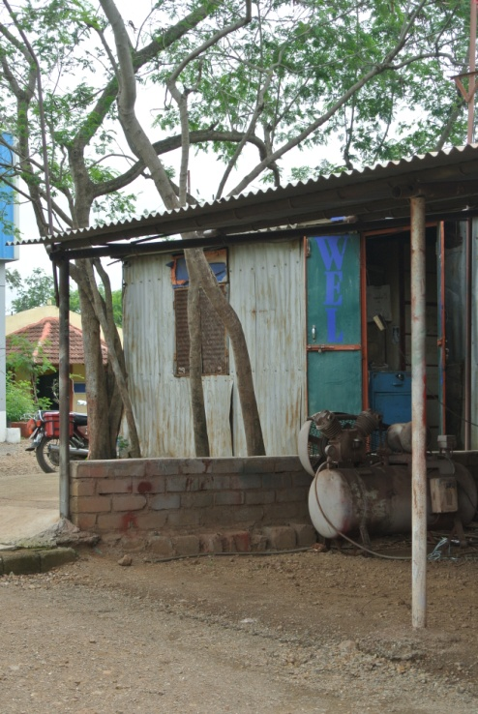
Overhang/ Awnings
There are two types: Manually operated and motorised.
Can be low cost and reduce light entering window or doorway, therefore keeping building shaded and cooler.
Can be constructed using metal or cloth.
Look at this website for more information on the different types of awnings:
http://en.wikipedia.org/wiki/Awning#Types

Slide 6
Here are some useful tips:
Install white window shades, drapes or blinds to reflect heat away from the house
Close curtains on East and North windows during the day
Install overhangs on North and East facing windows.
Use reflective films to cover East facing windows to reduce solar heat gain.
http://www.energysavers.gov/tips/windows.cfm
Measure the walls first:
http://www.surfacematerials.com/info/wacom12.htm

Slide 7
How can you decide the minimum number of windows to put in a room?
Make a list of all the things you think you must consider when trying to calculate this:
The minimum number of windows depends on:
...........................................
............................................
.........................................................................................................
..............................................
...............................................
.................................................
The purpose of the building.
The floor area of the room
The size and position of windows and whether they have blinds or shades.
The number of room occupants
The heat generated by equipment
The heat generated by lighting

Slide 8
Minimum number of windows
This can be calculated using the British Thermal Unit (BTU) which is a measure of heat energy or in Kilowatts (KW)
1KW = 3412BTUs
One BTU is defined as the amount of heat necessary to raise 1 pound (0.454kg) of water 1 degree Fahrenheit (0.55 degrees Celsius). http://www.wikihow.com/Calculate-BTU-Per-Square-Foot

Slide 9
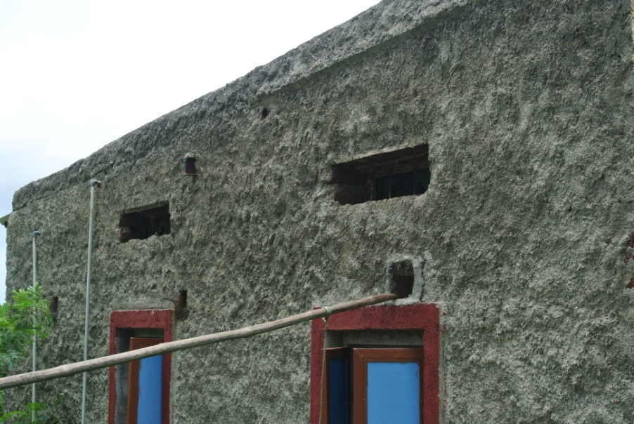
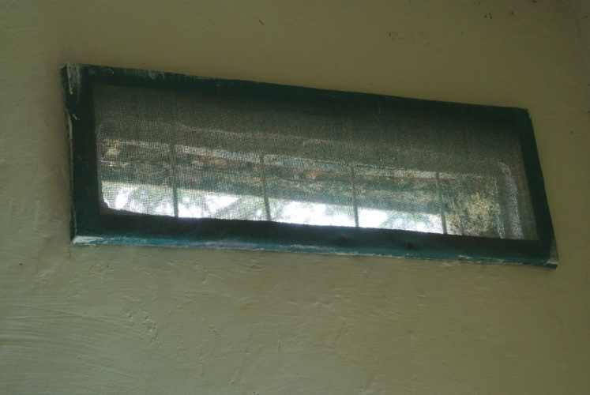
The size of windows is also important.
There should be smaller openings for inlets and larger openings for outlets.
You should make air move over as long a path as possible

Slide 10
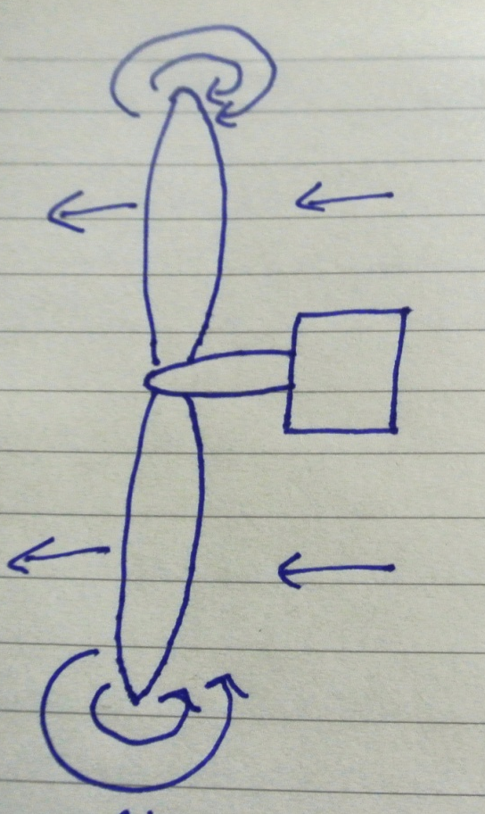


Fans are also a great way to ventilate a room.
Check the efficiency rating when buying.
Ensure your fan has cowling i.e. Covering around centre. Cowling prevents air circling inefficiently around the tip of the blades.
This website has some good information to help you select a good fan:
http://www.dummies.com/how-to/content/choosing-the-right-fan-to-cool-your-home.seriesId-246927.html
✓

Slide 11
Different types of Fan:
Enclosed window fan
Exhaust fan
Avoid oscillating fans
Box fans are portable
Ceiling fan
Wall mounted fan – can be more effective than ceiling fan when walls are made from tin.

Slide 12
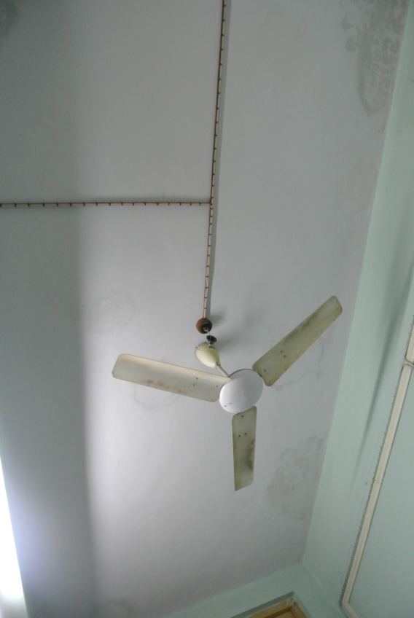
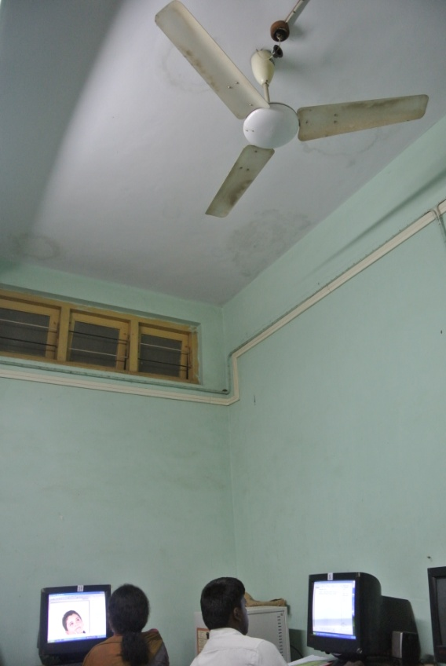
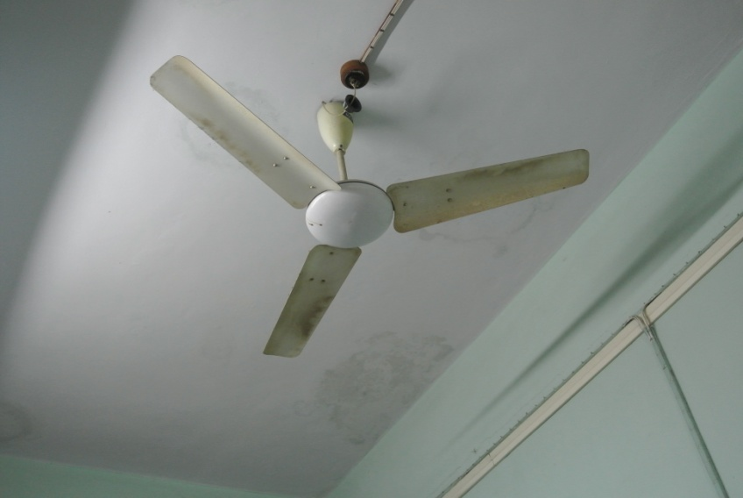
Ceiling Fan

Slide 13
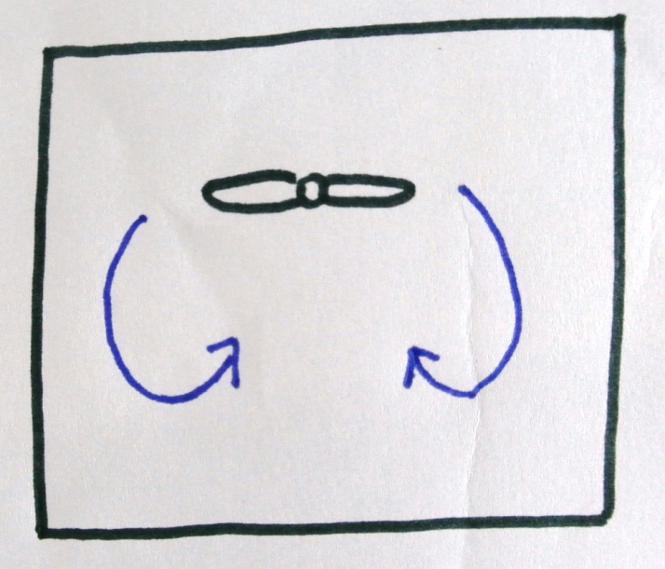
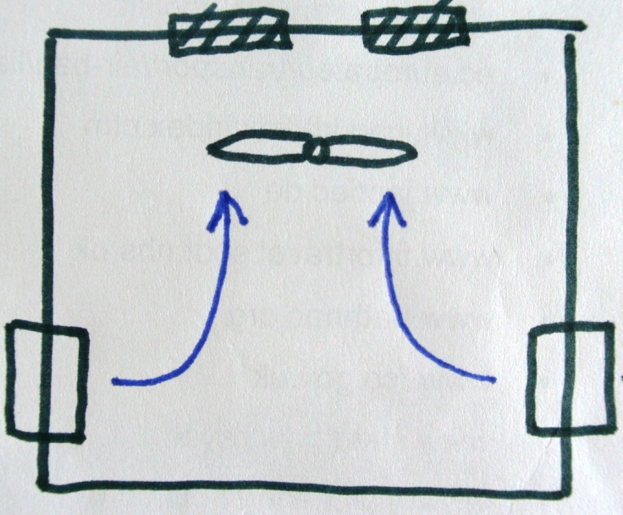
Ceiling Fan
Enclosed space
Ceiling fan can provide good air circulation
Ceiling fans work best if they are8-9 feet above the floor and 10 – 12 inches below the ceiling
Air Vents
Ceiling Fan
Window
Air travels from windows through the fan and then out through the vents. This is an example of good ventilation.

Slide 14
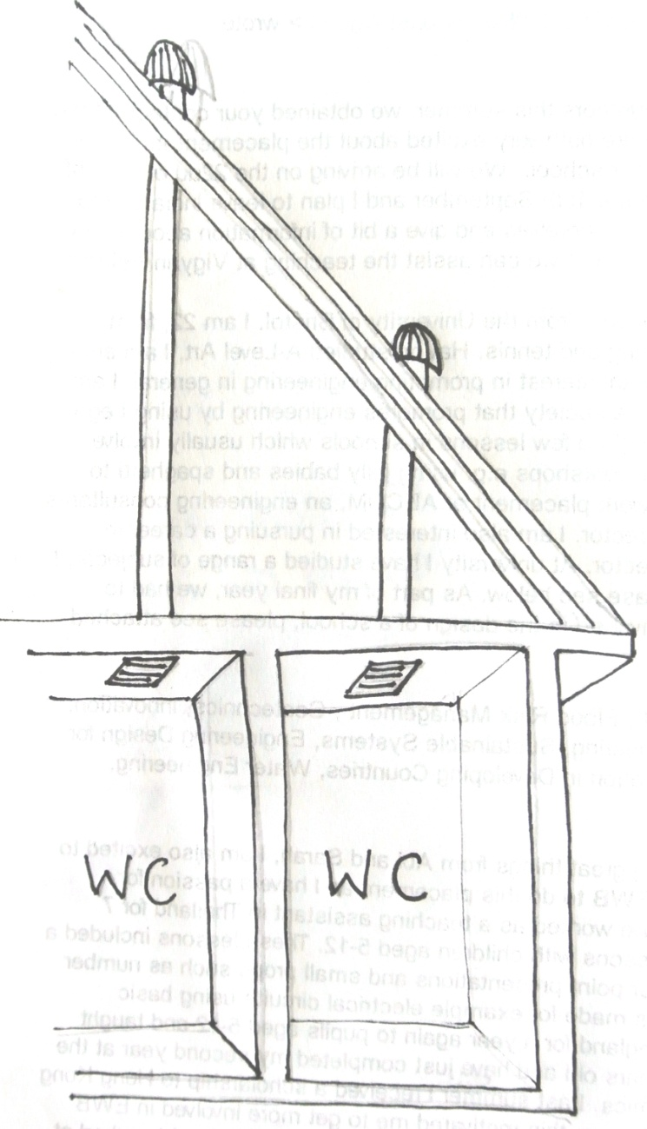
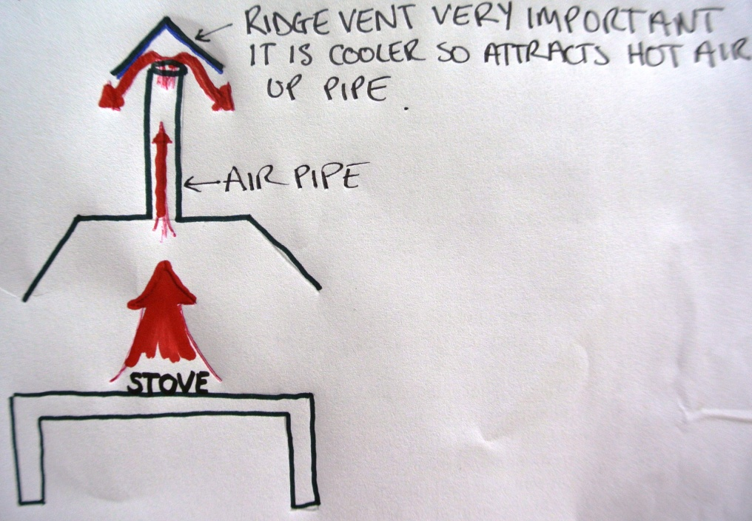
Air pipes are also a great way to ventilate a room.
These are good for enclosed spaces, especially kitchens and bathrooms.
Kitchen are usually the hottest area of house.
Gas is often needed to be removed from kitchen.
They us the chimney effect

Slide 15
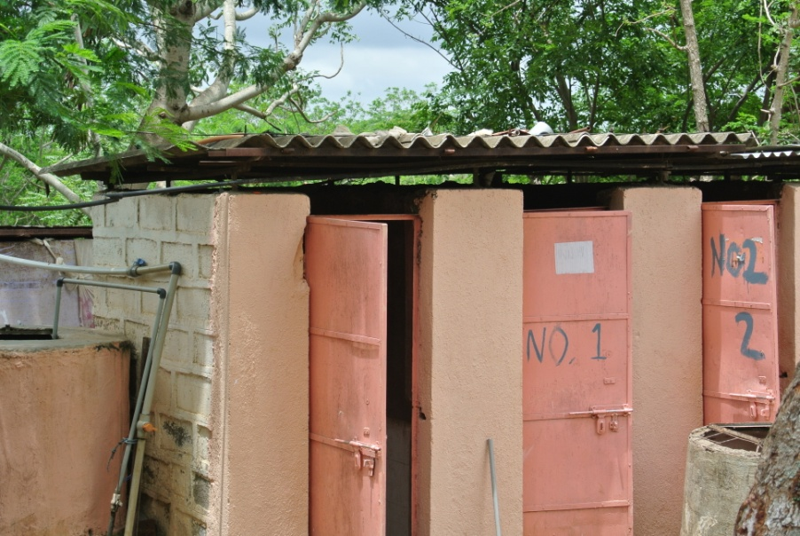
Bathrooms
If air pipes are not appropriate, then allowing a roof gap instead would provide ventilation.
This is only appropriate for public bathrooms. It is not to be used in homes.

Slide 16
Thermal mass
The sun is the most important source of thermal energy
Thermal mass is similar to ‘heat capacity’
Any gas, solid or liquid has thermal mass.
For buildings, which materials we choose determines the thermal mass of the building.

Slide 17
But why is thermal mass important in a building?
Thermal mass will absorb thermal energy when the surroundings are hot. Therefore making the building cooler.
Thermal mass will emit thermal energy when the surroundings are cool. Therefore making the building warmer.

Slide 18
So good materials to use have:
A high thermal mass and high density.
Concrete, water, ferro-cement, clay bricks, mud bricks, rammed earth bricks, natural rocks and wood all have reasonably high thermal mass.
Glass in windows has low thermal mass.

Slide 19

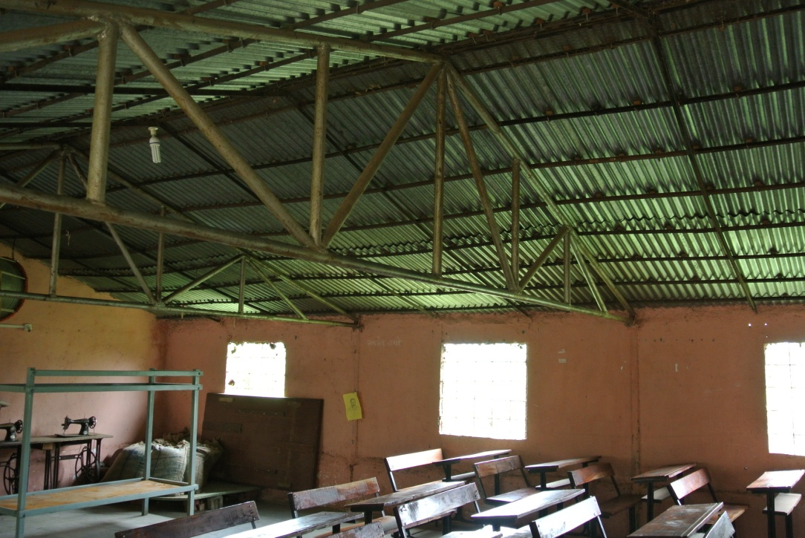
Materials used in Vigyan Ashram
Concrete with a steel sheet used for the roof.
Masonry and tin exterior.

Slide 20
Air holes in materials are also a good way to ventilate a building.
Holes can be deliberately included in walls to aid ventilation. Cost reduction technique called Rat Trap bonds for brick walls developed by Laurie Baker.
Baker has been called the ‘Gandhi of architecture’.
    (Reference : http://en.wikipedia.org/wiki/Laurie_Baker )

Slide 21
Thanks

