Slide 1
Low Cost Housing Ventilation 3b

Slide 2
Glazing
If glass is used in windows it is called glazing or glazed area.
Special considerations are needed as glazing allows sun to heat house.
If the level of glazing is greater than 7% of the floor area, we need to apply the thermal mass ratio of 6-8:1, non-glazed area: glazed area.
I’m confused!
Don’t worry I’ll show you an example that will help you understand

Slide 3
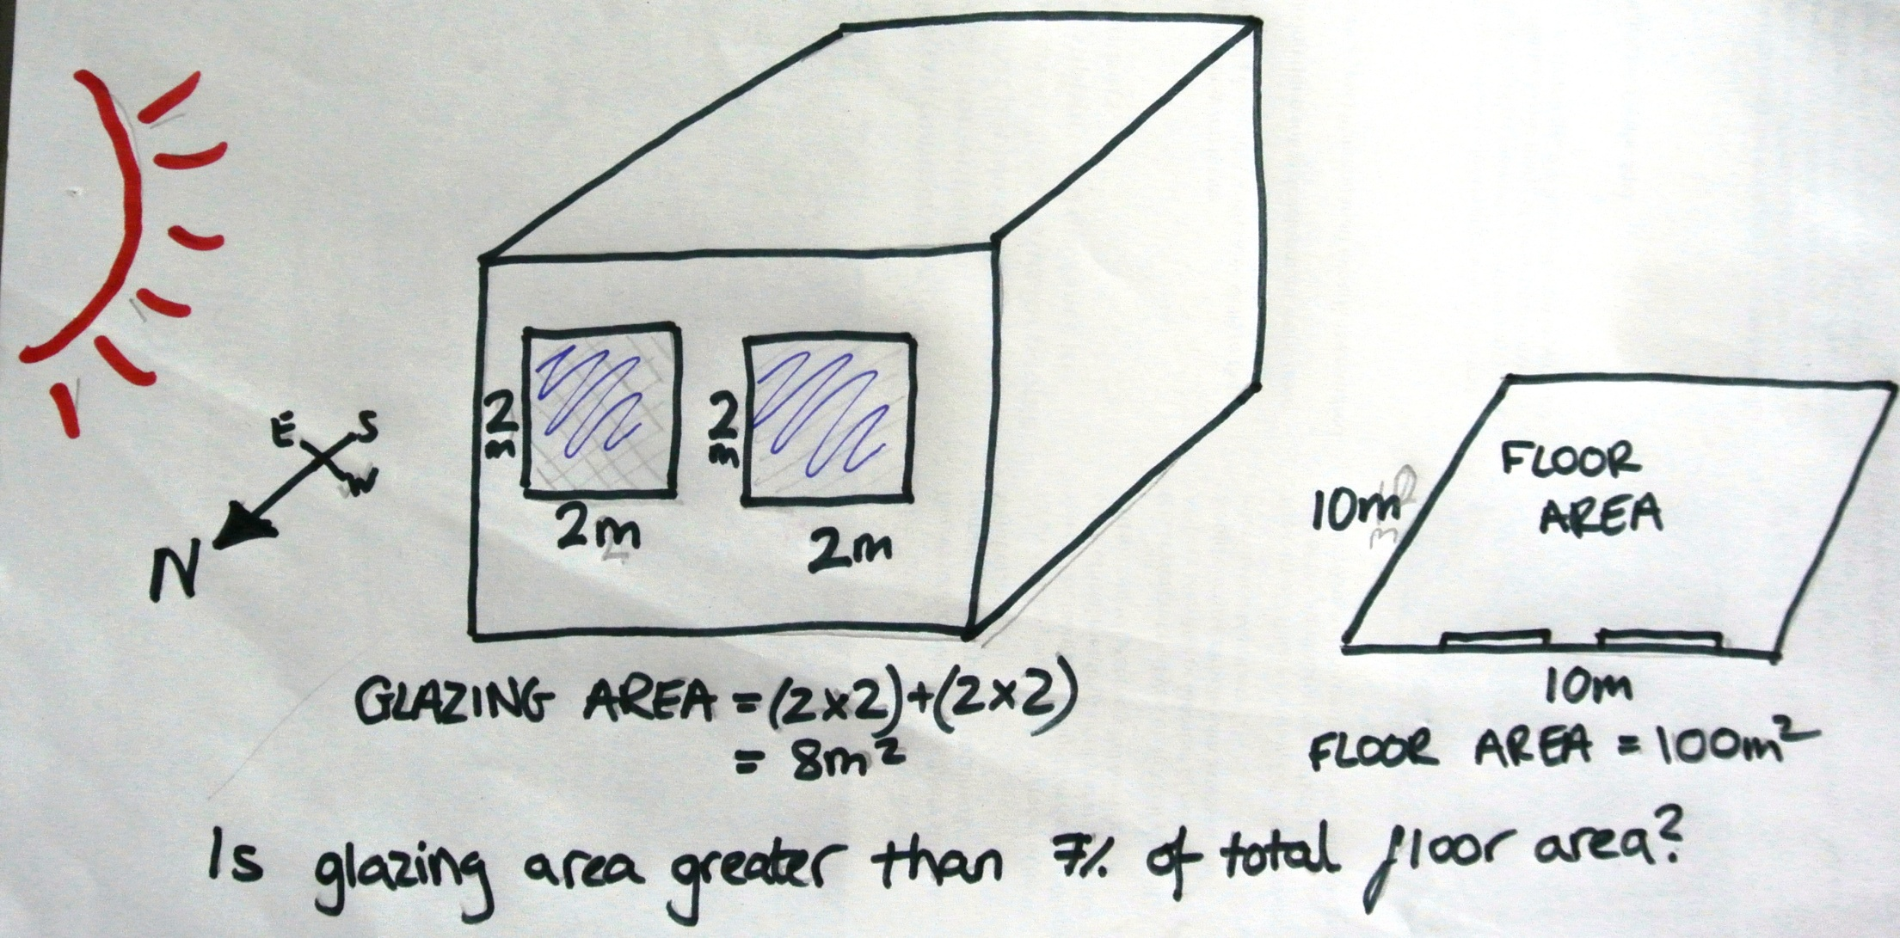
If glass is used in windows:

Slide 4
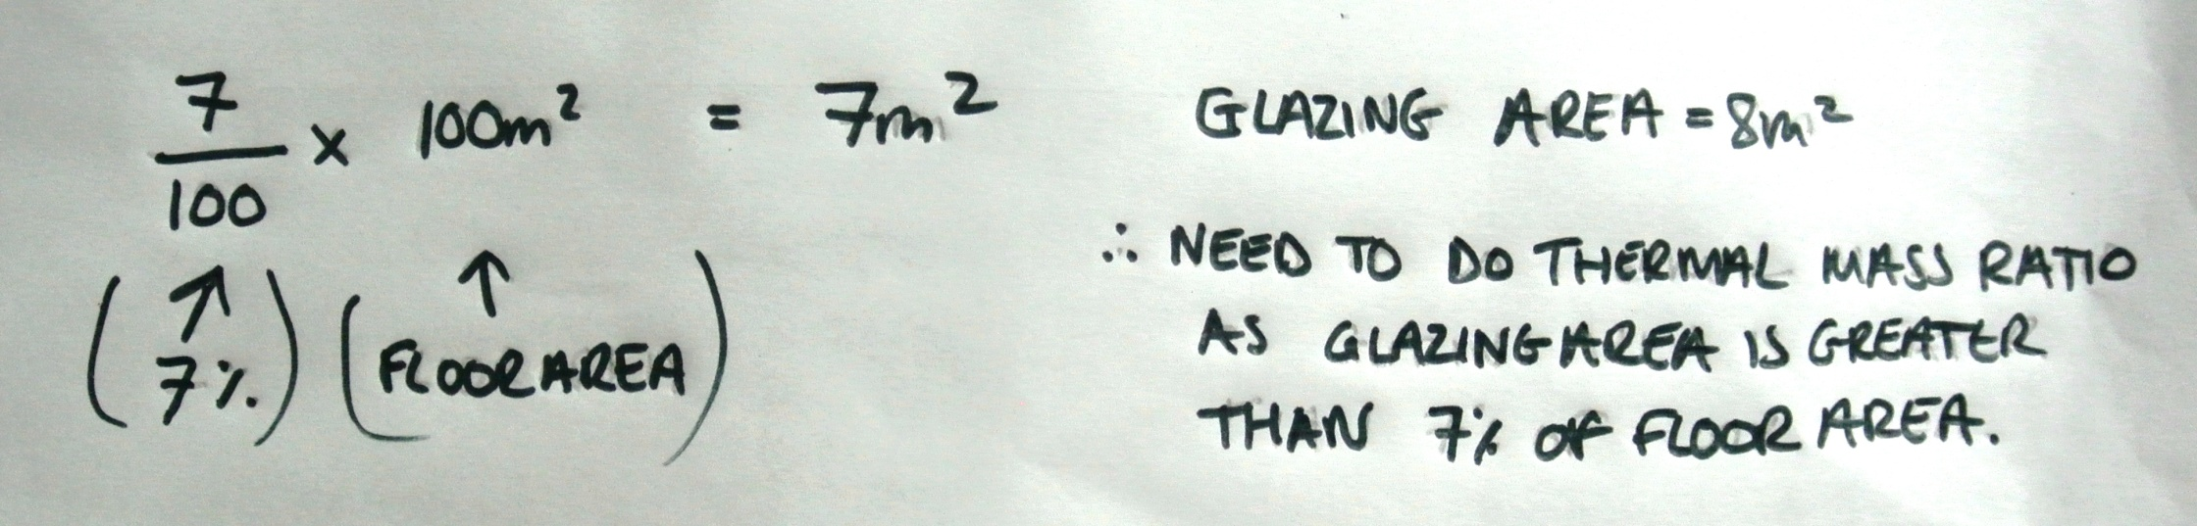
Example...
Thermal mass ratio is 6-8:1, Non glazing material to glazed.
For this example it is assumed the ratio is 8:1
6-8 : 1
Non glazed area : glazed area

Slide 5
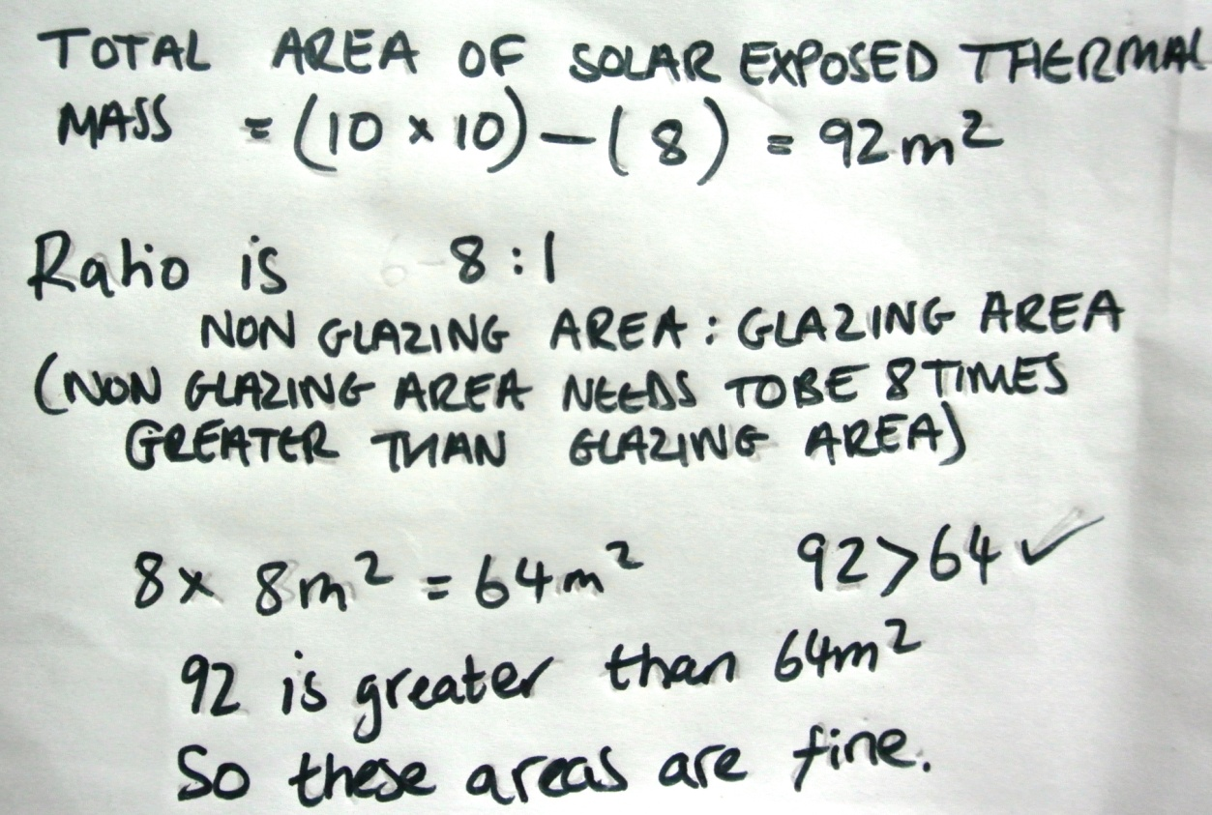
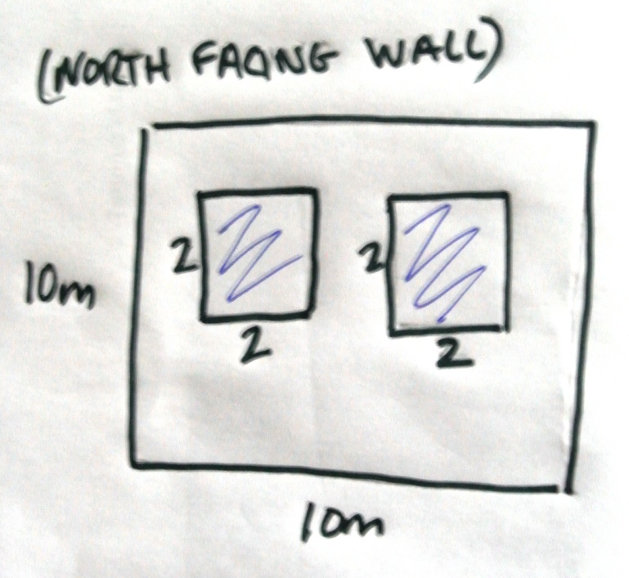
Example...
I hope these examples have made it more clear for you !

Slide 6
Thanks

