Slide 1
Low Cost Housing Ventilation 4

Slide 2
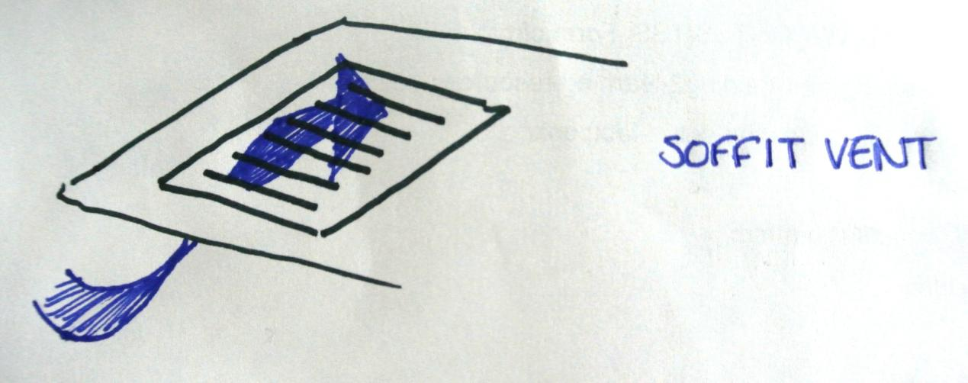
Vents are another great way to ventilate a building.
Vents let hot air out.
Hot air rises so you must put roof vents at the highest point.

Slide 3
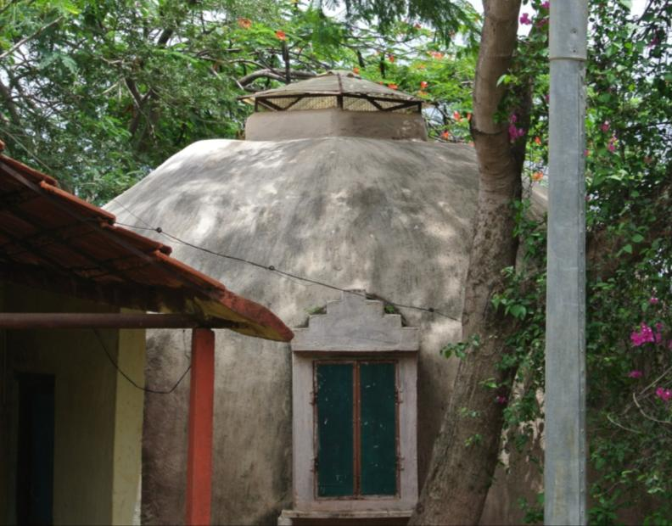
Vent at the highest point

Slide 4
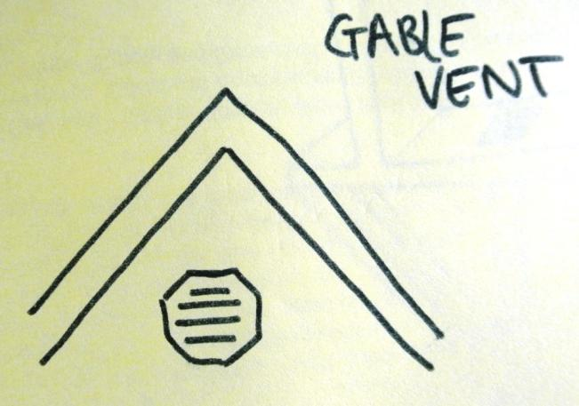
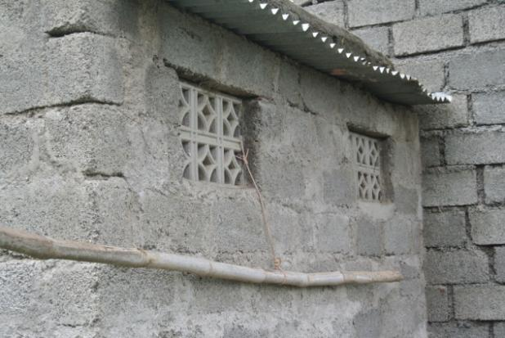
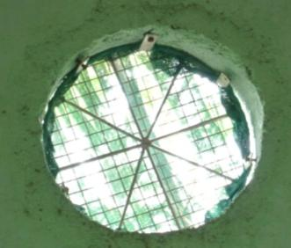
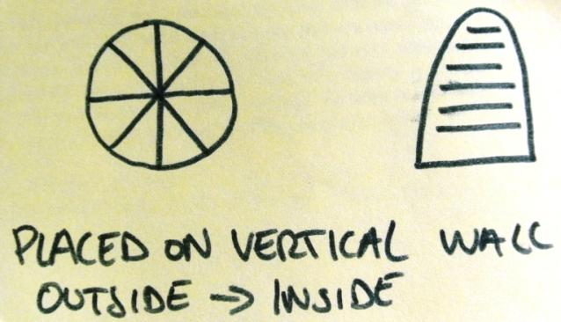
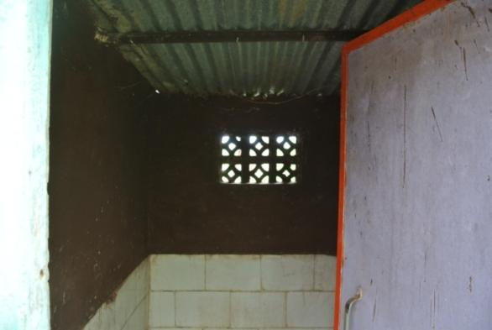
Gable Vents

Slide 5
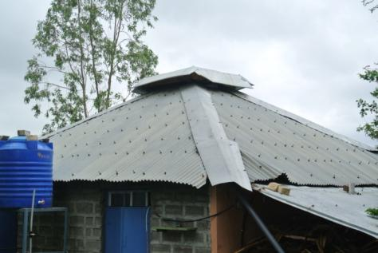
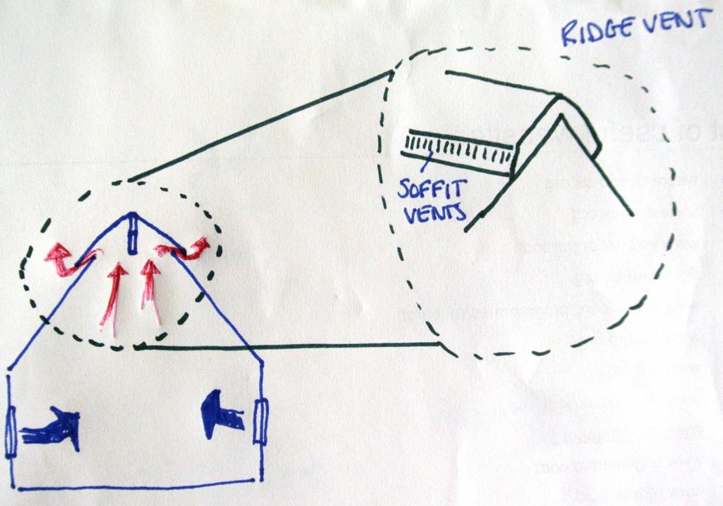
Roof Vents: Ridge Vent

Slide 6
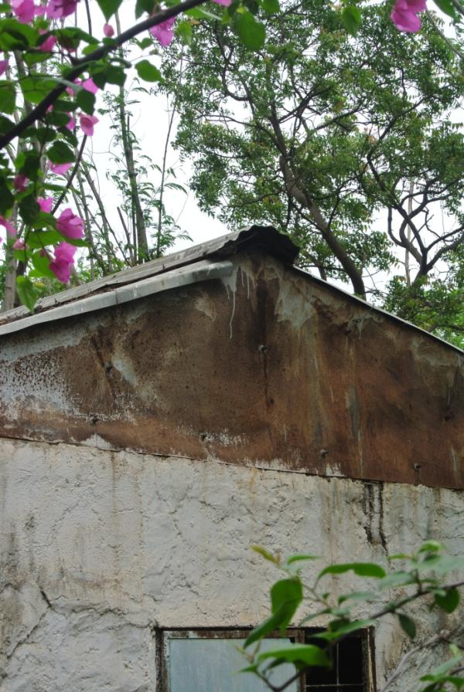
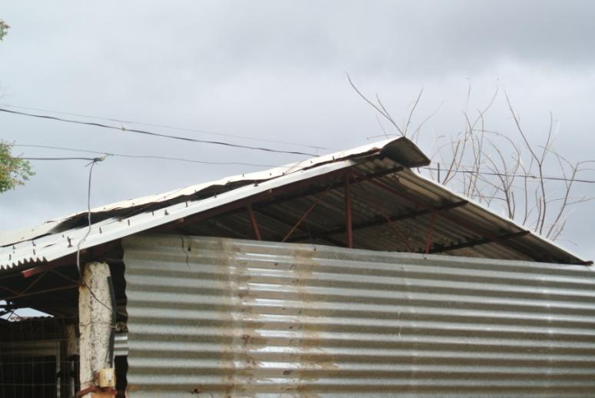

Slide 7
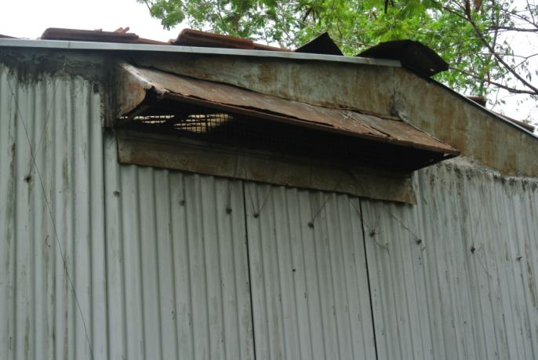
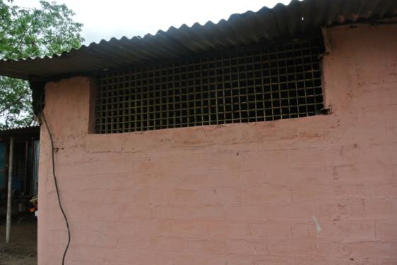
Here are some examples of different types of vent:

Slide 8
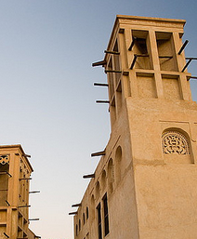
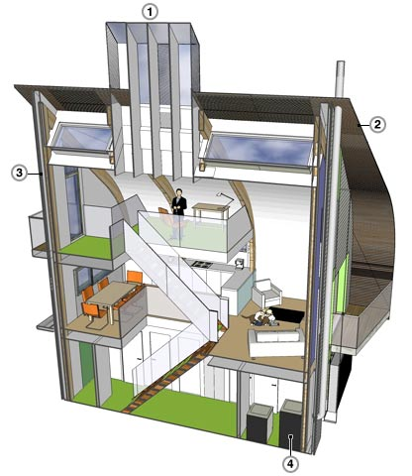
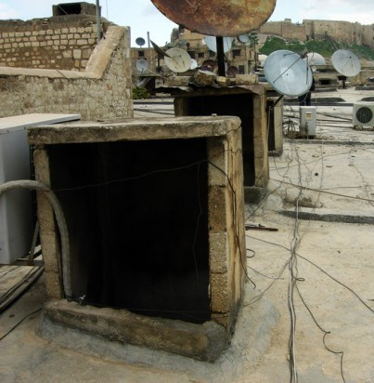
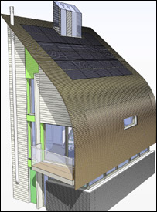
Wind catchers
References for pictures: http://travelogue.travelvice.com/syria/middle-eastern-rooftop-wind-catchers/
http://www.flickr.com/photos/32914117@N04/3327323478/
http://news.bbc.co.uk/2/hi/business/7021477.stm
Used traditionally in Persian architecture.
Tend to have one, four or eight openings.
Dependant on prevailing wind.
Aluminium effective material
Wind Catcher

Slide 9
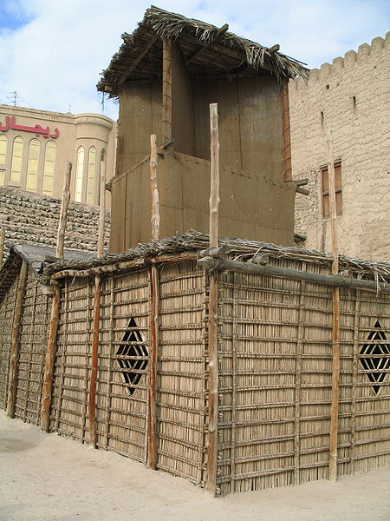
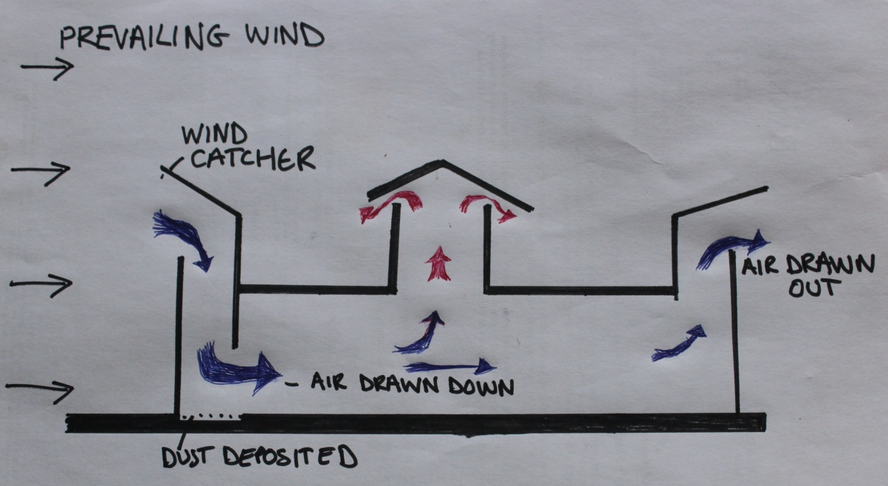
Wind Catchers
Reference: http://en.wikipedia.org/wiki/File:Wind_Tower_Dubai.jpg
Increase in the catcher size to about 1.5 times the size of roof opening produces an increase in average indoor wind speed. Any more than this does not necessarily provide additional benefit.
Location of air supply openings is important
Can use a net or mesh here to prevent dust too.

Slide 10
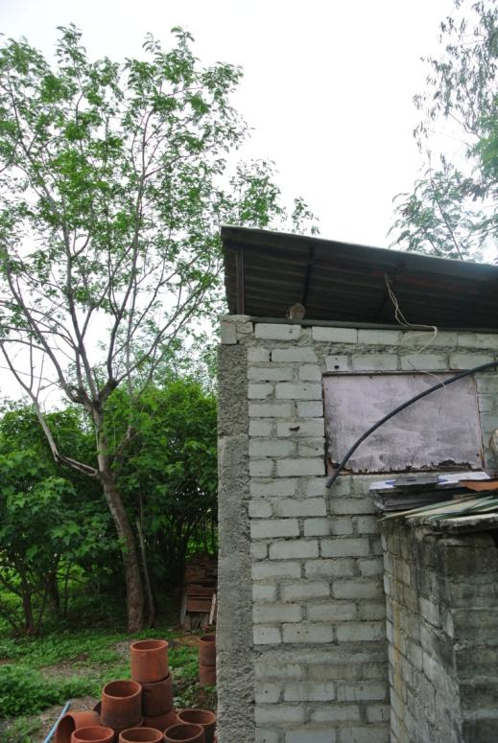
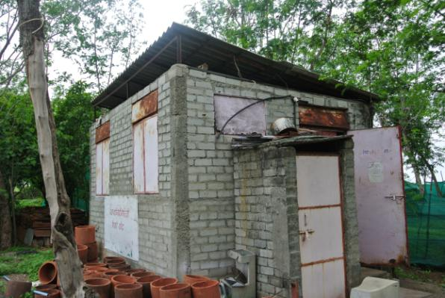
Another good ventilation technique is the double roof technique:
Here 2 layers of roof are used.
The 1st layer absorbs heat and castes a shadow on the 2nd layer . Making the building cooler.
1st layer
2nd layer

Slide 11
On the next few slides we are going to have a look at other techniques for low cost housing that have good ventilation
These techniques have often been used in ancient history e.g. Roman times. They are now modified and are becoming more common today as we are trying to be more sustainable in the East and in the West.

Slide 12

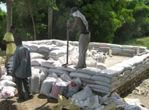
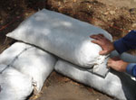
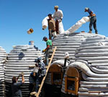
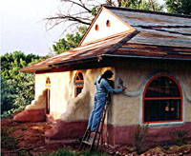
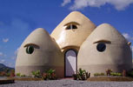
Earth bag construction
Sandbags are used by the military for creating strong, protective barriers or flood control
Earthbags can be filled with local, natural materials.
They can resist severe weather
Erected simply and quickly
Cheap
Provide thermal mass when filled with soil
Sacks can be purchases as recycled grain sacks
For permanent housing the bags should be covered
with some kind of plaster for protection
Ease and simple to construct, can use unskilled labour
Reference for all pictures: http://www.earthbagbuilding.com/

Slide 13
Solar Air Conditioning
Solar air conditioning refers to any air conditioning (cooling system that uses solar power.
Passive solar cooling:
  Slows rate of heat transfer into a building
  Removes unwanted heat
Involves a good understanding of heat transfer, heat conduction, convective heat transfer and thermal radiation.
Earth cooling tubes is an example of a passive system.
http://www.builditsolar.com/Projects/SolarHomes/plansps.htm#Passive Solar

Slide 14
Earth cooling tubes
Use the earth’s constant subterranean temperature to cool air
Viable and economic alternative to air conditioning
Can be used in agricultural facilities
2 types or a combination:
  Close loop system
  Open system
Use plastic pipes. Clean regularly.
Suitable for hot and dry climates
http://www.hindu.com/pp/2006/01/21/stories/2006012100491000.htm

Slide 15
Green Roofs and Walls
Use lining then layer of soil.
Can grow vegetables though technique is not recommended for tin roofs as tin is likely to rust.
Your roof must be able to support the weight of the soil, grass or vegetables.
Green roofs are popular in urban environments too...

Slide 16
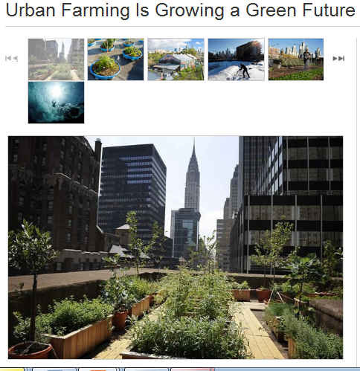
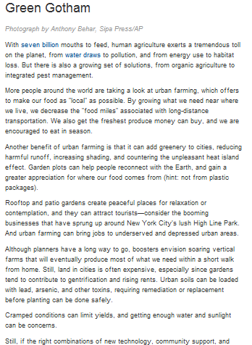
http://environment.nationalgeographic.com/environment/photos/urban-farming/#/earth-day-urban-farming-new-york-rooftop_51631_600x450.jpg

Slide 17
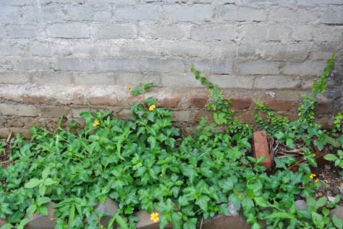
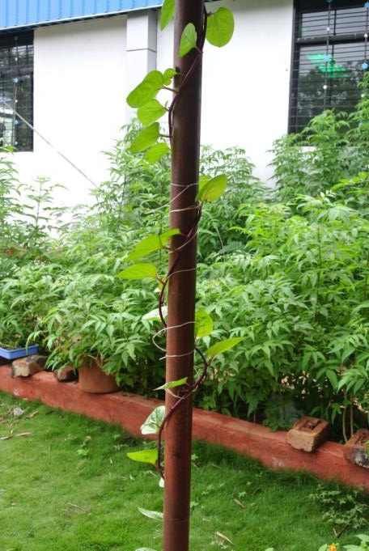
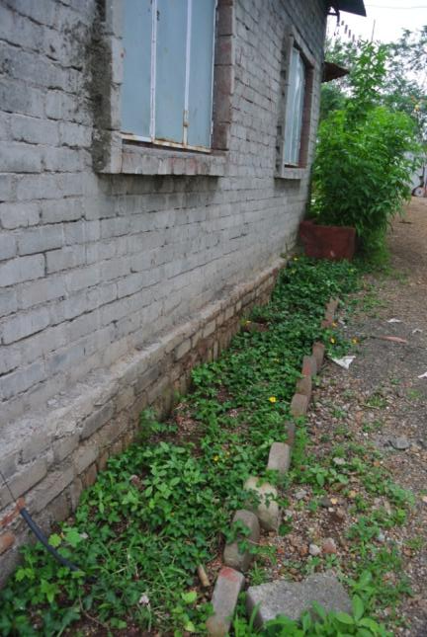
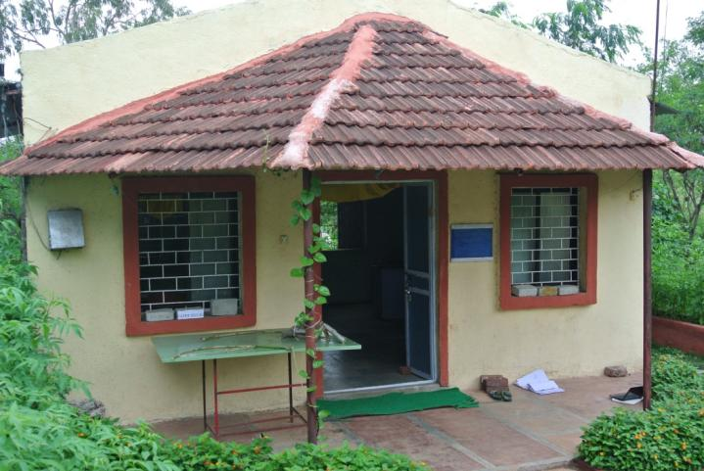
Green Solutions
Climbing plant

Slide 18
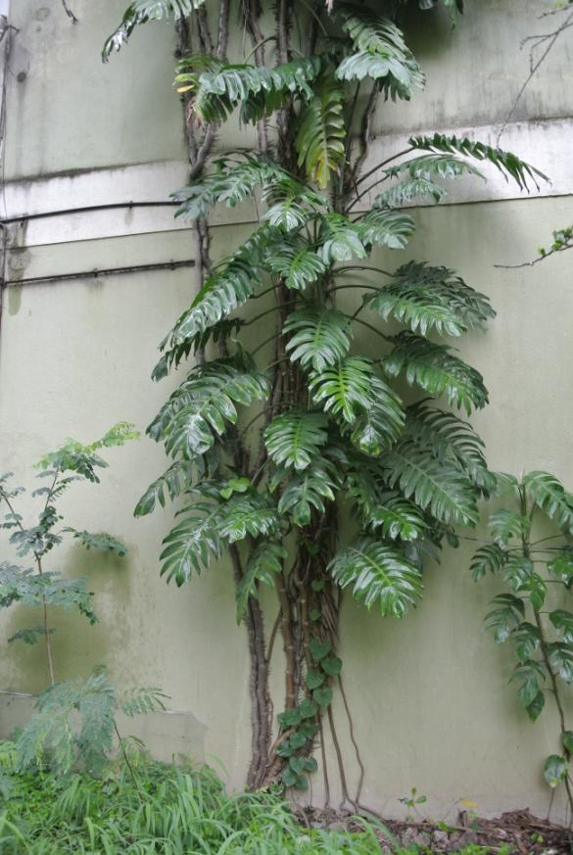
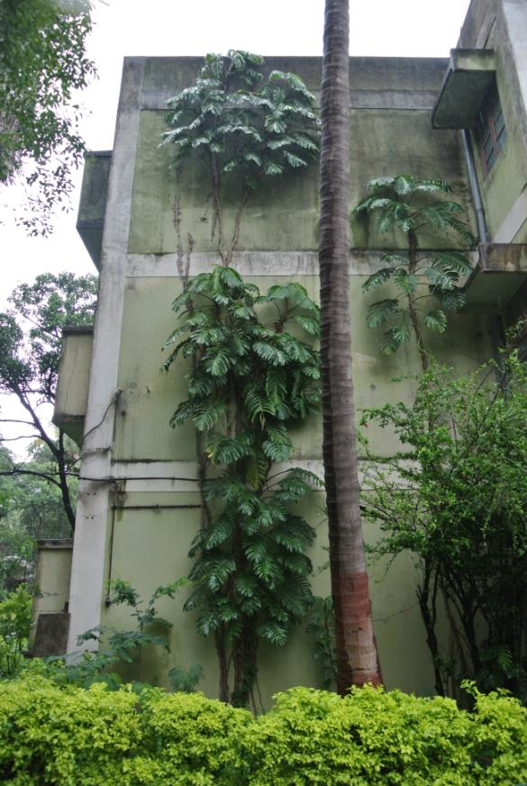
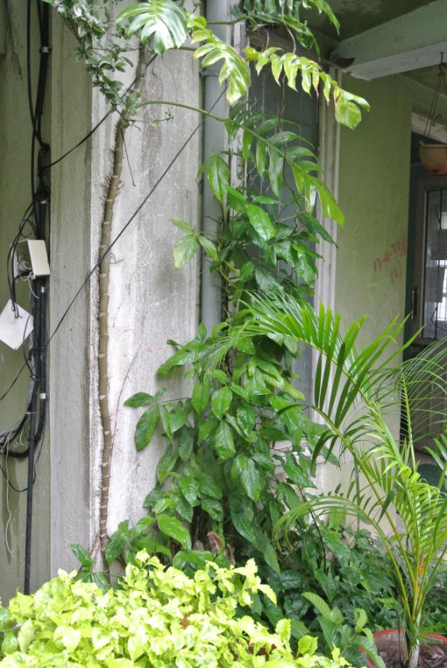
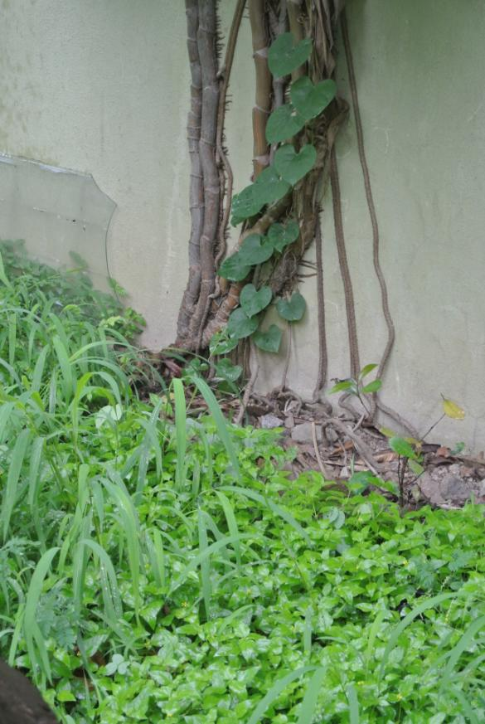
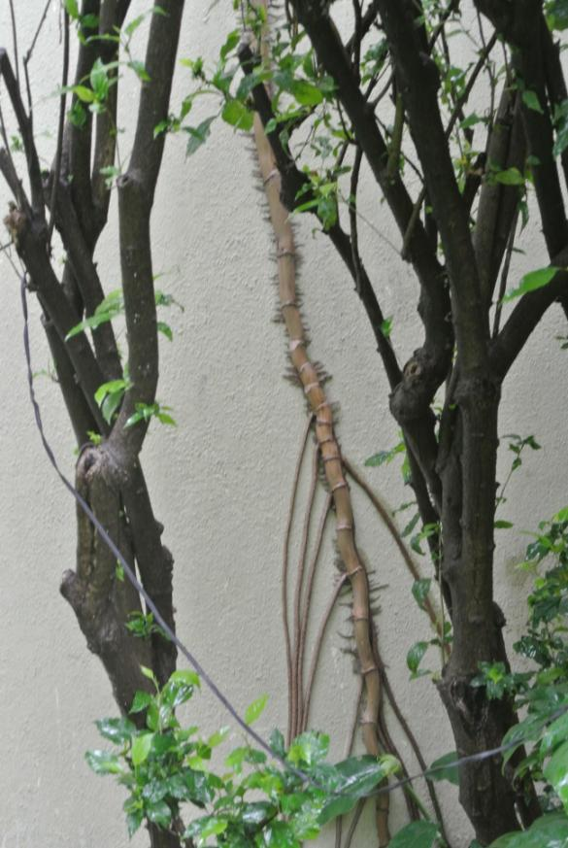
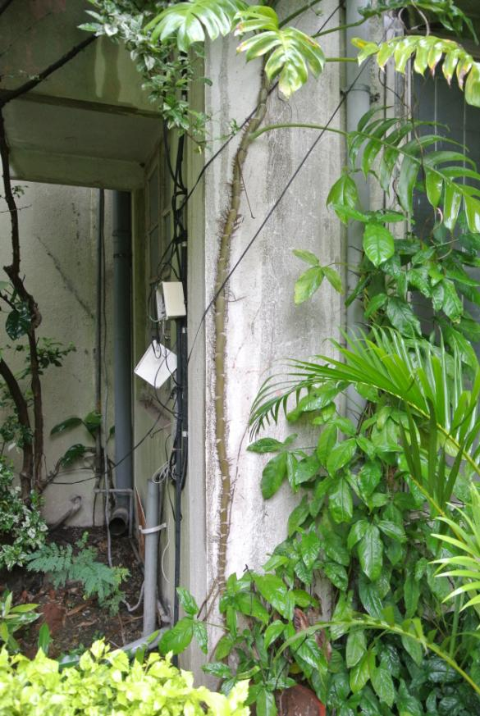
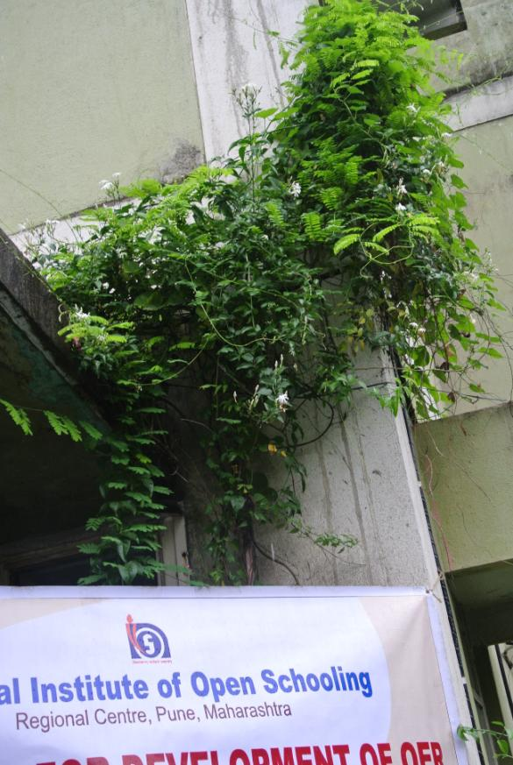

Slide 19
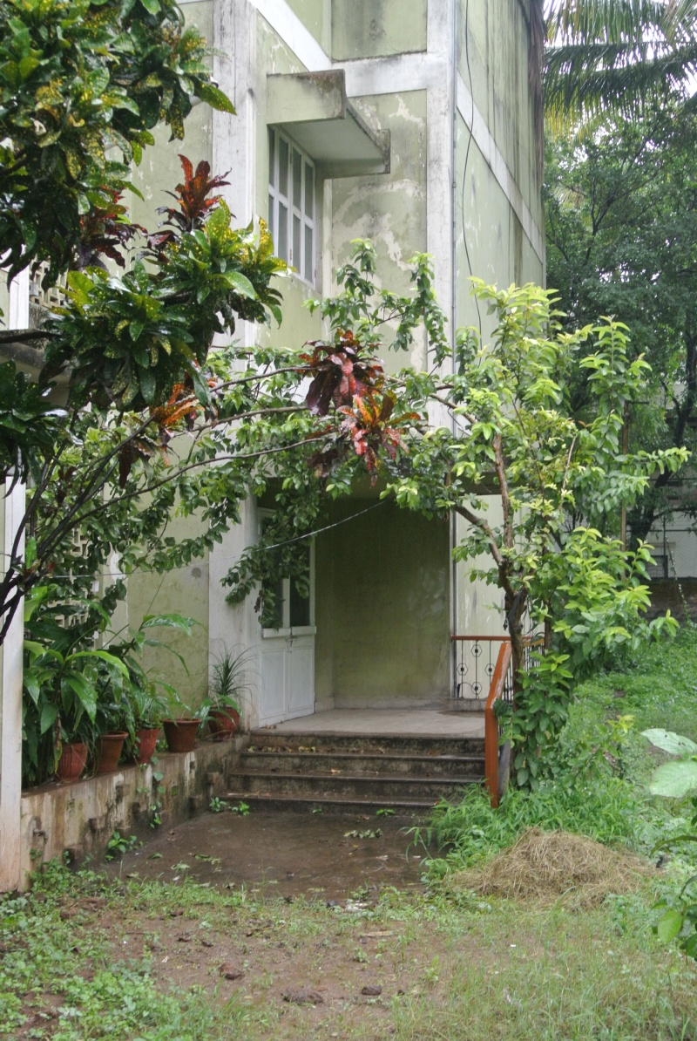
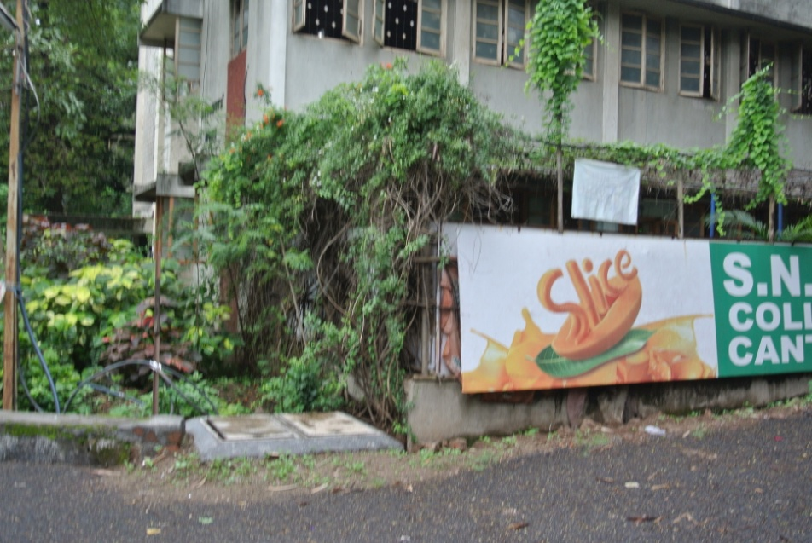
Other uses for climbers
Climbers can be used to provide shading.
While they are growing try encouraging them to bend perhaps by using string.

Slide 20
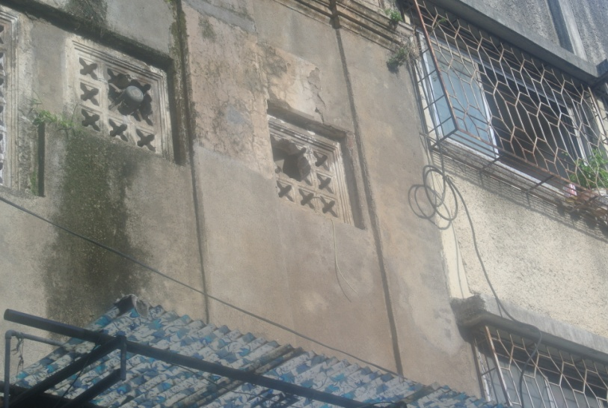
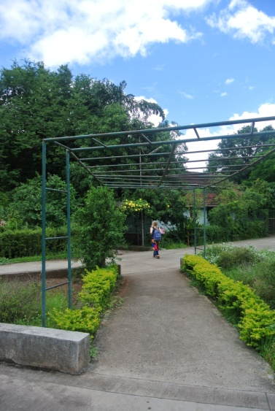
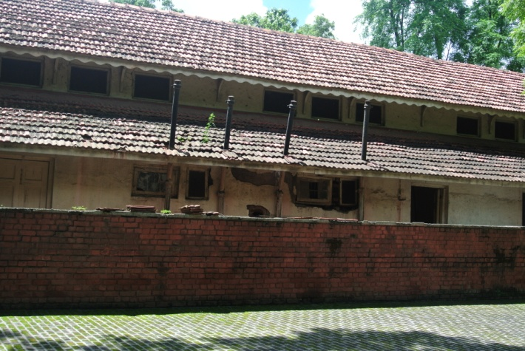
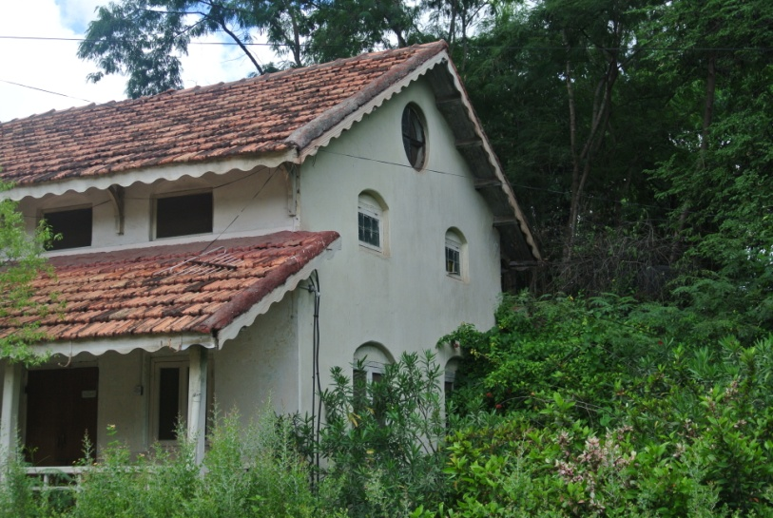
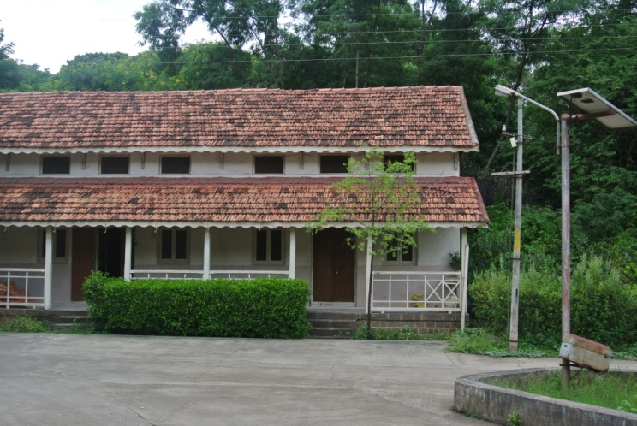
Research
Have a look around you and if you look carefully you will see a number of ventilation solutions
Structure to encourage ‘Climbers’ to grow
Air pipes
Vents... etc etc

Slide 21
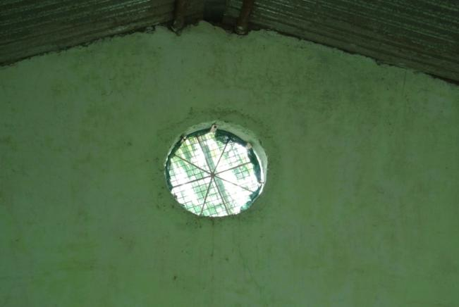
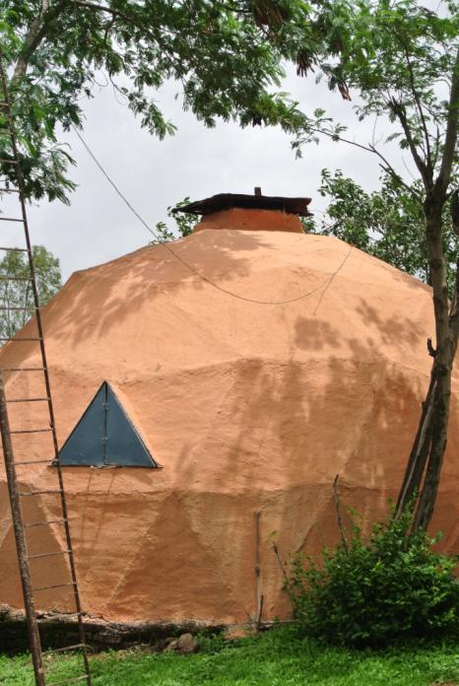
The End

Slide 22
Here are some useful step by step guides showing you how to install a ceiling fan and how to cool your home:
Installing ceiling fan: http://www.dummies.com/how-to/content/how-to-install-a-ceiling-fan.html
Reference on how to cool your home:
http://www.dummies.com/how-to/content/the-essentials-of-cooling-your-home-the-green-way.html

Slide 23
Thanks

