Slide 1
Circuits
Energy & Environment

Slide 2
Simple Circuit
What symbols are shown here and what do they do?
Connect circuit together
Wire
Power Source
-ve
Electricity to Light
Purpose
G
Battery
+ve
Lamp
Safety Device
Fuse
Switch
Controlling Device

Slide 3
Closed Circuit
For current to flow round circuit, must be a connecting path
Where is there potential difference & where is there resistance?
-ve
Some
resistance
Potential difference
G
Potential difference
+ve
Low resistance

Slide 4
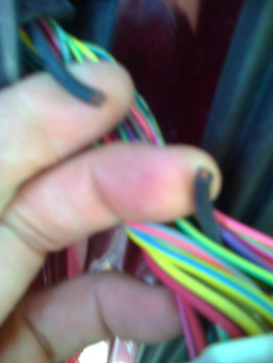
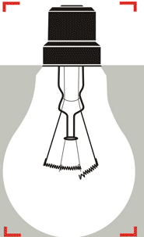
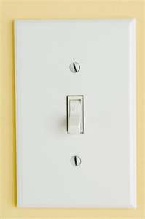
Open circuit
Where is there potential difference & where is there resistance?
Current stops as doesn’t have a complete path
No power used
-ve
G
+ve
Very high resistance
Examples of open circuit

Slide 5
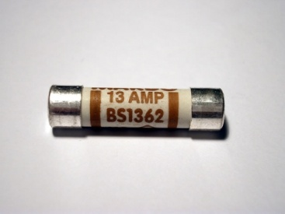
Short Circuit
Why does the current chose to go this way?
-ve
Some resistance
Almost no
resistance
G
+ve
Circuits are protected against excessive current by fuses
Results in excessive current
Which can cause overheating and damage.
Notes:
.

Slide 6
Series Circuit
Where could we put this bulb if we want to add it in series?
-ve
G
+ve

Slide 7
Series Circuit: Current
-ve
B
=4 amps
In a series circuit the current is the same across the circuit
G
A
=4 amps
+ve
I_{total}=I₁=I₂=I₃
Current through switch=4 amps
If the current through the switch is 4 amps, what is the current through the light bulb A and B?

Slide 8
Series Circuit: Voltage
The potential difference in EMF across two points is called the potential difference.
In a series circuit the voltage is the sum of the EMF
This side
A
This side
B
=6 volts
-ve
12 volts
EMF= 12 volts
12 volts=6 +6
G
A
=6 volts
+ve
(EMF)v_{total}=V₁+V₂+V₃
B

Slide 9
Series Circuit: Voltage
What happens when we add another bulb? What is the voltage of each identical bulb.
In a series circuit the voltage is the sum of the EMF
This side
A
This side
C
=4 volts
B
-ve
=4 volts
12 volts
EMF= 12 volts
12 volts
G
12 volts= 3 x light bulbs
Light bulb = 12 volts
3
=4 volts each
A
=4 volts
+ve
(EMF)v_{total}=V₁+V₂+V₃
B

Slide 10
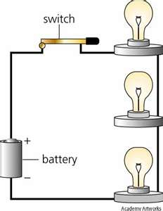
Series Circuits
If this bulb blows what happens to the other bulbs?
The circuit is open so there is no path for the current to travel.
If current=0
Power=0
As power=EMF x Current

Slide 11
Parallel Circuit
Where could we put this bulb if we want to add it in parallel?
-ve
G
+ve

Slide 12
Parallel Circuit: Current
In a parallel circuit the current is split up throughout the different branches
-ve
B
=2 amps
I_{total}=I₁+I₂+I₃
G
A
=2 amps
+ve
Current through switch=4 amps
If the current through the switch is 4 amps, what is the current through the identical light bulbs A and B?
Notes:
Need to work this out why

Slide 13
Parallel Circuit: Voltage
The potential difference in EMF across two points is called the potential difference.
Voltage in parallel circuits is equal across branches
This side
This side
A
A
A
1.5 volts
-ve
Voltage
=1.5 volts
G
1.5 volts
1.5 volts
1.5 volts
+ve
B
B
B

Slide 14
Parallel Circuit: Voltage
Voltage in parallel circuits is equal
What happens when we add another bulb?
This side
A
A
A
A
1.5 volts
1.5 volts
1.5 volts
-ve
Voltage
=1.5 volts
G
1.5 volts
+ve
B
B
B
B
(EMF)v_{total}=V₁=V₂=V₃

Slide 15
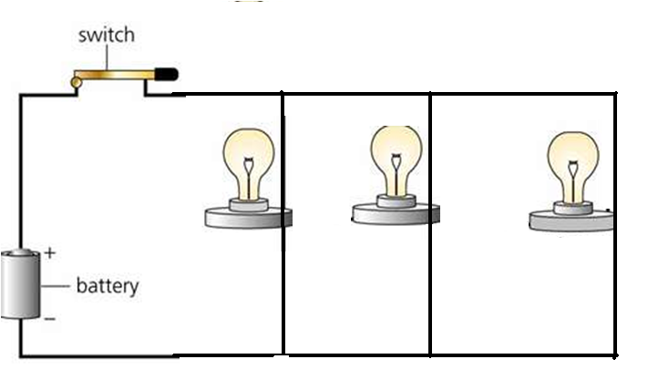
Parallel Circuits
If this bulb blows what happens to the other bulbs?
The circuit for that bulb is open but the circuit for the other two bulbs is ok

