Slide 1
Energy Audits & Electricity Bills
Energy & Environment

Slide 2
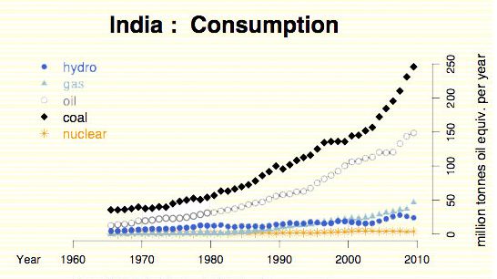
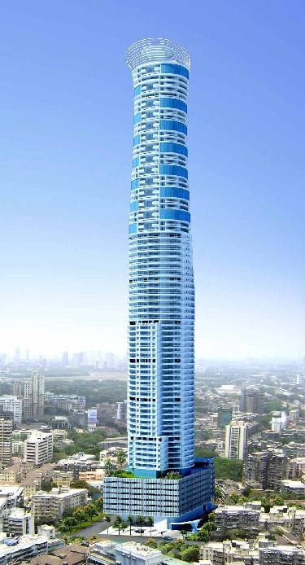
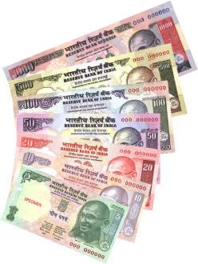
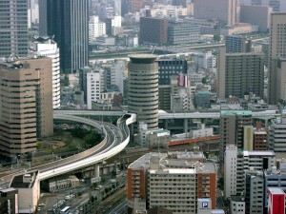
Increasing Energy Demand
India’s energy consumption has been increasing at one of the fastest rates in the world.
What does this graph tell you?
This is due to:
Population growth
Economic Development

Slide 3
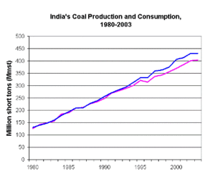
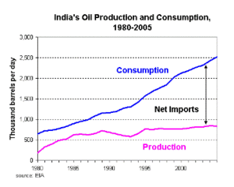
Increasing Energy Demand
What do these graphs tell you?
Supply is less than Demand
Need imports to meet the demand
There is an urgent need to reduce energy requirements
This can be achieved through conserving energy

Slide 4
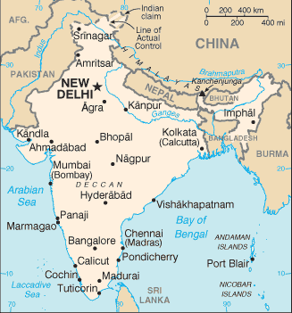
Advantages of Conserving Energy
Will help make power available to all
Reduce pollution
To conserve energy we need to find out where we are wasting it.
We can find this out by completing an energy audit
Reduce Power cuts
Will make India more independent from fossil fuel rich countries
Save money

Slide 5
Energy Audit
An energy audit helps you to calculate how much energy you use and where it is used.
This allows you to identify where you could make savings in your energy consumption
Notes:
Beyond simply identifying the sources of energy use, an energy audit seeks to prioritize the energy uses according to the greatest to least cost effective opportunities for energy savings
What they are
What used for
Why useful

Slide 6
How to carry out an energy audit
2. Find out energy consumed by every application
1. Set your boundaries
Electrical Wattage consumed by equipment is normally written on its name plate
3. To calculate the energy consumed by an appliance, multiply the power rating of the appliance by the time of consumption

Slide 7
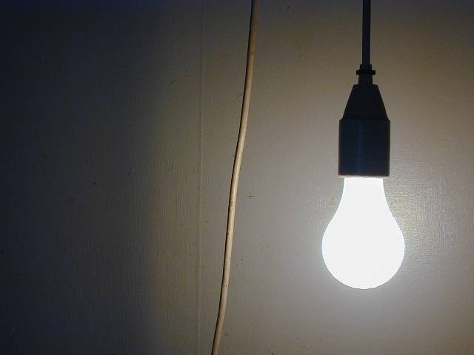
Energy Consumed
This is a 40W light bulb
Its on between 7pm and 12am every day
Calculate the monthly energy consumption in KW Hours

Slide 8
Energy Consumed
Consumption per day = wattage x daily use
= 40W x (12-7) hours
= 40W x 5 hours
=200 watt hours
Consumption per month = wattage per day x no of days in 1 month
= 200 watt hours x 30
= 6000 watts hours
= 6KW hours
1KWH = 1 unit of electricity
What could you do to reduce this amount of electricity consumed?
So 6 units of electricity are used by the bulb in a month.
Notes:
Figures from curriculum. Need to check electricty bill?
User (residential, industry, commerical, government, military....) Total usage over year (kwhs) Peak and average demand (kW) Time of usage patterns (day/night, peaking/steady...) Location (utility service, governenment) Service Type (secondary (480v), primary (12,600v), transmission (50,000v), substation.....)

Slide 9
Conserving Energy
Turn the light off if you don’t need it all 5 hours
Invest in a solar lamp
Use a CFL bulb
(reduced Watts)

Slide 10
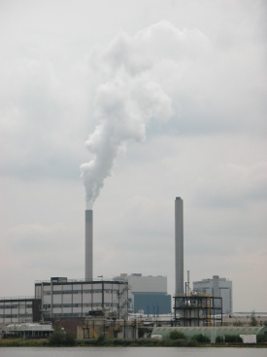
Energy Consumed
?
So how much does 6 units of electricity cost?
Depends on:
Electricity provider
Time of day
What type of customer you are

Slide 11
Electricity Bills
Why do you think there are different time slots?
Why do you think there are different charges?
Tariff Category | Demand Charges (Rs./ KVA/ Month) | Energy Charges paise/ KWH | slot 1 | slot 2 | slot 3 | slot 4
 |  |  | (22.00 to 6.00) | (06.00 to 9.00) and (12.00 to 18.00) | (9.00 to 12.00) | (18.00 to 22.00)
HT-1 Industries Continous (on express feeder) | 150 | 527 | -85 | 0 | 80 | 110
HT-V Agriculture | 25 | 215 | 0 | 0 | 0 | 0
LT-V Industrial 0-20KW | 150 per connection per month | 390 | 0 | 0 | 0 | 0
Vigyan Ashram

Slide 12
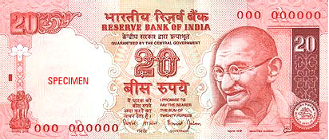
Energy Consumed
So how much does 6 units of electricity cost?
1 unit of electricity= Rs.3.9
What is the monthly cost of this light bulb?
6 units
x Rs 3.9
Rs 23.4

Slide 13
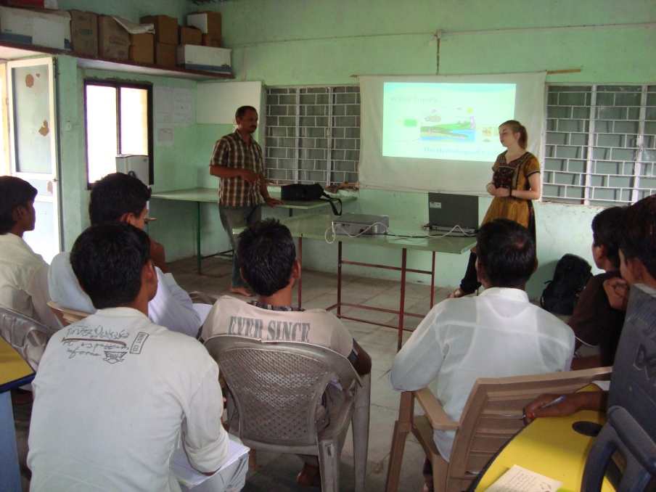
Energy Audit Exercise 1
As theoretical lessons with Powerpoint are new to Vigyan Ashram we need to calculate how much extra energy will be consumed.
?
We can then calculate the % increase in a monthly bill.
To do this we can carry out an energy audit for this room.

Slide 14
Energy Audit Exercise 1
Tariff Category | Demand Charges (Rs./ KVA/ Month) | Energy Charges paise/ KWH | slot 1 | slot 2 | slot 3 | slot 4
 |  |  | (22.00 to 6.00) | (06.00 to 9.00) and (12.00 to 18.00) | (9.00 to 12.00) | (18.00 to 22.00)
HT-1 Industries Continous (on express feeder) | 150 | 527 | -85 | 0 | 80 | 110
HT-V Agriculture | 25 | 215 | 0 | 0 | 0 | 0
LT-V Industrial 0-20KW | 150 per connection per month | 390 | 0 | 0 | 0 | 0
So what information do we need?
Equipment & Power need
Duration of use
Price of unit
Time of day?
Present these findings in a table

Slide 15
Energy Audit Exercise 1
How many days should we include in a month?
Equipment | Wattage (watts) | Per day usage (hrs) | Per day consumption (KW Hours) | Per month consumption = Per day usage * 26 days | Electric bill = Monthly usage (KWH) * per unit rate (Rs.3.9 per unit)
 |  |  |  | Total
On average there are 30 days in a month. But we have Saturdays off. So assume 4 Saturdays in each month.
Tariff Category | Demand Charges (Rs./ KVA/ Month) | Energy Charges paise/ KWH | slot 1 | slot 2 | slot 3 | slot 4
 |  |  | (22.00 to 6.00) | (06.00 to 9.00) and (12.00 to 18.00) | (9.00 to 12.00) | (18.00 to 22.00)
HT-1 Industries Continous (on express feeder) | 150 | 527 | -85 | 0 | 80 | 110
HT-V Agriculture | 25 | 215 | 0 | 0 | 0 | 0
LT-V Industrial 0-20KW | 150 per connection per month | 390 | 0 | 0 | 0 | 0
How do we find out what a unit of electricity costs?
30-4=26

Slide 16
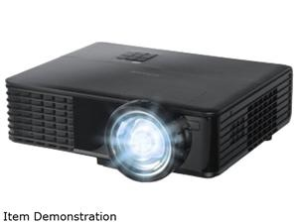
Energy Audit Exercise 1
What energy consuming appliances are there?
180 watts
65 watts
2 x 35 watts

Slide 17
Energy Audit Exercise 1
How long will they be on for today?
2 hours
2 hours
2 hours

Slide 18
Energy Audit Exercise 1
Equipment | Wattage (watts) | Per day usage (hrs) | Per day consumption (KW Hours) | Per month consumption = Per day usage * 26 days | Electric bill = Monthly usage (KWH) * per unit rate (Rs.3.9 per unit)
Lap top | 65 | 2 | 0.13 | 3.38 | 13.182
Projector | 180 | 2 | 0.36 | 9.36 | 36.504
Light | 35 | 2 | 0.07 | 1.82 | 7.098
Light | 35 | 2 | 0.07 | 1.82 | 7.098
 |  |  | Total | 16.38 | 63.882

Slide 19
Energy Audit Exercise 1
If we look at Vigyan Ashram’s old bill we can calculate % increase in units and cost that this will cause.
See Electricity Bill Here
So the school used 222 units last month
Will it be a 6.56% increase in price too?
% increase= increase in units
original units
Less due to fixed charges
% increase = 16.38 x 100= 7.38% increase in units
222 1

Slide 20
Energy Audit Exercise 1
From looking at the Energy Audit table, which factor has the greatest impact?
How could we reduce the energy consumption of this?
Reduce time that it is on

Slide 21
Energy Audit Exercise 2
Can you help Vigyan Ashram reduce its energy bill?
Split into pairs and carry out an energy audit of Vigyan Ashram
Anan’s
Cow shed
Girl’s Accommodation
Boys’s Accommodation
Classroom
Guest house
Engineering
Agriculture
Energy & Environment
Amma’s
Foodlab
DST
Office
Kitchen & Fablab
Water Pump

Slide 22
Energy Audit Exercise 2
This will change depending on what you are measuring
Equipment | Wattage (watts) | Per day usage (hrs) | Per day consumption (KW Hours) | Per month consumption = Per day usage * ?? days | Electric bill = Monthly usage (KWH) * per unit rate (Rs.3.9 per unit)
 |  |  |  | Total

Slide 23
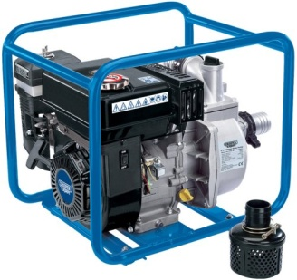
Energy Audit Exercise 2
How does your estimate compare to Vigyan Ashram’s last electricity bill?
What and where are the big users of electricity?
How could we reduce this energy consumption?
Reduce time used
Turn off appliances when not in use
Only use lights when needed
Think of other ways of powering what we need
Notes:
Identify the most likely area of energy wastage
Now you know energy consumption and cost incurred on various appliances. Please find out possible alternatives to save energy. Following are tips to identify energy saving areas –

Slide 24
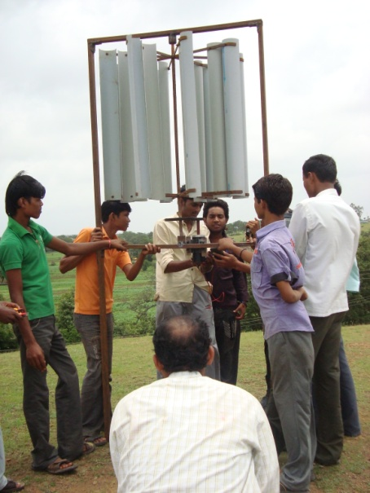
Energy Audit Exercise 2
Make an action plan for immediate action that requires no cost.
How can we communicate these to the rest of the school?
Create a long term plan of what could be done at Vigyan Ashram to reduce its electricity consumption
e.g. wind power for pumping water.
Could these be your future energy & Environment projects?
Notes:
4

Slide 25
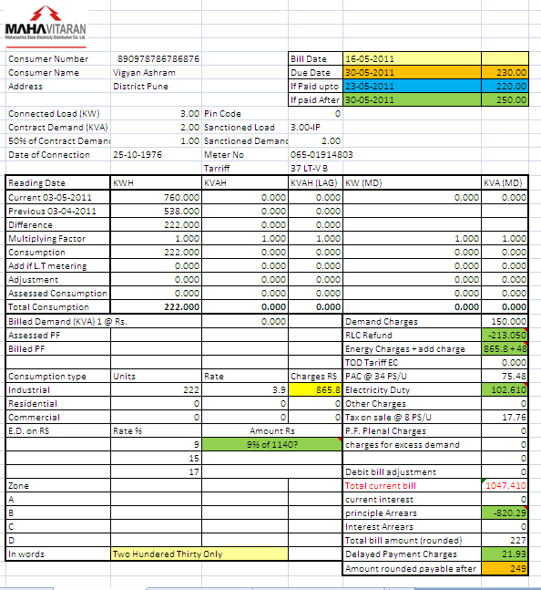
Energy Audit
Keep a review of the savings over the next few months
How could you do this?
Old Bills
Plot a graph of energy consumption over a year

