Slide 1
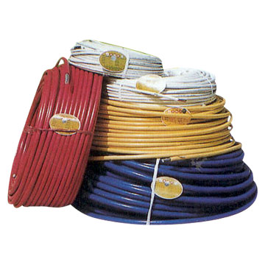
Wires & Cables
Energy & Environment

Slide 2
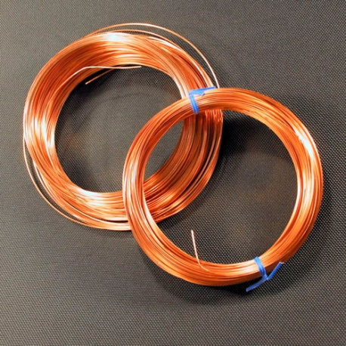
Conductors
A conductor has many free electrons so is good at transferring electrical current
-
-
-
-
-
-
-
-
-
-
-
-
-
-
-
-
-
Low Resistance
High Resistance
Good Conductor
Bad Conductor
Conductance is the opposite of resistance
It is measured in ‘Mho’s (ohm backwards) ℧

Slide 3
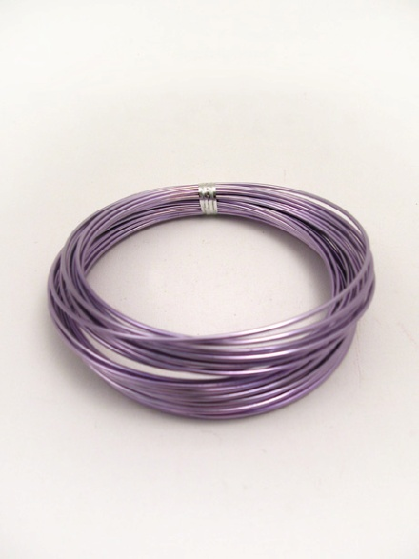
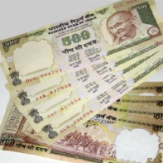
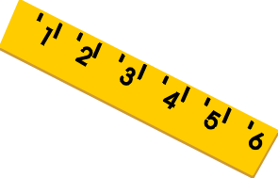
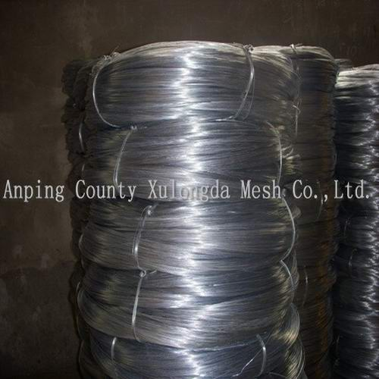
Different types of conductors
Material Used
Copper
Aluminum
High conductivity
60% conductivity of copper
Easily soldered
Heavier & more expensive than aluminum
Cheap & lighter than copper
Copper used in house wiring
1mm², 1.5mm²
4mm² , 6mm²
Galvanized Iron (GI)
Heavier than aluminum
Lowest conductivity
Used in overhead lines

Slide 4
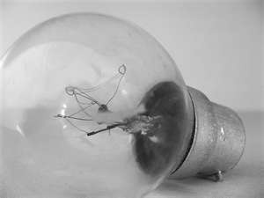

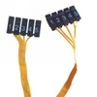
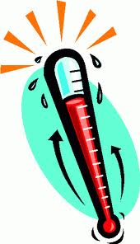
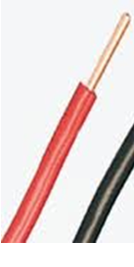
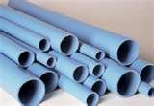
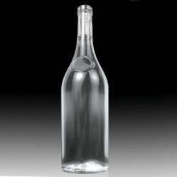
Different types of conductors
Respective of their property
Good Conductors
Bad Conductors
Low resistance
Medium resistance
Carry current
Used for converting electrical energy into heat, light & sound
Copper & Aluminum
Tungsten & Nichrome
Non Conductors
Wires & cables use conductors & non conductors to their advantage
High resistance
Insulators
PVC, glass

Slide 5
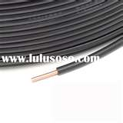
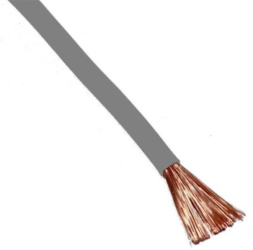
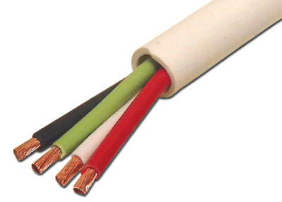
Different types of conductors
Physical Appearance
Solid Conductor
Stranded Conductor
Used in cables.
e.g. copper, aluminum, steel
Flexible
1, 7, 19, 37 stands
1.13 to 3.73 mm diameter
Multi stranded Conductor
Flexible Conductor
0.2 or 0.3 mm diameter
14, 23, 40 strands
<0.2 mm diameter
14, 22, 24,84 strands

Slide 6
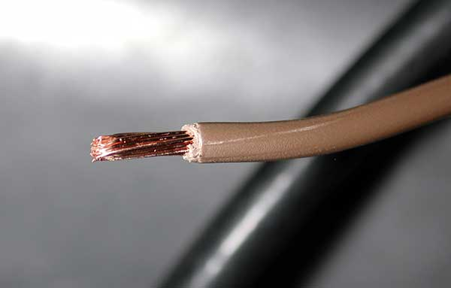
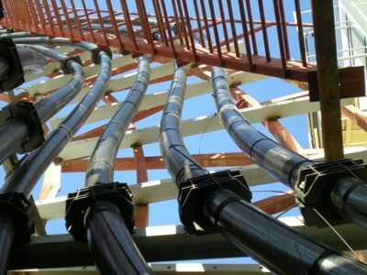
Wires & Cables
Wires & Cables are purpose built conductors
The size & type of wire/cable must suit the power rating required for their use. The higher the power the thicker the wire/cable
Wires
Domestic & small industry wiring
In appliances
Cables
Small & big industries
Distribution Lines
Transmission lines

Slide 7
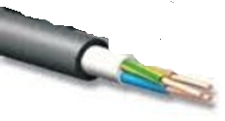
Types of wires
Vulcanized India Rubber (VIR)
To protect against corrosion from the VIR
Cotton tape & cotton braiding
tinned copper/ aluminum
suitable for: low & medium voltage supply only
Bitumen
Vulcanized India Rubber (VIR)
Old type: not readily available to purchase

Slide 8
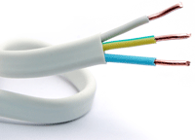
Types of Wires
Cabe Tyre Sheath wire (CTS)
tinned copper
Thicker Rubber/plastic
Old type: not readily available to purchase
Rubber/plastic
Don’t absorb moisture
Available in 250/440V only
Notes:
.

Slide 9
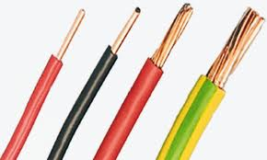

Types of Wire
PVC Wire
copper/ aluminum
Widely used
Long life
Durable against water, heat, oil, UV light
Available in 600, 660, 1100 Voltage
Polyvinyl chloride (PVC)

Slide 10
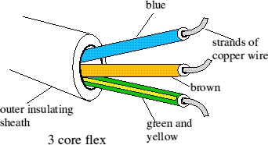

Wiring Appliances
Returns current to power source
What do each of these wires do?
Neutral
Live
Provides current to appliance
Earth
Takes current to ground if appliance has fault
What wire is missing and why?

Slide 11
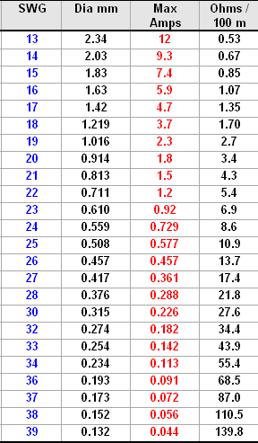
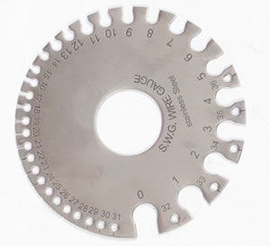
Standard Wire Gauge & Current Carrying Capacity
Maximum safe current that can flow through a cable
Each number represents a size of wire
Higher current will heat the cable and damage the insulation and may result in short circuit

Slide 12
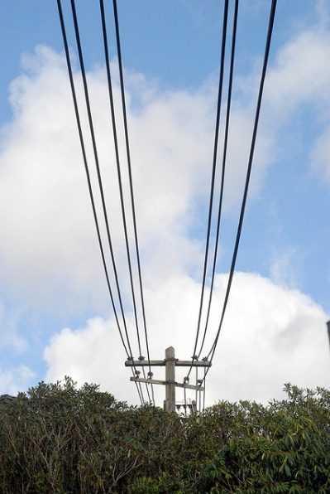
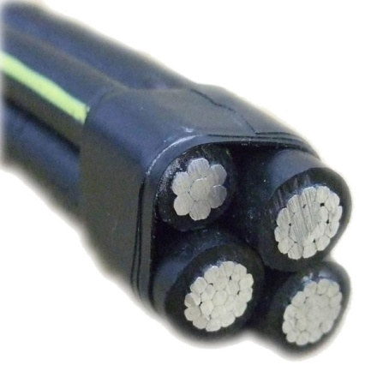
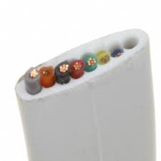
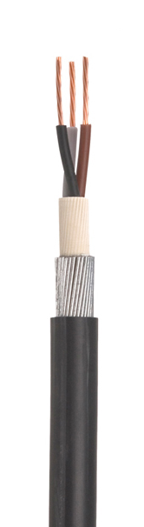
Cables
Larger sized conductors
Types of cable are sorted by:
Type of insulation
Type of conducting material
Cotton covered
Silk coated
Asbestos covered
Rubber coated
PVC coated
Copper
Aluminum
Their shape
Mechanical protection
Voltage Grade
Flat
Round
Unarmored
Armored
Low
High

Slide 13
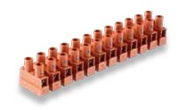
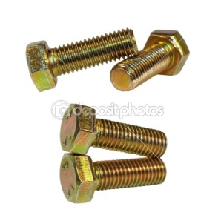
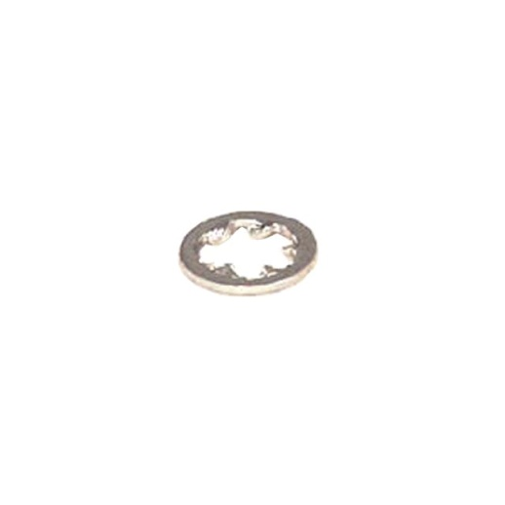
Splices & Terminals
When a cable enters into an accessory its called a termination.
Splices or terminals must be used at termination points
These must be as mechanically & electrically strong as the conductor or device which it is used.
Types
Pillar terminals
Screw heads & nuts
Washers

Slide 14

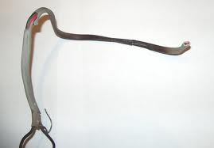
Summary Questions
Why might you use aluminum in wire instead of copper?
What are some advantages of PVC wire?
Why might you use ‘bad’ conductors in a circuit?
Why is it important not to supply a cable with more current than its current carrying capacity?

