Slide 1
Wiring Accessories
Energy & Environment

Slide 2
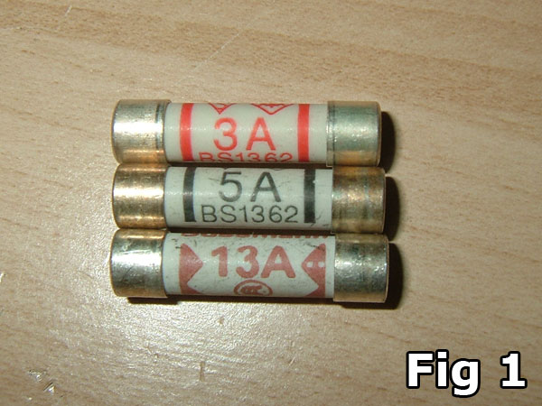
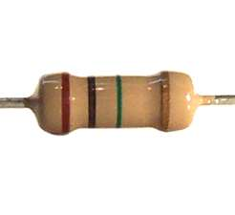
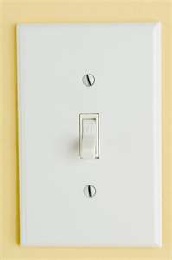
Electrical Accessories
Why might we use electrical accessories?
Protection
Adjustment of resistance
Control
The standard current ratings of the accessories are 6, 16 & 32 ampere
The voltage rating is 240V AC

Slide 3
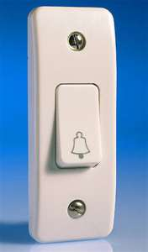
Switches
Manually operated device for closing & opening a circuit.
Single Pole Switch
Two Way Switch
Stair case wiring
U
C
D
Off
On
Bell Push
Spring loaded push button
Used in bell circuit

Slide 4
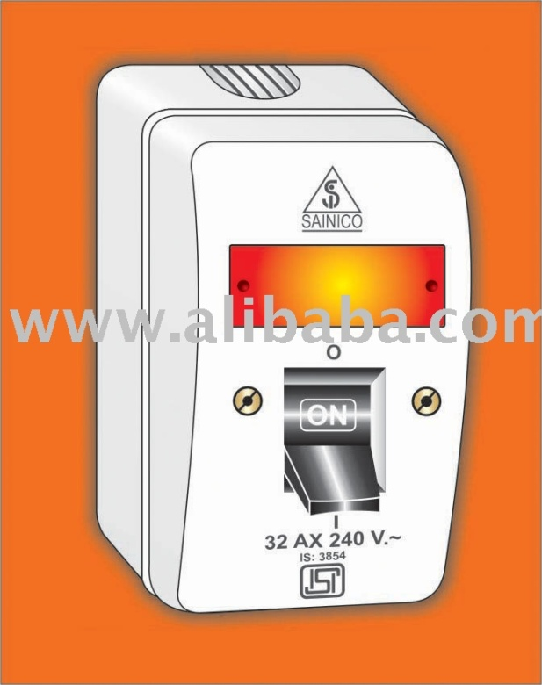
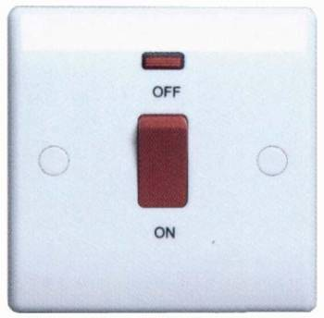
Switches
Double Pole Switch
Double pole switch + fuse + fuse link + neon indicator
10amp, 16amp, 32amp
250v only
Used as main switches to control a main or branch circuit in domestic installation

Slide 5
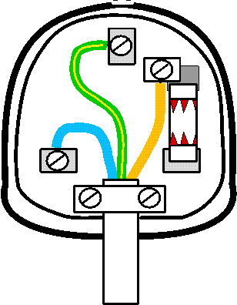
3 Pin Plug
What are these wires called and what do they do?
Earth
Takes current to ground if appliance has fault
Live
Provides current to appliance
6A 250V or 16A, 250V
Fuse
Neutral
Fuse blows if unsafe current passed through
Returns current to power source
Outer Insulation

Slide 6
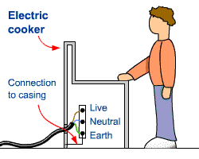
The Earth Wire: How does it work?
If the live wire becomes loose and touches the metal casing what will happen?
The metal casing will act as a live wire as it can conduct electricity.
Because of the nature of electricity it will try and travel to the ground.
What would happen if you were touching the cooker?

Slide 7
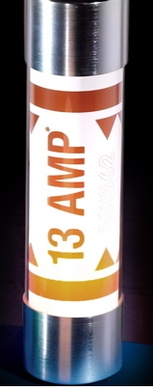
The Earth Wire: How does it work?
If you were touching the appliance the electricity would travel through you and give you an electric shock
The earth wire is connected to the metal casing and has a lower resistance than you so carries the current to the ground
The earth wire has a very low resistance. Therefore the current is increased. This blows the fuse and creates an open circuit.
Ω
Ω

Slide 8
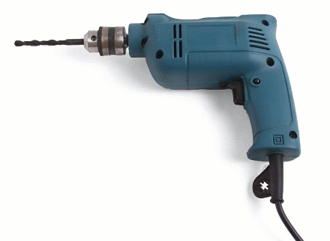
2 Pin Plug
What wire is missing?
Some appliances such as electric drills do not need an earth wire. You cannot get a shock from these appliances even if the wires inside become loose. This is because the casing is made from plastic.
These are Double insulated.
6 amps & 250V

Slide 9
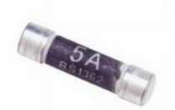
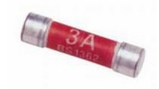
Fuse
The fuse is to create a short circuit in the event of too much current
It is important that the fuse matches the power rating of the appliance
If power <720W
If power >720W

Slide 10
Summary Questions
Explain what the wires in a plug do
Why is it important to have an earth wire?
When do you not need an earth plug?
What do fuses do?

