Slide 1
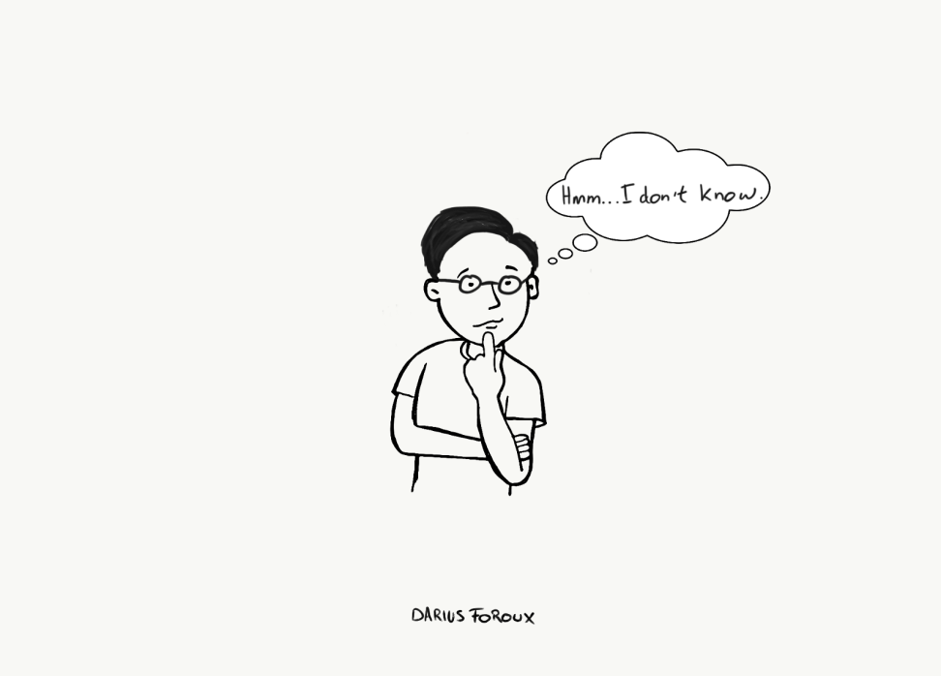
How do I choose a solar panel?

Slide 2
How much power (wattage) do you need?
There are three main stages to a solar powered system.
1. Power generation (the solar panel)
2. Power storage (the battery)
3. Power use (your items you want to run off solar power)

Slide 3
Find the Wattage of your appliances. List all the 12V electrical appliances you’ll use in a typical day, and find out how many Watts they each consume. Usually this is on the appliance or in its handbook. If you can only find a figure for Amps, simply multiply this by 12, to convert it to Watts.
Calculate your daily total Watt-hour requirement. Estimate how many hours you would use each appliance for over a typical week, then divide by 7 for a daily rate. Multiply each appliance’s wattage by the hours you’ll use it for in a day. Then add all the totals together to get the final daily total Watt-hours you require.
Next calculate your panel size. Simply divide the daily total Watt-hours you require by the hours of usable light you expect in an average day. This will give you your minimum panel wattage. In the UK, allow 1 hour of light in winter, rising to 4 hours by mid-summer.
Then your battery size… Multiply your daily Watt-hour requirement by 7 to create a weekly requirement, and divide this by 12 to convert back to Amp Hours, which batteries are rated in. Multiply by two to give the correct battery size.
And finally, your charge controller. Size your charge controller according to the Amps produced by your panel. Calculate the Amps produced by dividing the panel wattage by 16.5.

Slide 4
A worked example. In one week you want to run a 65W television for 4 hours, and an 8W light for 5 hours. Your daily Watt-hour requirement for the TV is 65 x (4/7) = 37Wh; and for the light you require 8 x (5/7) = 6Wh. Your total daily requirement is thus 43W. You only intend to use the system in summer, so you need a panel that is 43/4 = 11W or more. Your battery size needs to be (43 x 7 x 2)/12 = 50Ah. And you need a charge controller suitable for a solar input of at least 11/16.5 = 0.7A

