Slide 1
Bamboo Preservation & Treatment
Vigyan Ashram, Pabal

Slide 2
What if not protected?
Without any protective treatment, most bamboo species have an average durability of less than 2 years. Stored under cover, untreated bamboo may last 4-7 years

Slide 3
Importance of bamboo treatment and preservation
Bamboos are a natural material and will decay with time.
They are also susceptible to insect and fungal attack
Preserved bamboos increases the durability of the culms and increases the lives of the products they are used to produce.
If used as structural components they need to be replaced less often which reduces costs in the long term
Preserved bamboos fetch higher prices than non-preserved bamboos

Slide 4
Bamboo Preservation Methods
Basically there are two methods :
1.Non-Chemical, Traditional Bamboo Treatment Methods
2. Chemical Bamboo Treatment Methods

Slide 5
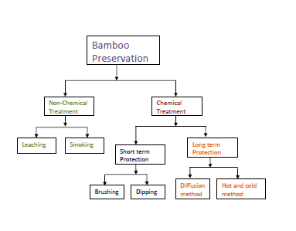
Bamboo Preservation Methods

Slide 6
Non-Chemical, Traditional Bamboo Treatment
Method 1 -Non-Chemical, Traditional Bamboo Treatment :
These are ancient methods which have been practiced in areas where bamboo commonly grows. They are simple and cost-effective without the use of chemicals or supporting equipment.

Slide 7
Chemical Bamboo Treatment
Method 2 - Chemical Bamboo Treatment :
Chemical preservatives are used to protect bamboo products from degradation. These are well established methods providing good protection even in adverse conditions

Slide 8
Non-Chemical, Traditional Bamboo Treatment
1. Leaching
Leaching helps remove starch and also enhances permeability for future treatment by diffusion and pressure.
This method is appropriate for treating any quantity of bamboo. It is also recommended for craft and mat applications where flexibility is required.

Slide 9
Non-Chemical, Traditional Bamboo Treatment
2. Smoking
Traditionally, culms are stored over the fireplace.
The moisture content in smoked culms is thus reduced so that biological degradation cannot take place.
Built-up deposits from smoke form a protective layer
on the culm. Smoke drying also reduces splitting.

Slide 10
Short Term Chemical Bamboo Treatment
1. Brushing
It is suitable for small handicraft and household tems. 2-3 coats of chemicals should be given using a brush.
2. Dipping
Dipping is used for medium quantities of bamboo/bamboo products.
Dipping is more effective than spraying or brushing.
A momentary dip of 30 seconds to a minute is sufficient to protect the material. The excess material should be drained and reused.

Slide 11
Long Term Chemical Bamboo Treatment
1. Diffusion Method:
Diffusion are suitable for green bamboo only.
Round bamboo, splits and slivers can be treated by keeping them submerged in water-borne preservative solution. (water-borne preservatives like Boric acid:Borax
1:1.4 ...etc )
The method of diffusion can be varied by increasing the concentration of preservative to reduce treatment time
Scale: The process is slow, requiring a large number of tanks. It is suitable for treating 50-100 culms a month.

Slide 12
Long Term Chemical Bamboo Treatment
2. Hot and cold Method:
Hot and cold treatment requires air-dry bamboo
It is based on the principle that on heating, air from the cells will expand and partially escape. During cooling a slight vacuum is created due to contraction of the residual air and causes the entry of preservative into the cell.
Scale: Large quantities can be treated at one time
Preservatives :
Creosote for exterior uses (can be heated to 900 C)
Boric acid-Borax (should be heated to 500 C)

Slide 13
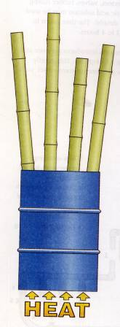
Long Term Chemical Bamboo Treatment
Hot and cold Method:

