Slide 1
Bamboo Uses
Vigyan Ashram, Pabal

Slide 2
Bamboo Uses
For the past 10 years, bamboo experts have been experimenting with the multiple uses of bamboo and are still discovering new applications everyday.
Bamboo fiber for the garment and automotive industries, flooring boards, veneers as thin as 0.2 mm, are just some of many examples.

Slide 3
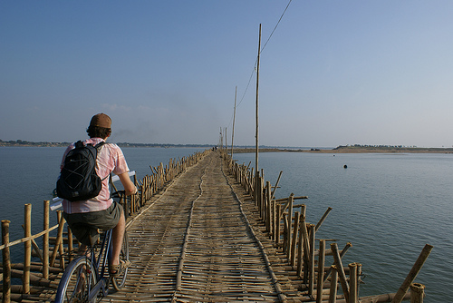
Bamboo Uses
Bamboo is commonly used for :
clothing manufacturing:
Bamboo as FOOD : Bamboo shoots have high nutritional value and low fat, and are a good source of fibre. Bamboo shoots are rich in vitamins, cellulose and amino acids.
Footbridges

Slide 4
Bamboo Uses contd…
Art & Writing Materials
Construction
bowls, cutting

Slide 5
Bamboo as food
Low in fat, calories, and cholesterol
Bamboo shoots are high in dietary fiber and a great source of potassium!
They’re also a good source of Protein, Iron, Vitamin E, Vitamin C, Vitamin A, Vitamin B6, Calcium

Slide 6
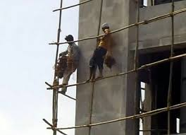
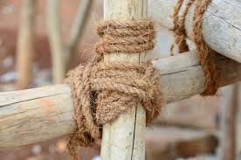
Bamboo uses in construction
Scaffolding : It is a temporary framework used by the workers during painting, repairing or building work Because of the load-bearing capacity and weight bearing capacity bamboo can be used during the construction.
During scaffolding , cane extension is carried out by lashing the cane ends together with several ties.

Slide 7
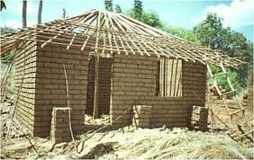
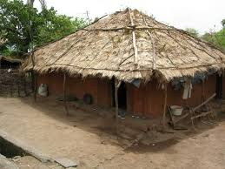
Bamboo uses in construction
Roofing: The roof offers protection against extremes of weather including rain, sun and wind . Above all it must be strong enough to resist the considerable forces generated by wind and roof coverings.
In this respect, bamboo is ideal as a roofing material- it is strong, resilient (not easily damaged) and light weighted.

Slide 8
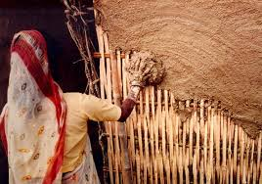
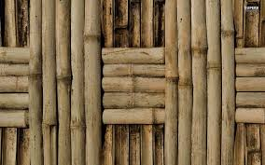
Bamboo uses in construction
Walls :The most extensive use of bamboo in construction is for the walls and partitions.
The major elements, the posts and beams, generally constitute part or structural framework.
An infill between framing members is required to complete the wall. The purpose of the infill is to protect against rain, wind and animals, to offer privacy and to provide in plane bracing to ensure the overall stability of the overall structure when
subjected to horizontal forces.

Slide 9
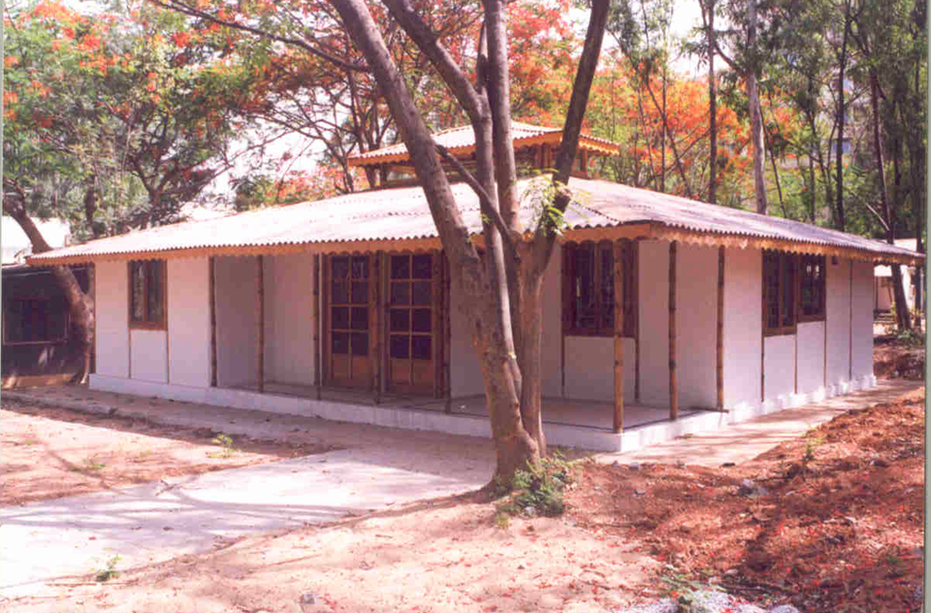
Real life Pictures
Two bedroom bamboo house constructed at IPIRTI, Bangalore

Slide 10
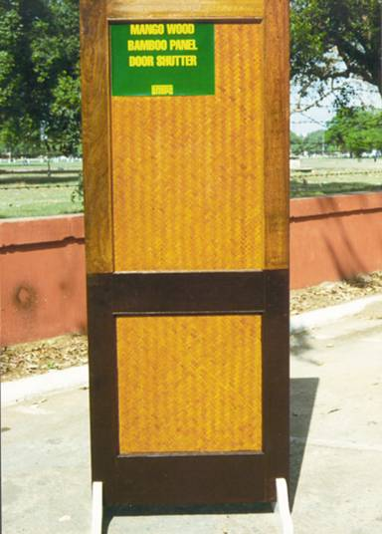
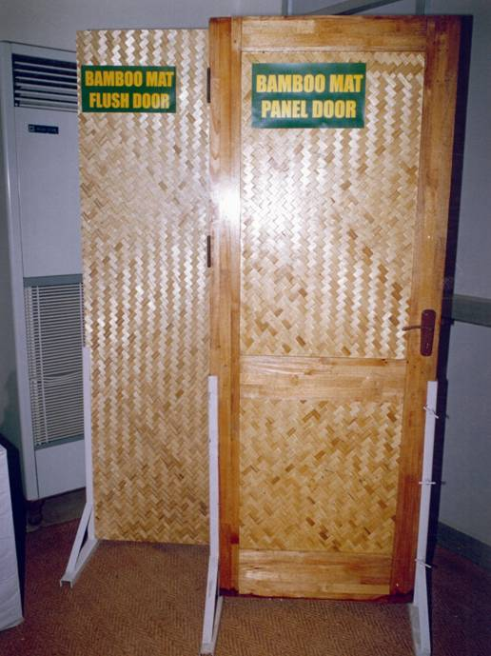
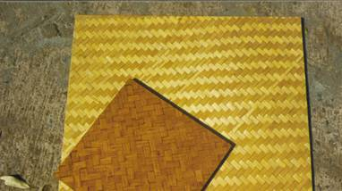
Real life Pictures

Slide 11
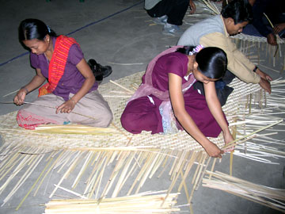
Real life Pictures

Slide 12
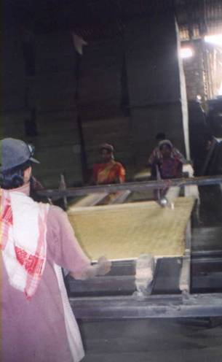
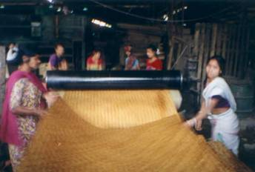
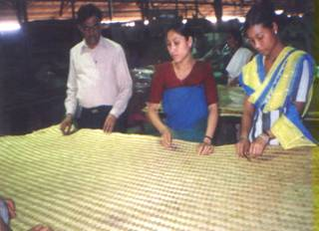
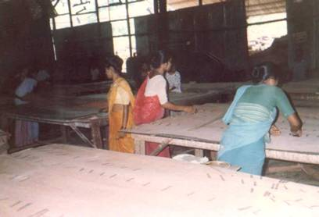
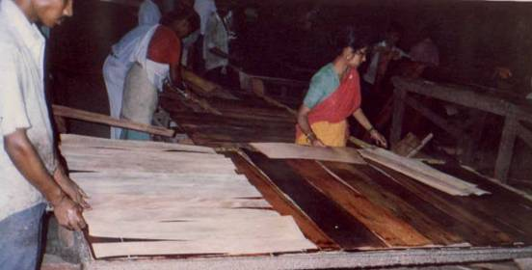
Real life Pictures
Women Working in Corrugated Sheet Factory in Byrnihat, Meghalaya

