Slide 1
Bamboo
Vigyan Ashram, Pabal

Slide 2
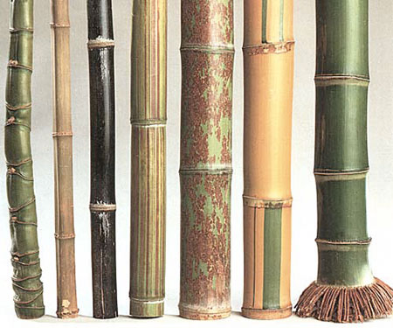
What is bamboo ?
Bamboos are from a true grass family
They are widely distributed throughout parts of the world, particularly in the Asia-Pacific region
It grows primarily in tropical and subtropical areas but several species grow in temperate areas
Bamboo species vary in height from 1 ft to over 100 ft tall and have stem diameters ranging from 1 mm to 30 cm
Certain species can grow up to 1 ft/day!!

Slide 3
Advantages of bamboo
Can be harvested in 3-5 yrs. versus in 10-50 yrs. for softwoods and hardwoods
The yield (weight per acreage) for bamboo is 25% greater than that of timber
Resistant to earthquake damage and practical on steep slopes
Bamboo structures can be built very quickly, are low cost, durable, and environmentally friendly
The energy required in processing bamboo is less than for concrete, wood, and steel

Slide 4
Advantages of bamboo
Aesthetically beautiful
Bamboo exhibits little dimensional change compared to other commonly used woods
Bamboo plant can be used in rural livelihoods - shoots for food, leaves for fodder, and branches for items such as brooms and for firewood
Bamboos are excellent for rejuvenating degraded lands and protecting against soil erosion.

Slide 5
Disadvantages of bamboo
Durability–bamboo is subjected to attack by fungi, insects
Untreated bamboo structures are viewed as temporary with an expected life of not more than 5 years.
Jointing–although many jointing techniques exist, their structural efficiency is low.
Lack of design guidance and codes.
Prone to catch fire very fast by the friction among the culms during wind, and is seen to cause forest fires.
Shaped by nature

Slide 6
BAMBOO RESOURCES IN INDIA
MAJOR BAMBOO GROWING
REGIONS / STATES
State | Area (% ) | Gross share (%)
North East | 28 | 66
Madhya Pradesh | 20.3 | 12
Maharashtra | 9.9 | 5
Orissa | 8.7 | 7
Andhra Pradesh | 7.4 | 2
Karnataka | 5.5 | 3
Other States (Kerala, UP, Jharkhand, West Bengal) | 20.2 | 5
India is home to almost 45 % of world's bamboo forests

Slide 7
Distribution of Some Important Bamboo Species in India
Species | Availability % Growing Stock | States
D. strictus | 45 | Andhra Pradesh, Assam, Gujarat, Maharashtra, Himachal Pradesh, Madhya Pradesh, Manipur, Orissa, Karnataka, Uttar Pradesh, Rajasthan
M. baccifera | 20 | Assam, Manipur, Meghalaya, Mizoram, Tripura
B. arundinacia | 13 | Arunachal Pradesh, Karnataka, Orissa, Maharashtra, Himachal Pradesh, Andhra Pradesh and Gujarat
D. hamiltonii | 7 | Arunachal Pradesh, Assam, Nagaland, Mizoram
B. tulda | 5 | Arunachal Pradesh, Nagaland, Tripura, Mizoram, Assam
B. pallida | 4 | Arunachal Pradesh, Nagaland, Tripura, Mizoram
Rest | 6

Slide 8
Most common species
Most commonly used :
Dendrocalamus strictus (D. strictus )
Melocanna baccifera (M. baccifera )
Most commonly cultivated across India
Dendrocalamus strictus D. strictus )
Bambusa arundinacea (B. arundinacia )

Slide 9
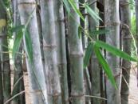
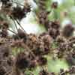
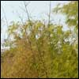
Dendrocalamus strictus
(Common name : Indian bamboo)
Widely distributed in India in semi dry and dry zone along plains and hilly tracts usually up to an altitude of 1000 m., also commonly cultivated throughout the plains and foot hills.
Culms 8-16 m high, 2.5-8 cm diameter, pale blue green when young, dull green or yellow on maturity, much curved above half of its height
It is extensively used as raw material in making bamboo furniture, paper mills and also for a variety of purposes such as construction, agricultural implements, musical instruments, furniture etc
D.strictus
Flowering - D. strictus
D.strictus-flowering

Slide 10
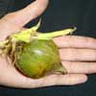
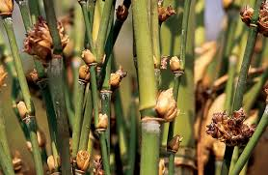
Melocanna baccifera
(Local name : Mautak or Muli)
Commonly found in north eastern states of India
It is distributed thoroughly between 400-1520 m altitude
M. baccifera develops big, pear-shaped fruit of about 30 to 35 (45) mm
M. baccifera
Seed: M. baccifera

Slide 11
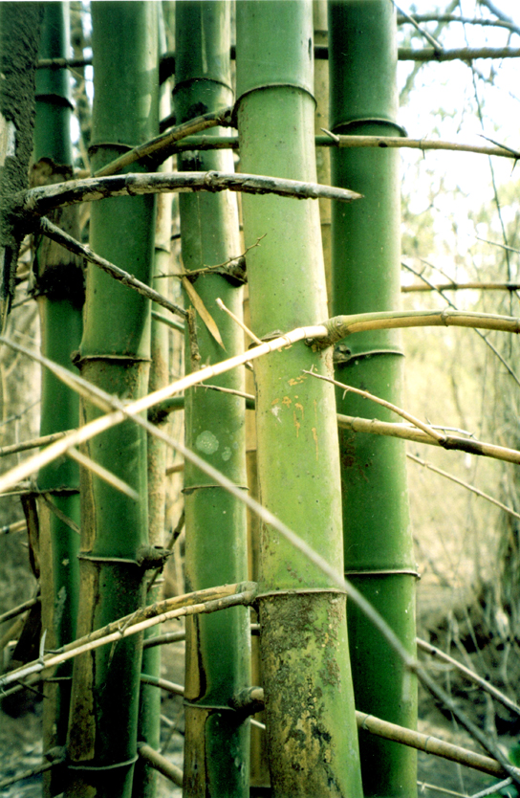
Bambusa arundinacea
Comman name: The spiny or Thorny bamboo
Distributed throughout the most parts of India, up to an altitude of 1,250m, particularly near river banks
Cultivated in the plains of most of the Indian states.
It flowers once in 30-40 years.
Bambusa arundinacea

