Slide 1
Introduction to arduino

Slide 2
Arduino
Arduino हा एक open source electronics platform आहे जो की साध्या वापरात येणाऱ्या software आणि hardwareवर आधारित आहे.
Arduino Board हा एक छोटासा CPU आहे ज्यामध्ये एक चिप लावलेली असते. त्या चिपला आपण microcontroller असे म्हणतो.
या चिपमध्ये आपण program upload करून त्याच्या pinsला आपण हवे तसे inputs(eg.sensors) आणि outputs(eg.motors) देऊ शकतो.
Arduinoला आपण हवे ते device लावू शकतो आणि आपला project बनवू शकतो.

Slide 3
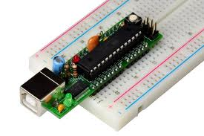
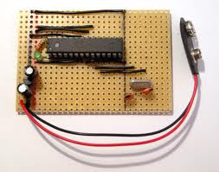
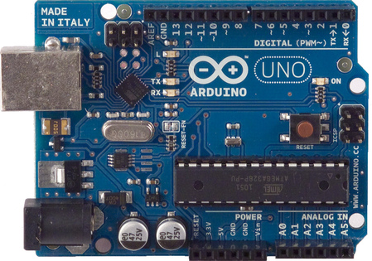
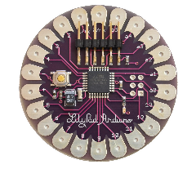
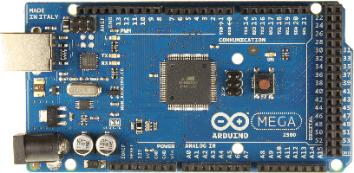
Different types of Arduino
Boarduino Kit
Arduino LilyPad
DIY Arduino
Arduino Uno
Arduino Mega 2560

Slide 4
Arduino uno
What does it have?
14 Digital In/Out pins (6 can be used as PWM)
6 Analog Inputs
A USB Connection
A Power Jack
Reset Button
On-board LED
SCL/SDA pins (Serial Clock/ Serial Data pins)
In short, it contains everything needed to support the microcontroller; simply connect it to a computer with a USB cable or power it with a AC-to-DC adapter or battery to get started.

Slide 5
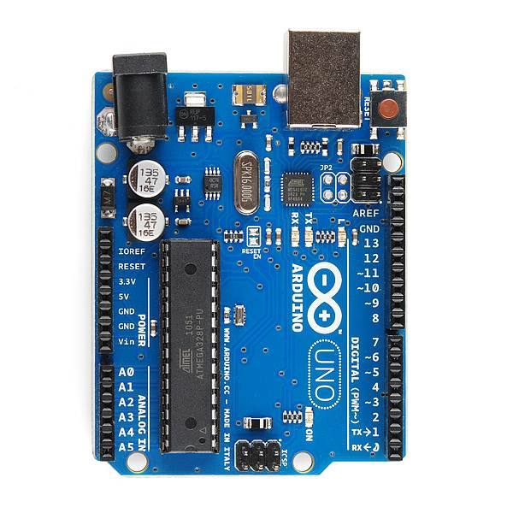
USB
(to Computer)
PWR IN
RESET
SCL\SDA
(I2C Bus)
POWER
5V / 3.3V / GND
Digital I\O
PWM(3, 5, 6, 9, 10, 11)
Analog INPUTS

Slide 6
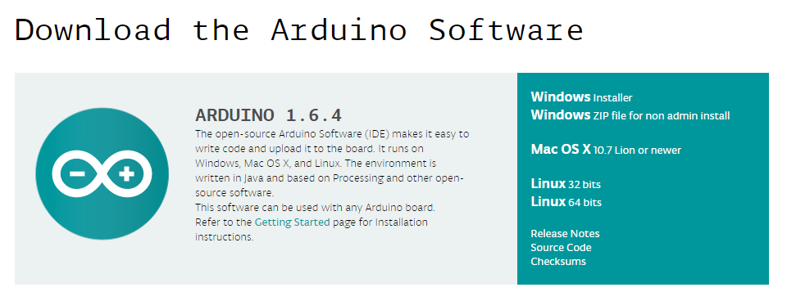
How to code in arduino
You need to download Arduino IDE (Integrated Development Environment).
Arduino IDE is available for all Mac, Windows.and Linux.

Slide 7
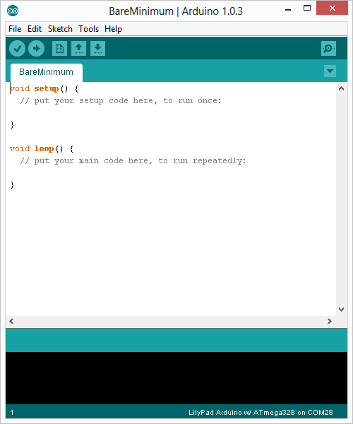
How to code in arduino
Once you have downloaded and installed/extracted the folder, you can directly run Arduino.exe, which will take you to its IDE.
The IDE will look like the shown screenshot.
error & status messages

Slide 8
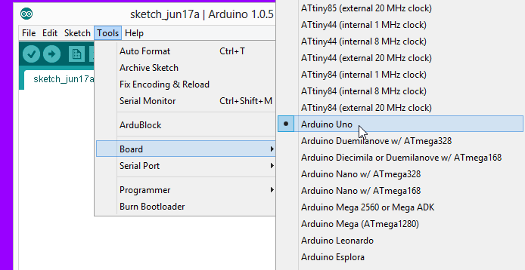
Program your arduino
Before you start programming, double check that correct board is selected under Tools → Board.
Now, you can start playing with Arduino.

Slide 9
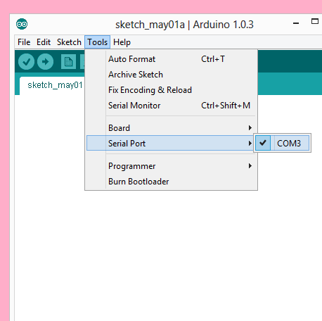
Program your arduino
The Arduino Uno can be programmed with the Arduino software. Select "Arduino Uno from the Tools > Board menu (according to the microcontroller on your board).
All the peripheral connected with Computers are using Serial Port.
You can check port for Arduino Uno in Device Manger.

Slide 10
Input vs output
Image from Theory and Practice of Tangible User Interfaces at UC Berkley

Slide 11
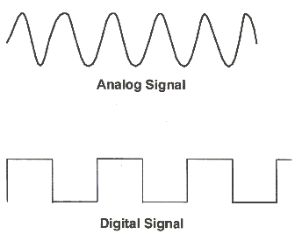
Analog vs digital
Microcontrollers are digital devices – ON or OFF. Also called – discrete.
Analog signals are anything that can be a full range of values.
5 V
5 V
0 V
0 V

Slide 12
Analog vs digital
Analog Sensors
Digital Sensors
Digital sensors are more straight forward than Analog.
No matter what the sensor there are only two settings: On and Off
Example, Push button, Switch
Sensors | Variables
Mic | soundVolume
Photoresistor | Light Level
Potentiometer | dialPosition
Temp Sensor | temperature
Flex Sensor | bend
Accelerometer | tilt/acceleration

Slide 13
Let’s start coding

Slide 14
Project #1 led blink
digitalWrite()

Slide 15
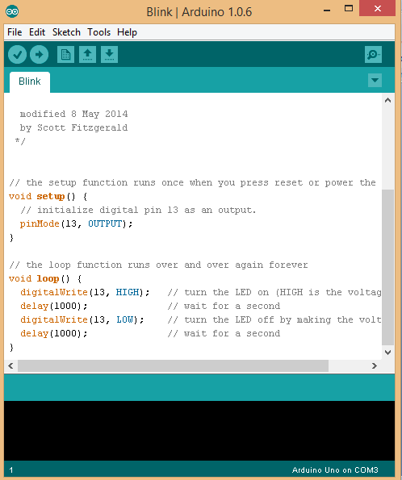
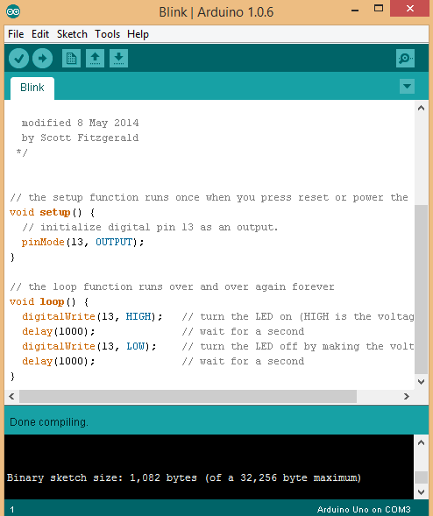
Upload
Compile
Status Message

Slide 16
Thank you

