Slide 1
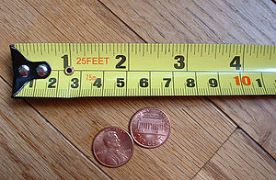
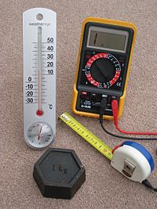
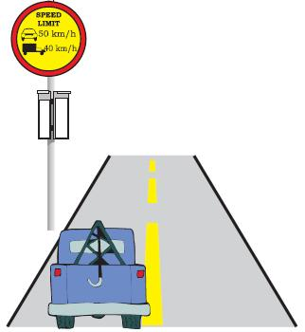
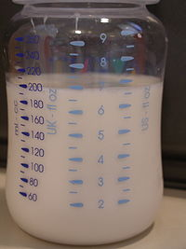
MEASUREMENTS

Slide 2
IMPORTANCE OF MEASURMENT
QUANTITATIVE INFORMATION IS MORE USEFUL THAN QUALITATIVE (DESCRIPTIVE) INFORMATION.
QUANTITATIVE INFORMATION GIVES SPECIFIC INFORMATION.
QUALITATIVE INFORMATION | QUANTATIVE INFORMATION
GIVE ME LITTLE WATER. | GIVE ME 200ml OF WATER.
GIVE ME SOME MONEY. | GIVE ME 20 RUPEES.
I ATE SUFFICIENT FOOD. | I ATE 2 CHAPATTIS.

Slide 3
IDENTIFY QUANTITATIVE & QUALITATIVE INFORMATION….
WE GOT GOOD YIELD OF CROP. ___________________
WE GOT 5 QUINTALS OF RICE. ___________________
THIS YEAR THERE IS ENOUGH RAIN. ____________________
THIS YEAR WE GOT 500mm RAIN. ____________________
THIS CONSTRUCTION NEEDS LOT OF CEMENT. ____________________
THIS CONSTRUCTION NEEDS 5 BAGS OF CEMENT. __________________________

Slide 4
MEASURING UNIT AND IT’S PARAMETERS
PARAMETER | BRITISH UNIT | SI UNITS
WEIGHT | POUND | KILOGRAMS
VOLUME | GALLON | LITERS
DISTANCE | YARD, MILES, INCHES | METERS
TIME | SECOND | SECOND

Slide 5
INTERNATIONAL STANDARD UNITS
BASE UNITS-
SIMPLE MEASUREMENTS FOR TIME, LENGTH, MASS, TEMPERATURE, ELECTRIC CURRENT AND LIGHT INTENSITY.
DERIVED UNITS-
MADE UP OF BASE UNITS, COMBINATION OF UNITS.

Slide 6
Meter & its multiple units
micrometer = 10⁻⁶ m
mm = 0.001 m
cm = 0.01 m
meter
Decameter = 10 m
Hectometer = 100 m
Kilometer = 1000 m
Mega meter = 10⁶ m

Slide 7
Derived units
 | NAME | SYMBOL
LENGTH | METER | M
MASS | GRAM | Gm
TIME | SECOND | S
ELECTRIC CURRENT | AMPERE | A
TEMPERATURE | DEGREE CENTIGRADE | ⁰C

Slide 8
DERIVED UNITS ARE CALCULATED AS FOLLOWS:
SPEED
DISTANCE
TIME
SPEED = DISTANCE / TIME
UNIT OF SPEED = ?
SPEED = M / S

Slide 9
AREA OF SQUARE = LENGTH * BREADTH
A [SQUARE]
LENGTH
BREADTH
UNIT OF AREA = ?
UNIT OF AREA = M * M = M ²

Slide 10
DERIVED UNITS & THEIR SYMBOL NAMES
DERIVED QUANTITY | NAME | SYMBOL
AREA | SQUARE METER | m²
VOLUME | CUBIC METER | m³
SPEED, VELOCITY | METER PER SECOND | m/s
ACCELERATION | METER PER SECOND | m/s²
DENSITY | MASS PER VOLUME | Kg/ m³

Slide 11
CONVERT FOLLOWING:
50cm = _________m
5.5km = _________m
1600m = _________km
102mm = _________m
Observe different weight & answer:
500gm
500gm
?

Slide 12
FACTORS AFFECTING MEASUREMENT:
READING TAKEN BY THE INDIVIDUALS.
THE WAY OF MEASUREMENT.
ALERTNESS OF INDIVIDUAL & CARE TAKEN BY HIM IN MEASUREMENT.
ERROR DUE TO VARIATION IN THE MEASURING INSRTUMENT.

Slide 13
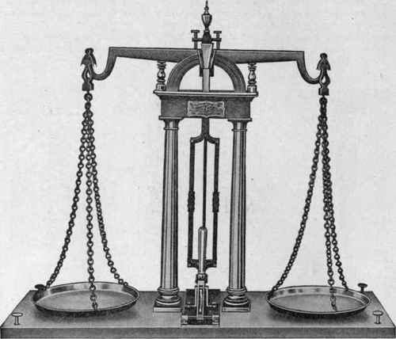
LEAST COUNT SCALE
?______
SELECTION OF INSTRUMENT DEPENDS ON THE ACCURCY REQUIRED.
WRIST WATCH
TAPE, SCALE.
WEIGH BRIDGE.
SIMPLE BALANCE.

Slide 14
NAME PROPER INSTRUMENTS TO MEASURE FOLOWING JOBS:
JOB | INSRTUMENTS
DIAMETER OF ROD
CURRENT
TEMPERATURE
MEASURE WEIGHT
WRITE DOWN LEAST COUNT OF FOLLOWING INSTRUMENTS:
VERNIER CALIPER = ____________
METER TAPE = ____________
WRIST WATCH = ____________

