Slide 1
Lever

Slide 2
What is lever ?
A lever is one of the simplest mechanical devices. A lever consists of a beam or stick or rod. However, a lever by itself is not effective. It must have something on which to pivot. This pivot is called a fulcrum. A lever helps to lift weights with less effort. Children on opposite ends of a seesaw lift each other's weight up and down easily. Anyone who has ever pried something loose with a crowbar or a board has used a lever.

Slide 3
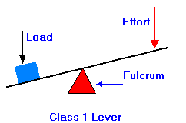
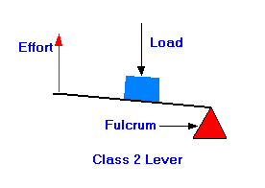
Classes of lever
1. First-class levers : Have the fulcrum placed between the load and the effort, as in the seesaw, crowbar, and balance scale. If the two arms of the lever are of equal length, as with the balance scale, the effort must be equal to the load. If the effort arm is longer than the load arm, as in the crowbar, the effort travels farther than the load and is less than the load.
2. Second-class levers : Have the load between the effort and the fulcrum. A wheelbarrow is a second-class lever. The wheel’s axle is the fulcrum, the handles take the effort, and the load is placed between them. The effort always travels a greater distance and is less than the load.

Slide 4
Classes of lever ....
3. Third-class levers : Have the effort placed between the load and the fulcrum. The effort always travels a shorter distance and must be greater than the load. A hammer acts as a third-class lever when it is used to drive in a nail: the fulcrum is the wrist, the effort is applied through the hand, and the load is the resistance of the wood. Another example of a third-class lever is the human forearm: the fulcrum is the elbow, the effort is applied by the biceps muscle, and the load is in the hand.

Slide 5
Quiz time ...

Slide 6
Which class of lever?

Slide 7
Which class of lever?

Slide 8
Which class of lever?

Slide 9
Examples of lever

Slide 10
Which class of lever?

Slide 11
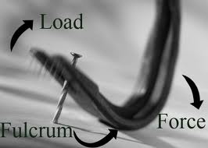
Examples of lever

Slide 12
Which class of lever?

Slide 13
Which class of lever?

Slide 14
Thanks
For further information:
Website : www.vigyanashram.com
e-Mail : vapabal@gmail.com, director@vigyanashram.com

