Slide 1
Examples of Slope

Slide 2
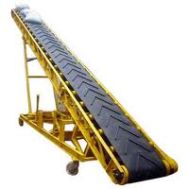
Examples of Slope

Slide 3
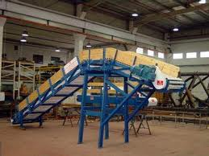
Examples of Slope

Slide 4
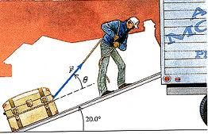
Examples of Slope

Slide 5
Examples of Slope

Slide 6
Examples of Slope

Slide 7
Examples of Slope

Slide 8
Examples of Slope

Slide 9
Examples of Slope

Slide 10
Examples of Slope

Slide 11
Thanks
For further information:
Website : www.vigyanashram.com
e-Mail : vapabal@gmail.com, director@vigyanashram.com

