Slide 1
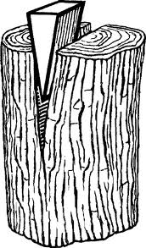
Wedge

Slide 2
Wedge
Definition :
A piece of wood, metal, etc. having one thick end and tapering to a thin edge, that is driven between two objects or parts of an object to secure or separate them.
"the door was secured by a wedge"

Slide 3
Wedge Applications
Use:
To separate out two objects or portions of an object
To lift up an object or hold an object in place.
How it works ?
It functions by converting a force applied to its blunt end into forces perpendicular (normal) to its inclined surfaces. Although a short wedge with a wide angle may do a job faster, it requires more force than a long wedge with a narrow angle.

Slide 4
Example…
To separate out two objects or portions of an object

Slide 5
Example…
A doorstop (also door stopper or door stop) is an object or device used to hold a door open or closed, or to prevent a door from opening too widely. Alternatively, a doorstop can be a thin slat built inside a door frame to prevent a door from swinging through when closed.

Slide 6
Thanks
For further information:
Website : www.vigyanashram.com
e-Mail : vapabal@gmail.com, director@vigyanashram.com

