Slide 1
सेन्सर म्हणजे काय ?

Slide 2
काही बॉडी सेन्सर
अ.क्र | सेन्सर | कार्य
१ | कान | ऐकणे.
२ | नाक | वास घेणे.
३ | जीभ | चव कळणे.
४ | डोळे | पाहणे.
५ | त्वचा | स्पर्श जाणवणे.

Slide 3
काही इलेक्ट्रोनिक सेन्सर
अ.क्र | सेन्सर | कार्य
१ | माईक | साउड
२ | एल डी आर | लाईट
३ | ऑबस्टयाकल अवोईडिंग | ऑबस्टयाकल (अडथळा)
४ | मोशन | गती
५ | आय आर | प्रेजेन्स

Slide 4
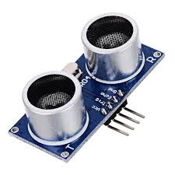
Obstacle Avoiding सेन्सर

Slide 5
Ultrasonic सेन्सर म्हणजे काय ?
An Ultrasonic sensor is a device that can measure the distance to an object by using sound waves. It measures distance by sending out a sound wave at a specific frequency and listening for that sound wave to bounce back. Ultrasonic transducers are divided into three broad categories: transmitters, receivers and transceivers. Transmitters convert electrical signals into ultrasound, receivers convert ultrasound into electrical signals, and transceivers can both transmit and receive ultrasound.
In a similar way to radar and sonar, ultrasonic transducers are used in systems which evaluate targets by interpreting the reflected signals. For example, by measuring the time between sending a signal and receiving an echo the distance of an object can be calculated. Passive ultrasonic sensors are basically microphones that detect ultrasonic noise that is present under certain conditions.

Slide 6
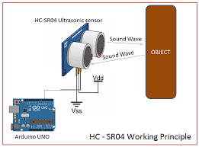
Ultrasonic सेन्सर कसा काम करतो ?

Slide 7
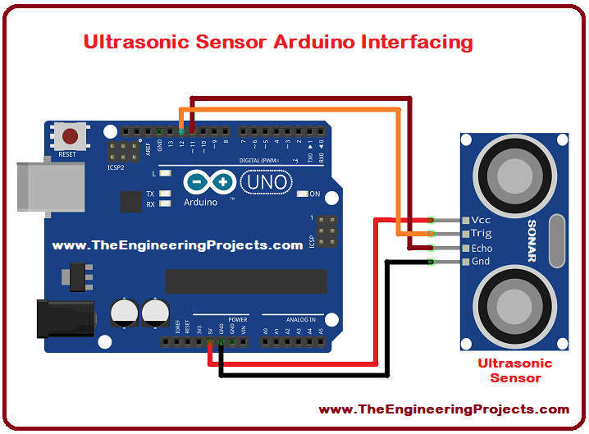
Ultrasonic सेन्सर Arduino Board ला कसा जोडावा?

Slide 8
Ultrasonic sensor चा उपयोग
Humidifiers,
Sonar,
Medical ultrasonography,
Burglar alarms,
Non-destructive testing
Wireless charging.

Slide 9
धन्यवाद

