Slide 1
Arduino Board

Slide 2
या भागामध्ये आपण Arduino Board म्हणजे काय ते शिकणार आहोत ?

Slide 3
Arduino
Basically Arduino is Microcontroller.
Microcontroller is microprocessor with memory, RAM and some other peripheral connected with it.
The Arduino Uno is a microcontroller board based on the ATmega328 . The ATmega328 has Flash memory of 32 KB (with 0.5 KB used for the boot loader). It also has 2 KB of SRAM and 1 KB of EEPROM

Slide 4
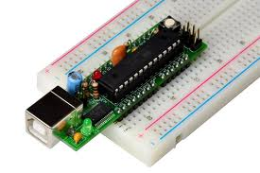
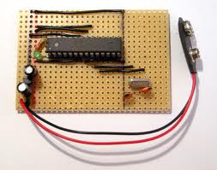
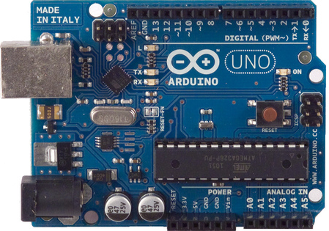
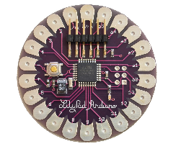
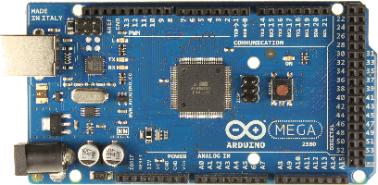
Different types of arduino
Nano arduino
Arduino LilyPad
DIY Arduino
Arduino Uno
Arduino Mega 2560

Slide 5
धन्यवाद

