Slide 1
Introduction To Manufacturing Process Tools -Cutting
Vigyan Ashram
(A center of Indian Institute Of Education)
At. Post Pabal Dist. Pune 412403
www.vigyanashram.com
www.techshala.com
www.renindia.in

Slide 2
Manufacturing Process Tools
Manufacturing processes are basic processes for converting raw material into products
Below is list of common tools/processes used to convert the raw material into the product :
  Cutting
  Welding
  Drilling, threading and tapping
  Grinding
  Aesthetics

Slide 3
Cutting
Metal cutting tools are divided into categories depending on their power source, either hand or power.
The operator provides the power for operating the hand tools, while power tools rely on a source other than the operator for power.
Cold metal may be cut with a hacksaw, cut-off saw, band saw, bolt cutter, file, snips or shears, or a cold chisel.

Slide 4
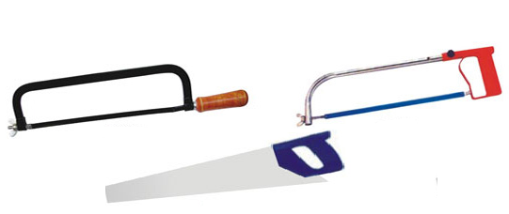
Cutting tool : Hacksaw
Metal Frame
The Hacksaw is used for
cutting metal by hand
It consists of a frame, which
holds a thin blade
Hacksaw blades are two types
(i) All hard and (ii) flexible type.
Hard blades are made of H.S.S
Flexible blades are made of
H.S.S or low alloy steel but
only the teeth are hardened
and the rest of the blade is
soft and flexible.
Blade

Slide 5
Cutting tool : Hacksaw
Select the proper blade for the job to be completed.
Hacksaw blades vary in type and size.
  All-hard blades are hardened throughout and are used for sawing heavy work, tool steel, cast iron, and brass.
Only the teeth are hardened on the flexible blades. They are used for sawing light and hollow materials.
Hand hacksaw blades are made in 8 inch, 10 inch and 12 inch lengths, with 14, 18, 24, or 32 teeth per inch

Slide 6
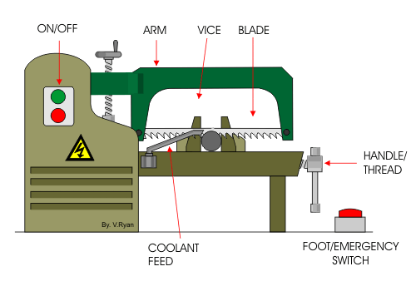
Power Hacksaw
The power hacksaw movement is similar to the hand hacksaw, however it cuts much faster.
  The frame holds a rigid blade which is ¾ inch to 1 inch wide and 12 inches to 18 inches long.
  Blades are available with fine to coarse teeth.

Slide 7
Hacksaw applications
Hacksaw blades have a number of teeth ranging from 5 to 15 per centimetre (cm). Blades having lesser
number of teeth per cm are used for cutting
soft materials like aluminium, brass and bronze
Blades having larger number of teeth per centimetre
are used for cutting hard materials like steel and cast iron

Slide 8
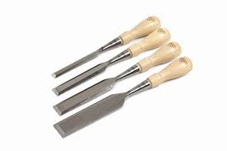
Cutting tool : Chisel
Chisels are used for removing surplus metal or for cutting thin sheets.
These tools are made from 0.9% to 1.0% carbon steel of octagonal or hexagonal
section.
Chisels are annealed, hardened and
tempered to produce a tough shank
and hard cutting edge.
Annealing relieves the internal stresses in a metal.
The cutting angle of the chisel for general
purpose is about 60°.
Chisels

Slide 9
Chisel types and applications
There are many different types of chisels and each has a particular use.
  BEVEL edged chisels are slightly undercut making them easy to push into corners. They are normally used for finishing dovetail joints. (dovetail is a joint technique most commonly used in woodworking joinery including furniture, cabinets,)
  FIRMER chisels have a blade with a rectangular cross-section. This means that they are stronger and can be used for tougher/heavier work.
  A PARING chisel is a longer, thinner chisel which can be pushed into long joints such as housing joints. It is used for cleaning up the joint and to make it an accurate fit.

Slide 10
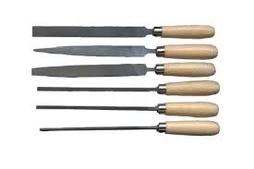
Cutting tool : File
Filing is one of the methods of removing small amounts of material from the surface of a metal part.
A file is hardened steel too, having small parallel rows of cutting edges or teeth on its surfaces.
On the faces, the teeth are usually
diagonal to the edge.
One end of the file is shaped to fit into a wooden handle.
Different file types

Slide 11
Cutting tool : File
A file with sharp pointed teeth is known as a rasp.
Both single cut and double cut files are made in different degrees of coarseness.
  Rough, middle, bastard, second cut, and smooth are examples of coarseness.
  The coarseness also varies with the length of the file.

Slide 12
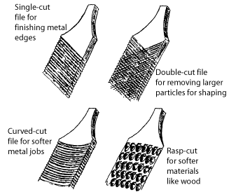
File Cut

Slide 13
Cutting tool Files
Common files are flat, rasp, half round, round bastard, and taper triangular.
  Flat files are used for smoothing both wood and metal.
  Rasp cut files are used for smoothing coarse wood work.
  Half round files are used for both metal and wood.
  Round bastard files are used for enlarging and smoothing holes.
  Taper triangular files are used for filing saws or cleaning threads.

Slide 14
File types and applications
Files come in a wide variety of materials, sizes, shapes, cuts, and tooth configurations. Most common are listed below :
Mill files :These are the most common shape; they are rectangular in cross section and taper slightly in both width and thickness from tang to end. They are all single-cut.
Hand files : These are parallel in width and tapered in thickness; they are used for general work.
Joint round edge files : These are parallel in width and thickness, with rounded edges. The flats are safe (no teeth) and cut on the rounded edges only. Used for making joints and hinges.
Half round ring files: These are taper in width and thickness, coming to a point, and are narrower than a standard half round. Used for filing inside of rings.

Slide 15
Shearing machine
A shearing machine is a machine that cuts metal.
An industrial shearing machine generally presses blades down into metal sheets to punch out shapes. These shapes may be the desired end product or they may be the waste product.
While shearing metal sheets is most common, other metallic objects may be processed in one of these machines.

Slide 16
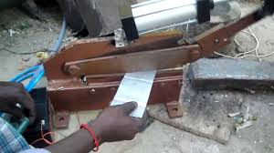
Shearing machine
A metal shearing machine uses sharp blades and a lot of pressure to quickly cut shapes
The blades on a shearing
machine are typically directly perpendicular to the surface getting punched.
Commonly shearing machine is used to cut metal bars
Shearing machine cut is so fast and the pressure is so high, steel can often cut steel
Bench shearing machine (hand operated

Slide 17
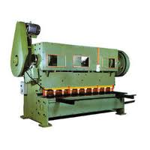
Power Shearing
The power shear can cut flat, angle, and other structural steel faster and cleaner than by hand or by power saw.

Slide 18
Shearing machine applications
Applications of shearing machine :
- Bench shearing machine can cut sheet bar and flat bar up to 10mm.
-Mechanical workshops, industry
-Construction sites
- Specific Industrial Applications- based on the cutting capacity shearing equipment is applied particularly in metal and engineering industry.
-Paper and plastic industries which produce materials in rolls prefer shearing machine to be the perfect device to handle cutting operations.

Slide 19
Safety Precautions
Hacksaw :
  Select a blade with enough teeth per inch so that two or three teeth are in contact with the metal at all times.
  Fasten the blade into the hacksaw frame with the teeth pointing away from the handle of the saw.
  Make sure the blade is fastened securely so that it will not twist and break.

Slide 20
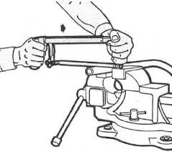
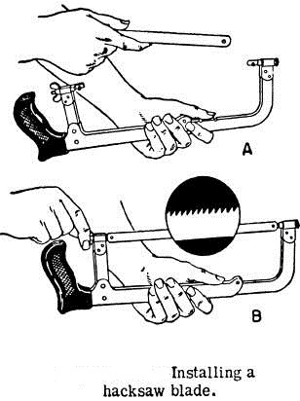
Safety Precautions
Proper way to hold

Slide 21
Safety Precautions
Shears are used for cutting sheet metal and fabrics.
  1. Be sure safety glasses are worn.
  2. Mark the material to be filed.
  3. Place the stock in a vise or clamp it to the table.
  4. It is advisable to wear gloves when handling and working with sheet metal.
  5. Select the correct shears for the job to be done.
  Select a pair of shears that are sharp and free of nicks.
  6. A piece of scrap should be cut first to be sure the shears are heavy enough.

