Slide 1
Introduction To Manufacturing Process Tools -Drilling
Vigyan Ashram
(A center of Indian Institute Of Education)
At. Post Pabal Dist. Pune 412403
www.vigyanashram.com
www.techshala.com
www.renindia.in

Slide 2
Manufacturing Process Tools
Manufacturing processes are basic processes for converting raw material into products
Below is list of common tools/processes used to convert the raw material into the product :
Cutting
Welding
Drilling and threading
Grinding
Aesthetics

Slide 3
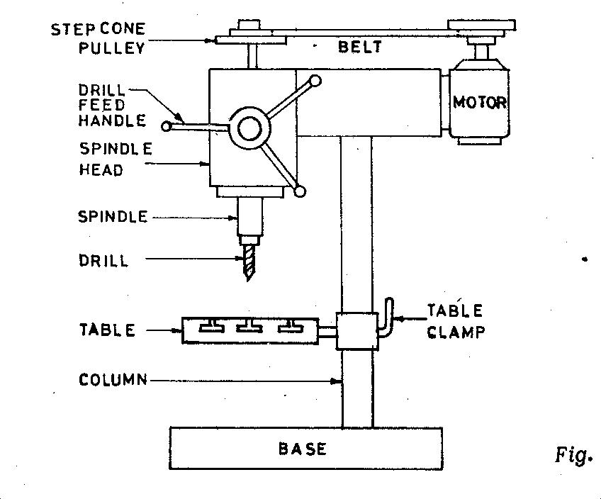
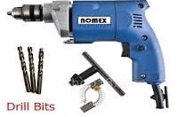
Drilling machine
Drilling is the operation of producing circular hole in the work-piece by using a rotating cutter called DRILL. The machine used for drilling is called drilling machine
This device is normally made of a tapered shank rotated by a motor or by hand
The work piece is held stationary ie. Clamped in position and the drill rotates to make a hole
The most common drill used is the twist drill.
Drill Machines

Slide 4
Drilling operations
Operations that can be performed in a drilling machine are
Drilling
Reaming
Boring
Counter boring
Countersinking
Tapping

Slide 5
Drill materials
The two most common types are
1. HSS drill
- Low cost
2. Carbide- tipped drills
- high production and in CNC machines
Other types are
Solid Carbide drill, TiN coated drills, carbide coated masonry drills, parabolic drills, split point drill

Slide 6
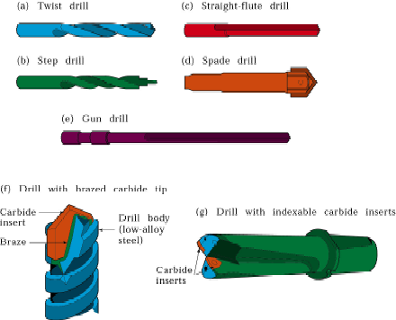
Drill materials

Slide 7
Safety Precautions : Drill machine
Do not support the work piece by hand – use work holding device.
Use brush to clean the chip
No adjustments while the machine is operating
Ease the feed if drill breaks inside the work piece.
Do not wear loose or baggy clothing, ties, jewelry, or sandals. If you have long hair, tie it back or wear a cap — especially when drilling
Wear eye protection when sawing and drilling. Safety glasses or goggles are inexpensive and available at any hardware store.

Slide 8
Safety Precautions : Drill machine
Do not hold your finger on the switch button while carrying a plugged-in tool — it may start accidentally.
Grip all tools firmly.
Be sure to work at a safe distance from others.
Do not use electric power tools in wet or damp locations.
Never carry a power tool by its cord.
Never leave a running power tool unattended.

Slide 9
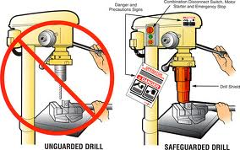
Safety Precautions : Drill machine

Slide 10
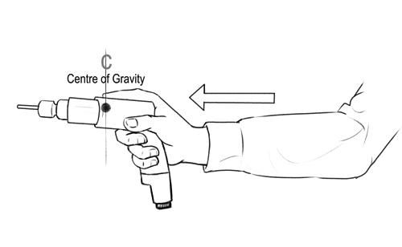
Safety Precautions : Drill machine

Slide 11
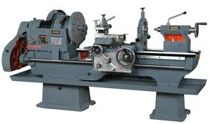
Lathe Machine
Lathe is a machine, which removes the metal from a piece of work to the required shape &size

Slide 12
Lathe Machine Types
Engine Lathe
The most common form of lathe, motor driven and comes in large variety of sizes and shapes.
Bench Lathe
A bench top model usually of low power used to make precision machine small work pieces.
Tracer Lathe
a lathe that has the ability to follow a template to copy a shape or contour.

Slide 13
Lathe Machine Operations
Turning: produce straight, conical, curved, or grooved work-pieces
Facing: to produce a flat surface at the end of the part or for making face grooves.
Boring: to enlarge a hole or cylindrical cavity made by a previous process or to produce circular internal grooves.
Drilling: to produce a hole by fixing a drill in the tailstock
Threading: to produce external or internal threads
Knurling: to produce a regularly shaped roughness on cylindrical surfaces

Slide 14
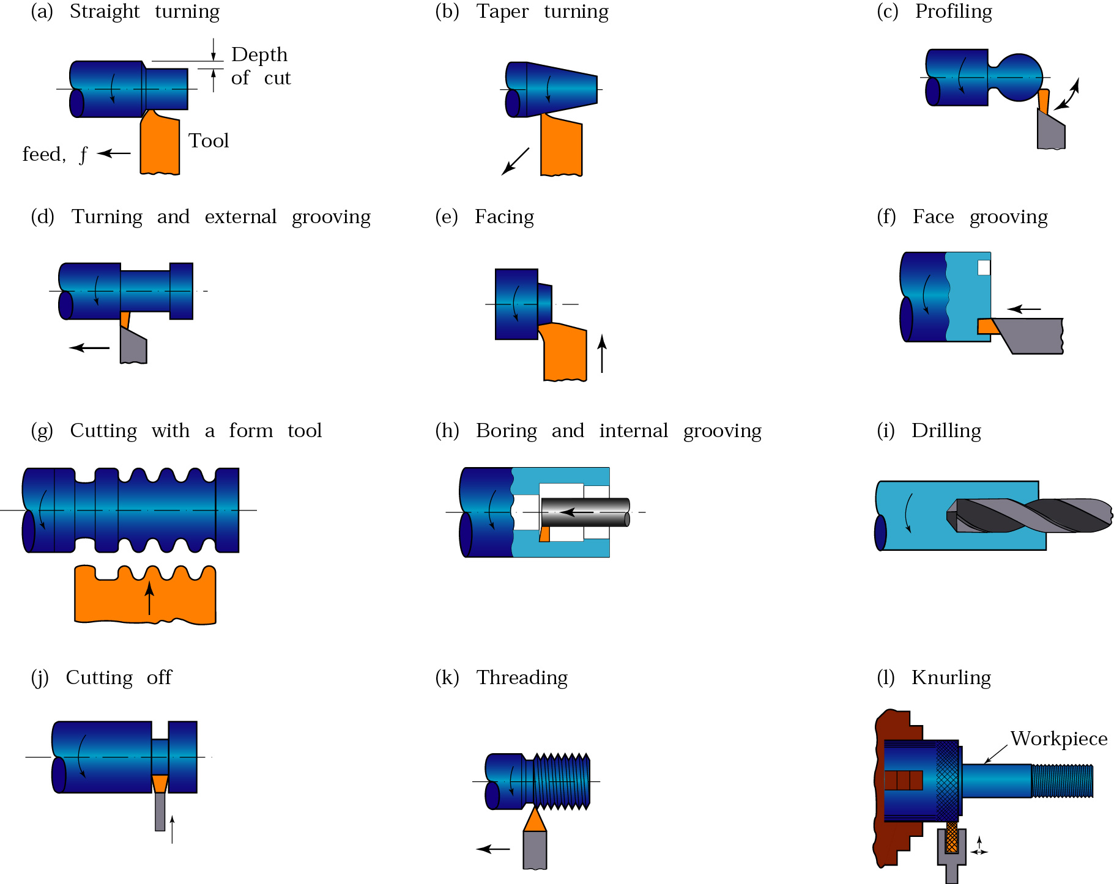
Lathe Machine Operations

