Slide 1
Introduction To Manufacturing Process Tools -Grinding
Vigyan Ashram
(A center of Indian Institute Of Education)
At. Post Pabal Dist. Pune 412403
www.vigyanashram.com
www.techshala.com
www.renindia.in

Slide 2
Manufacturing Process Tools
Manufacturing processes are basic processes for converting raw material into products
Below is list of common tools/processes used to convert the raw material into the product :
Cutting
Welding
Drilling and threading
Grinding
Aesthetics

Slide 3
Grinding machine
A grinding machine is a machine with abrasive wheel as the cutting tool.
A job is hold against rotating wheel. It is mainly used for surface finish and to make tools sharp.
Bench grinder is commonly found in workshop.
Other types of grinder are belt grinder, surface grinder, cylindrical grinder etc
Bench Grinder

Slide 4
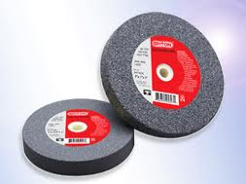
Grinding machine
The grinding machine consists of a bed with a fixture to guide and hold the work piece
The grinding wheel is composed of hard grains held together in a binder. These hard grains act as cutting tools, removing tiny chips of material from the work
The most commonly used abrasive is aluminium oxide

Slide 5
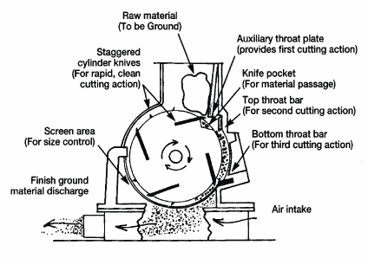
Components

Slide 6
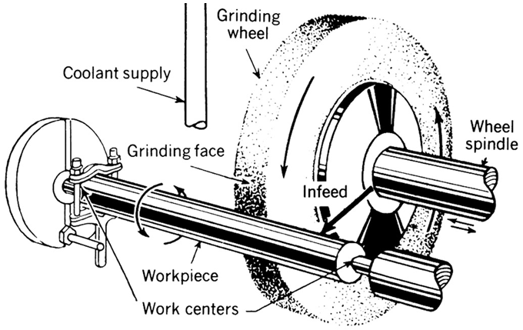
Components

Slide 7
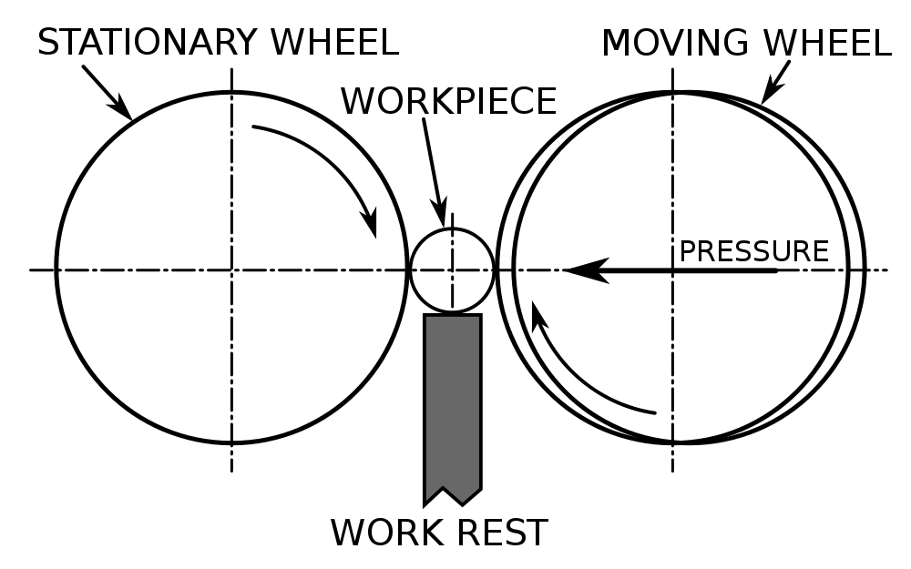
Components

Slide 8
Grinding
Grinding consists an abrasive (rough or hard) product, usually a rotating wheel brought into controlled contact with a work surface.
Characteristics of an abrasive must be:
Harder than material being ground
Strong enough to withstand grinding pressures
Heat-resistant so that it does not become dull at grinding temperatures
Friable (capable of fracturing) so when cutting edges become dull, they will break off and present new sharp surfaces to material being ground

Slide 9
Grinding machine applications
There are many forms of grinding, but the four major industrial grinding processes are:
-Bench grinding : It can be used to keep your chisels, knives, and other similar cutting tools sharp. It can also be used for shaping metal objects when modifications are needed.
-Cylindrical grinding : It is used to make precision rods, tubes, bearing races, bushings, and many other parts.
-Belt grinding : Is a versatile process suitable for all kind of applications like finishing, de-burring, and stock removal.
-Surface grinding : Used to make and sharpen; burn-outs, metal stamping die sets, flat shear blades, fixture bases or any flat and parallel surfaces.

Slide 10
Safety guards of grinding machine

Slide 11
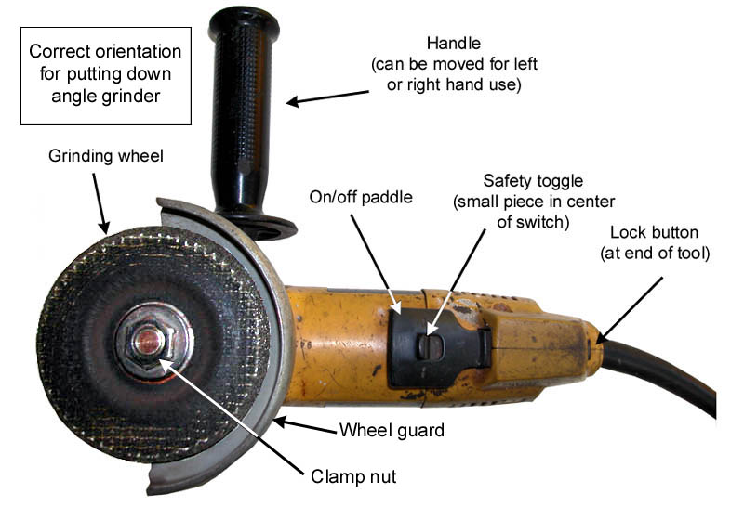
Safety guards of grinding machine

Slide 12
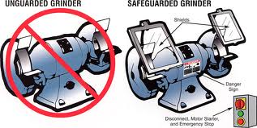
Safety guards of grinding machine

Slide 13
Safety Precautions :Grinding machine
Grinding machines are used daily in a machine shop. To avoid injuries follow the safety precautions listed below.
•Wear goggles for all grinding machine operations.
•Check grinding wheels for cracks before mounting.
•Never operate grinding wheels at speeds in excess of the recommended speed.
•Never adjust the work piece or work mounting devices when the machine is operating.
•Do not exceed recommended depth of cut for the grinding wheel or machine.
•Remove work piece from grinding wheel before turning machine off.
•Use proper wheel guards on all grinding machines.
•On bench grinders, adjust tool rest 1/16 to 1/8 inch from
the wheel.

