Slide 1
Introduction To Manufacturing Process Tools –Quality
Vigyan Ashram
(A center of Indian Institute Of Education)
At. Post Pabal Dist. Pune 412403
www.vigyanashram.com
www.techshala.com
www.renindia.in

Slide 2
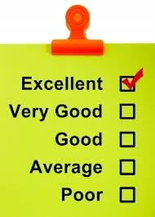
What is Quality?
Everything includes some aspect of design and all designs should establish Quality Requirements / Expectations:
Reliability
Look and Feel
Value for Money

Slide 3
Quality Defination

Slide 4
Quality is Central
Quality is Central to protecting and enhancing the “Brand Reputation”
Quality issues can have a huge impact on profitability and in the worst cases even the survival of a Business
Profitability and Survival of Business
Protect and Enhance Brand Reputation
Quality

Slide 5
How ?
Organizations Manage Quality by:
Establishing Policies and Processes for undertaking activities
Ensuring these Policies and Processes are effectively implemented
Ensuring these Policies and Processes deliver the required outcomes – i.e. is a quality product delivered?
Revising and Improving these Policies and Processes as required

