Slide 1
Introduction To Manufacturing Process Tools -Welding
Vigyan Ashram
(A center of Indian Institute Of Education)
At. Post Pabal Dist. Pune 412403
www.vigyanashram.com
www.techshala.com
www.renindia.in

Slide 2
Manufacturing Process Tools
Manufacturing processes are basic processes for converting raw material into products
Below is list of common tools/processes used to convert the raw material into the product :
Cutting
Welding
Drilling, threading and tapping
Grinding
Aesthetics

Slide 3
What is welding?
Joining of 2 or more metal parts together is called as welding
Permanently joining metal – usually steel, using heat to bring the base metal to its melting temperature.
There are many types of methods in welding but primarily followed are
Pressure Welding
Fusion Welding

Slide 4
Classification of welding processes
(i). Arc welding
Carbon arc
Metal arc
Metal inert gas
Tungsten inert gas
Plasma arc
Submerged arc
Electro-slag
(ii). Gas Welding
Oxy-acetylene
Air-acetylene
Oxy-hydrogen
(iii). Resistance Welding
Butt
Spot
Seam
Projection
Percussion
iv)Thermit Welding
(v)Solid State Welding
Friction
Ultrasonic
Diffusion
Explosive
(vi)Newer Welding
Electron-beam
Laser
(vii)Related Process
Oxy-acetylene cutting
Arc cutting
Hard facing
Brazing
Soldering

Slide 5
Common Welding Types
Most common welding types are :
Arc welding
Gas welding

Slide 6
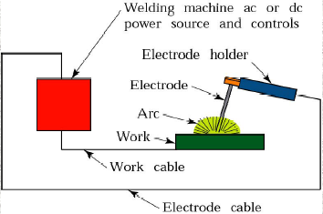
Arc Welding
Two electrodes having electric charge are joined together and seperated .The spark produced due to this is known as arc. Following is the diagram of Arc Welding

Slide 7
Arc welding equipments
Equipments:
A welding generator (D.C.) or Transformer (A.C.)
Two cables- one for work and one for electrode
Electrode holder
Electrode
Protective shield
Gloves
Wire brush
Chipping hammer
Goggles

Slide 8
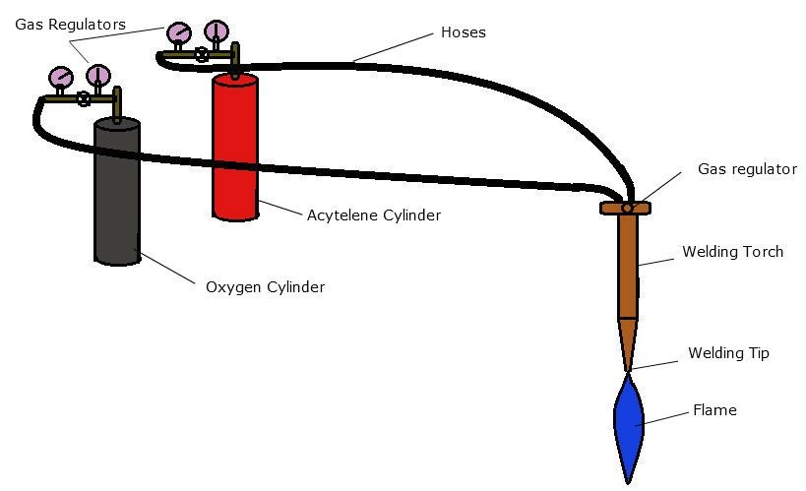
Gas Welding
- The most common gas welding process is oxyfuel welding, also known as oxyacetylene welding
-Common fluxes used are made of sodium, potassium. Lithium and borax
- Sound weld is obtained by selecting proper size of flame, filler material and method of moving torch
- The temperature generated during the process is 33000c

Slide 9
Gas Welding
In this type, Cylinders of Highly inflammable gases like Acetylene is used for making a strong flame and the metals are cut or joined through heat produced by these flames.
In this process, Inflammable gas like acetylene is combined with oxygen to enhance the process

Slide 10
Equipments in Gas Welding
Oxygen Cylinder
Acetylene cylinder
Rubber Hose Pipe
Welding Rods
Welding flux
Apron
Wire brush
Hammer
Goggle

Slide 11
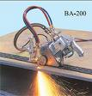
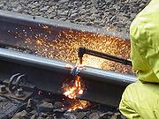
Gas Cutting
Automatic Manual

Slide 12
Gas Welding

Slide 13
Welding Positions
INCREASING DIFFICULTY
FLAT
HORIZONTAL
OVERHEAD
VERTICAL

Slide 14
Types of Joints
BUTT JOINT
FILLET JOINT
STRAP JOINT
CORNER JOINT
LAP JOINT

Slide 15
Reason for accidents in welding
Wrong information
Carelessness in handling equipments
Insufficient lighting at workplace
Congested place
Not using safety equipments

Slide 16
Welding Precautions
Check the Machines conditions regularly
Use of proper safety equipments
Welding should not be done in a congested place
Welding Machine and Main Switch distance must be less

Slide 17
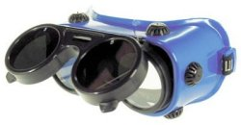
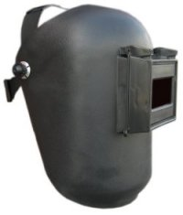
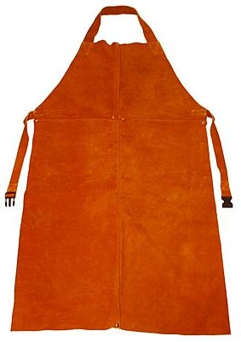
Welding Safety Equipments

