Slide 1
Safety measures for Engineering Workshop Equipments
Vigyan Ashram
(A center of Indian Institute Of Education)
At. Post Pabal Dist. Pune 412403
www.vigyanashram.com
www.techshala.com
www.renindia.in

Slide 2
In this presentation our focus is on learning safety precautions for Drilling machine, Welding machine , Grinding machine and Shearing machine

Slide 3
Why safety....
Imagine what may happen if you cut on safety....

Slide 4
Common injuries with power tools
Power tools - A power tool is a tool that requires an additional power source and mechanism other than the solely manual labour used with hand tools
Type of injuries power tools may cause :
Electric shock
Flash burns
Falling
Hand and Eye injuries
Hearing loss
Crushing, cuts or
losing a body part
Ergonomic injuries

Slide 5
Protecting our body parts

Slide 6
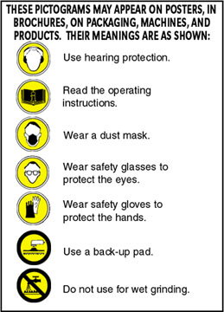
Attention towards Safety signs..

Slide 7
General precautions :Power tools
Must be fitted with guards and safety switches
Refer manufacturer manual for safety instructions
Extremely hazardous when used improperly
Different types, determined by their power sources:
Electric
Pneumatic
Liquid fuel
Hydraulic
Powder-actuated

Slide 8
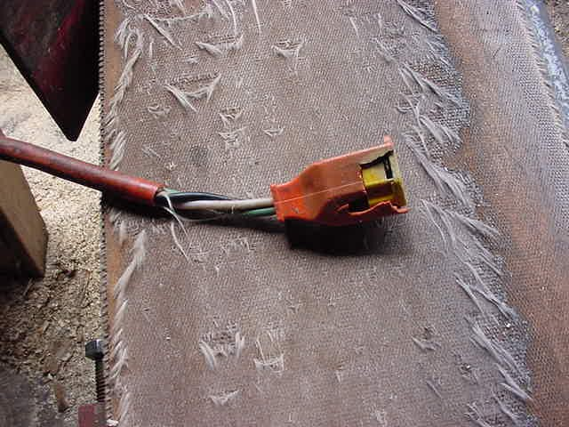
General precautions :Power tools
Do not use extension cord like this..
Operate within design limits
Use gloves and safety shoes
Store in a dry place
Don’t use in wet locations unless
approved for that
Keep work areas well lit
Ensure cords don’t present a tripping hazard
Plug with a grounding pin

Slide 9
General precautions :Power tools
Disconnect tools when not in use, before servicing and cleaning, and when changing accessories
Secure work with clamps or a vise, freeing both hands to operate the tool
Don’t hold the switch button while carrying a plugged-in tool
Keep tools sharp and clean
Remove damaged electric tools & tag them: “Do Not Use”

Slide 10
Engineering Workshop Equipments
Next slides will help to lean safety precautions for :
1. Drilling machine
2. Grinding machine
3. Welding machine
4. Shearing machine

Slide 11
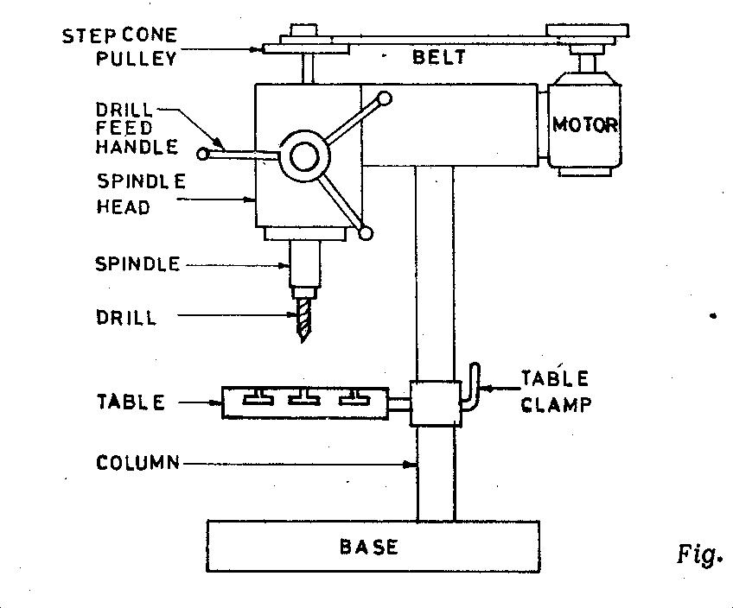
Drilling machine
Quick recap about drilling machine :
Drilling is the operation of producing circular hole in the work-piece by using a rotating cutter called DRILL. The machine used for drilling is called drilling machine
This device is normally made of a tapered shank rotated by a motor or by hand
The work piece is held stationary ie. Clamped in position and the drill rotates to make a hole
The most common drill used is the twist drill.
Drill Machines

Slide 12
Safety Precautions : Drill machine
Do not support the work piece by hand – use work holding device.
Use brush to clean the chip
No adjustments while the machine is operating
Ease the feed if drill breaks inside the work piece.
Do not wear loose or baggy clothing, ties, jewelry, or sandals. If you have long hair, tie it back or wear a cap — especially when drilling
Wear eye protection when sawing and drilling. Safety glasses or goggles are inexpensive and available at any hardware store.

Slide 13
Safety Precautions : Drill machine
Do not hold your finger on the switch button while carrying a plugged-in tool — it may start accidentally.
Grip all tools firmly.
Be sure to work at a safe distance from others.
Do not use electric power tools in wet or damp locations.
Never carry a power tool by its cord.
Never leave a running power tool unattended.

Slide 14
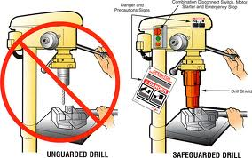
Safety Precautions : Drill machine

Slide 15
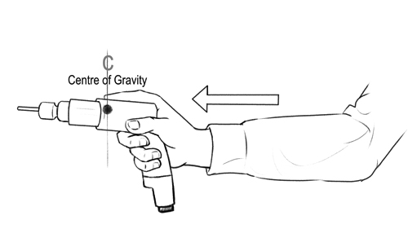
Safety Precautions : Drill machine

Slide 16
Grinding machine
Bench Grinder
Quick recap about drilling machine :
Grinding is a material removal and surface generation process used to shape and finish components made of metals and other materials

Slide 17
Safety guards of grinding machine

Slide 18
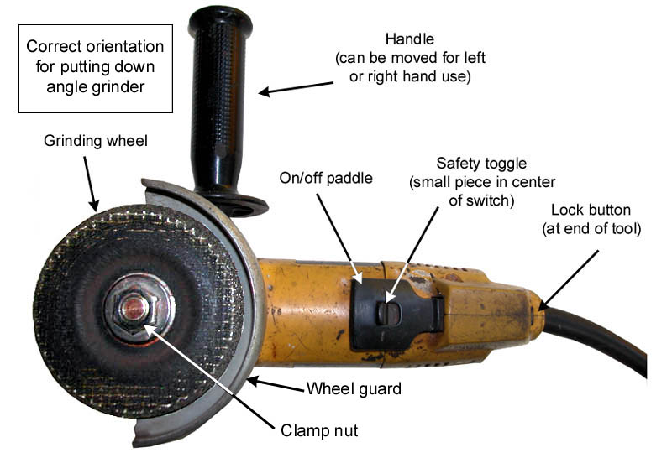
Safety guards of grinding machine

Slide 19
Safety guards of grinding machine

Slide 20
Safety Precautions :Grinding machine
Grinding machines are used daily in a machine shop. To avoid injuries follow the safety precautions listed below.
•Wear goggles for all grinding machine operations.
•Check grinding wheels for cracks before mounting.
•Never operate grinding wheels at speeds in excess of the recommended speed.
•Never adjust the work piece or work mounting devices when the machine is operating.
•Do not exceed recommended depth of cut for the grinding wheel or machine.
•Remove work piece from grinding wheel before turning machine off.
•Use proper wheel guards on all grinding machines.
•On bench grinders, adjust tool rest 1/16 to 1/8 inch from
the wheel.

Slide 21
Welding Machine
Welding is joining metal parts (usually) together by heating the surfaces to the point of melting with a blowpipe, electric arc, or other means, and uniting them by pressing, hammering, etc

Slide 22
Safety precautions for welding
Safety precautions for welding :
Welding booths should be painted with dull finishes so they don’t reflect UV light
Eye protection should be used in all welding operations
Wear face shields or helmets and goggles or safety glasses
Use appropriate filters on eye protection

Slide 23
Safety precautions for welding
Protective Clothing
Fire resistant gauntlet gloves
Head cap
High top hard toed shoes
Leather apron
Face shield
Flame retardant clothing
Safety Glasses
Safety helmet
Hearing plugs and/or muffs

Slide 24
Gas welding Precautions
Gas welding Precautions
When transporting and handling, valve cap should be securely in place
Cylinders should never be lifted by valve cap
Cylinder valve should be closed when cylinder is empty, being moved or not in use
Cylinders should be secured to a pallet, cradle, or sling board for hoisting
Cylinders should not be dropped, bumped, struck or receive any other huge impact
Cylinders should be thawed with warm water when frozen in place

Slide 25
Gas welding Precautions
Gas welding Precautions
Fuel, gas and oxygen hoses must be easily and clearly distinguishable.
Oxygen and gas hoses must not be interchangeable
When oxygen and fuel hoses are taped, no more than 4 inches per foot of hose may be taped
Gas and oxygen hoses must be inspected before every shift and removed if defects are found.
Torches should be inspected before each shift to detect leaks
Tip openings should be kept clean and unclogged
Torches should be lighted by friction lighters

Slide 26
Arc welding Precautions
Arc welding Precautions
Only use manual electrode holders designed specifically for arc welding
All current-carrying parts should be properly insulated for maximum voltage encountered
Cables must be properly insulated, flexible and able to handle maximum current required
All equipment and cables should be inspected before each shift and should be removed if any defects are found
Operations should be shielded appropriately as to protect other workers in the area

Slide 27
Safety measures : welding
1. Cylinder with no valve or cap installed 2. Laying horizontal on the ground
3.Subject to damage

Slide 28
Safety measures : welding
Evidence of smoking next to acetylene cylinders

Slide 29
Shearing machine
A shearing machine is a machine that cuts metal.
An industrial shearing machine generally presses blades down into metal sheets to punch out shapes. These shapes may be the desired end product or they may be the waste product.
While shearing metal sheets is most common, other metallic objects may be processed in one of these machines.

Slide 30
Shearing machine Precautions
Shearing machine Precautions
Bench shears must be securely fastened to a bench or purpose designed stand.
Guards or safety devices must never be removed or adjusted, except by an authorized person for maintenance purposes.
Shearing edges should be maintained in good condition, should be distortion free and correctly adjusted.
Working parts should be well lubricated and the blades free of rust and dirt.
Ensure no slip/trip hazards are present in workspaces and walkways.
Sufficient space must exist around the machine to prevent accidental contact with passers by.
Familiarise yourself with and check all machine operations and controls.

Slide 31
Shearing machine Precautions
Shearing machine Precautions
Never use bench shears for cutting metal that is beyond the machine’s capacity with respect to thickness, shape, or type.
Material should be properly supported during cutting and industrial type gloves should be worn to protect the hands.
Use supports for long material - signpost if a tripping hazard.
Manual handling tasks should be assessed and appropriate procedures put in place.
Hold material securely to prevent it tilting during the cut.
Ensure fingers and limbs are clear before operating the bench

Slide 32
Shearing machine Precautions
Shearing machine Precautions
When not in use this machine must be locked by, for example, a stout pin through the hole in the blades and kept in place by a padlock.
Leave the work area in a safe, clean and tidy state.
Closing movements between shearing surfaces and other parts can result in trapping
Sharp edges on cutters, work pieces can cause cuts
Squash/crush and pinch points

Slide 33
Thanks
For further information:
Website : www.vigyanashram.com
e-Mail : vapabal@gmail.com, director@vigyanashram.com

